Slide 1

Photoresistor
Arduino Programming Notes
Things you need to know.

Slide 2

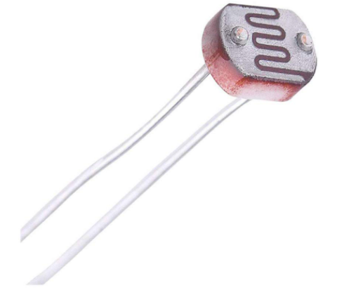
What is a Photoresistor?
A photoresistor is also called a LDR (Light Dependant Resistor)
This is a variable resistor and it will give different values based on how much light is shining onto its surface.
This is an analog sensor. It will give values from completely on, to completely off, and everything in between.

Slide 3
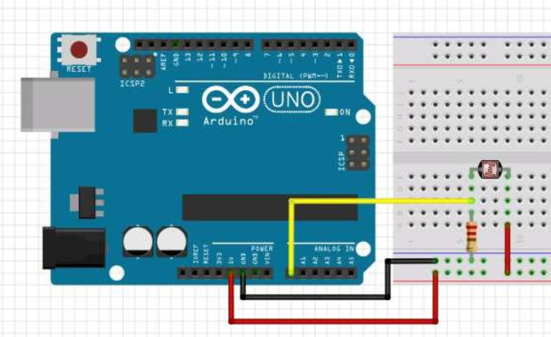
Wiring a Photoresistor
Wiring a photoresistor is very similar to wiring a switch.
Click here for a step by step process.

Slide 4
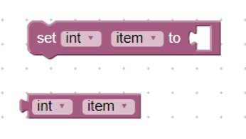
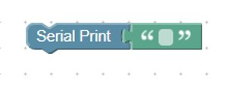
Code Blocks
The Serial Print block tells the arduino to print out information in human readable text.
Variables are used to hold onto a changing piece of information. We will use a variable to store the resistance value of the potentiometer. Click the drop down box on “item” to change the variable’s name.

Slide 5
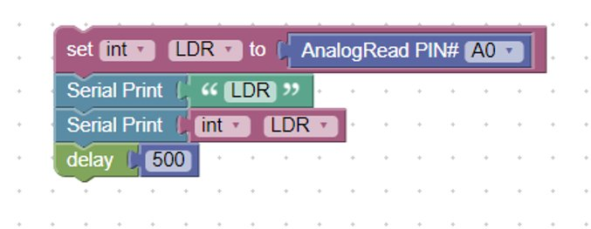
Reading a Photoresistor (LDR)
Wire the photoresistor how it is shown in the previous slide.
Write the following program on Blockduino. Its OK to have to look around a little bit to find the correct blocks.
This bock sets the variable LDR to the value of the light in the room.
This block tells the arduino to print the variable value.
This blocks tells the arduino to label the print as “LDR”
The delay slows the readings of the LDR in order to increase their quality.

Slide 6
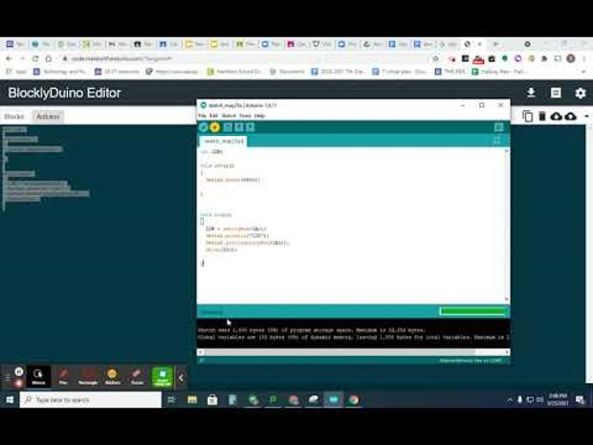
Running it on Arduino

Slide 7
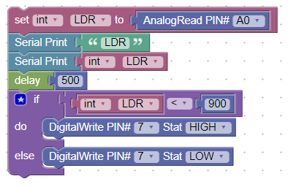
Using the Photoresistor
To use the photosensor, add IF brackets below the sensor and variable code that are dependant on the reading of the photoresistor. For example:
The IF bracket tells digital pin 7 to be HIGH if the photoresistor reading is greater than 900.

