Slide 1

Servo Solutions
Example Solutions - There are lots of ways to solve these problems, this document includes one for each challenge.

Slide 2
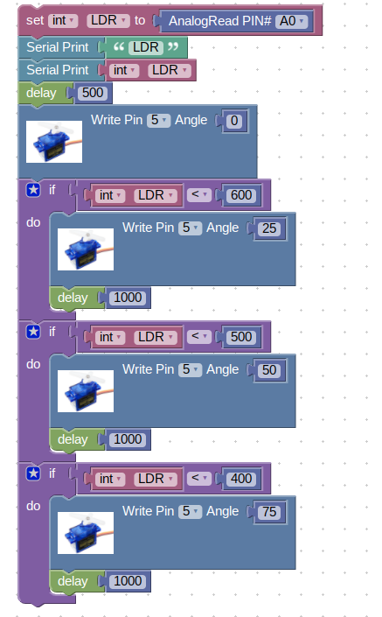
Servo Problem 2
Use an analog sensor (photoresistor OR ultrasonic sensor) to control the angle of the servo.
If photoresistor: The darker it gets, the higher the angle of the servos should be.
If ultrasonic sensor: The closer the object gets to the sensor, the higher the angle should be.
Credit: Have the servo move into three different positions based on the input from the analog sensor. Low, medium, and high.

Slide 3
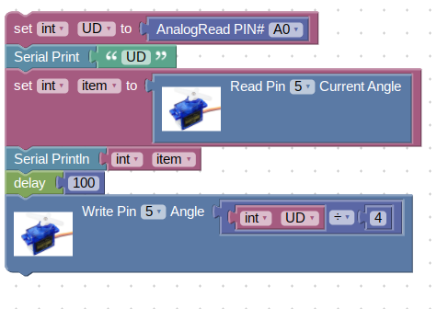
Servo Problem 2
Use an analog sensor (photoresistor OR ultrasonic sensor) to control the angle of the servo.
If photoresistor: The darker it gets, the higher the angle of the servos should be.
If ultrasonic sensor: The closer the object gets to the sensor, the higher the angle should be.
Extra Credit: Have the servo move infinitely based on the input of the analog sensor. (AS the analog value changes, the servo moves proportionally.)

