Slide 1

Measurement

Slide 2
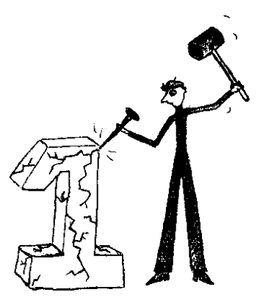
Early Measurement
Early Measurement used units like…
The “CUBIT”…
The “Fathom”…
The “Hand/span”…
The “Pace”…
The “Girth”…
The “Palm"…

Slide 3
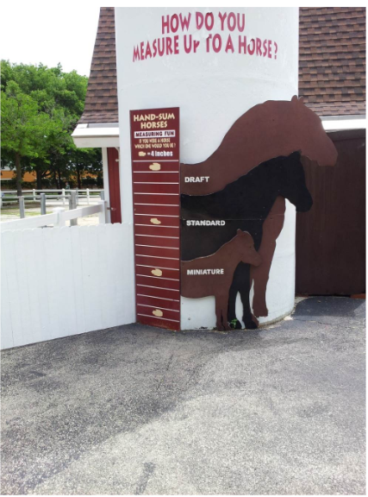
Hand

Slide 4
Measurement Units
What are some examples of…
Length Units
Volume Units
Weight Units
Measurement units are constant values no matter what!

Slide 5
Measurement Systems
There are two types of measurement systems, what are they?
Imperial (sometimes called English or Standard)
Metric

Slide 6
The Metric System
1 meter = 10 dcm = 100cm = 1000mm
Used all over the world
Common in Machining, Mechanical applications
Expressed in decimal form

Slide 7
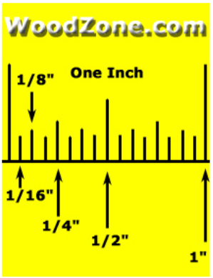
The English / Standard System
1 yard = 3 feet = 36 inches
Foot = ‘
Inch = “
Broken into fractions of an inch
1/2, 1/4, 1/8, 1/16

Slide 8
