Slide 1
Drawing Like an Engineer
Use the same drawings as the professionals

Slide 2
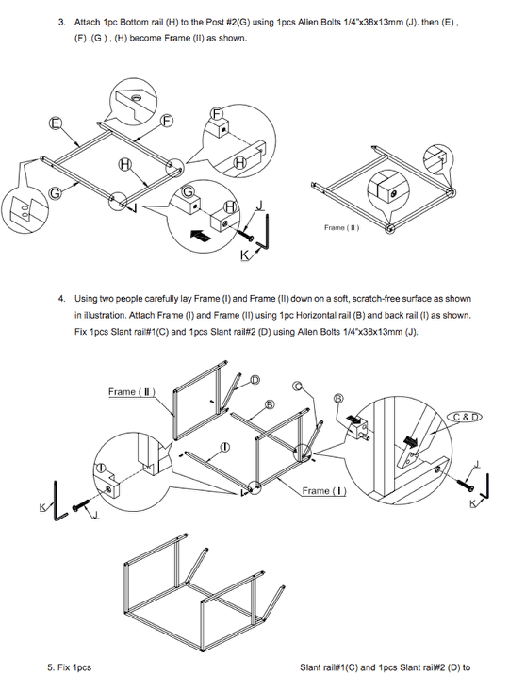
Here is an example from a playset manual.
What do you notice about this technical drawing?
Do you think you could put it together?

Slide 3
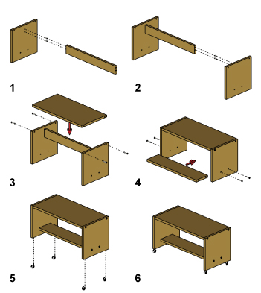
Here is an example from a desk assembly manual.
What do you notice about this technical drawing?
Do you think you could put it together?

Slide 4
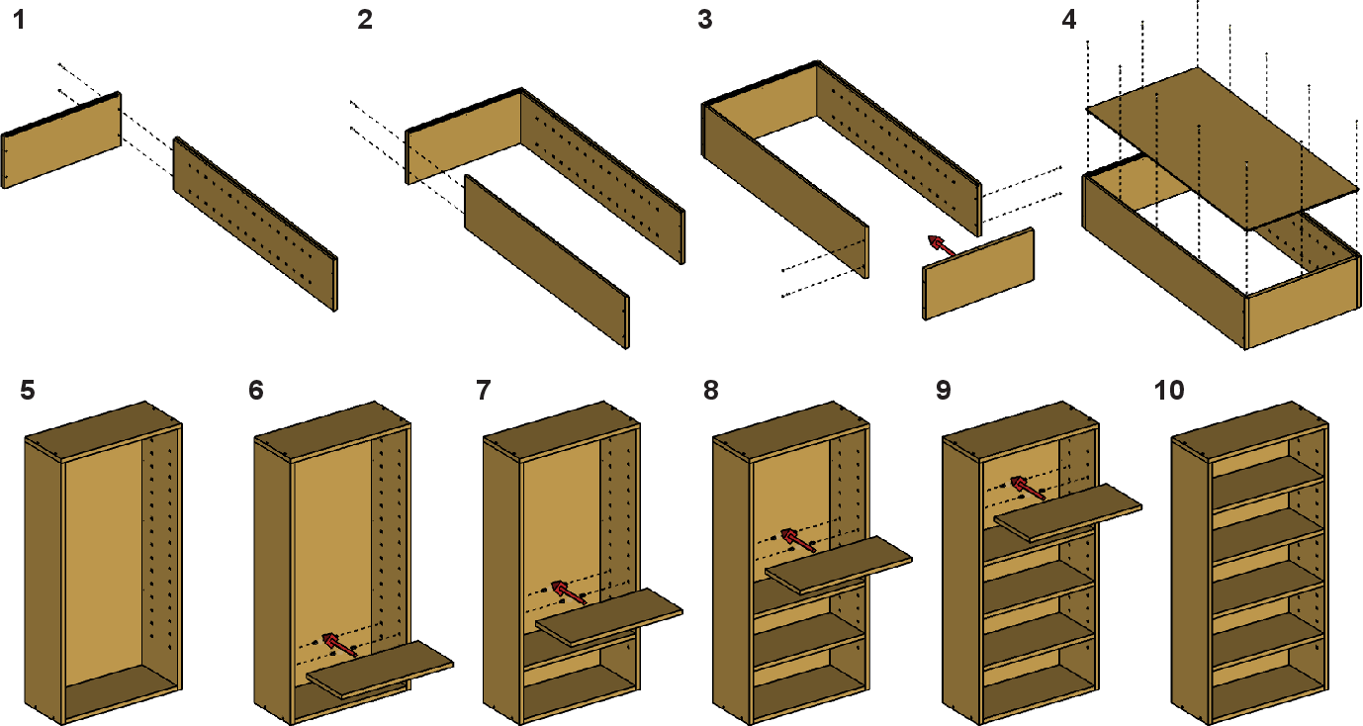
Why was the desk assembly technical drawing easier to understand than the playset?
The picture was in color
The steps were broken down more
Bigger Pictures
No confusing text
Non-English speakers can read it

Slide 5
Engineers and Designers working in technology fields want to make it easy for people to understand their ideas.
Everyone who works in technology fields knows how to read certain drawings.
We are going to learn about 3 of those drawings:
Thumbnail Drawings
Isometric Drawings
Orthographic Projection

Slide 6
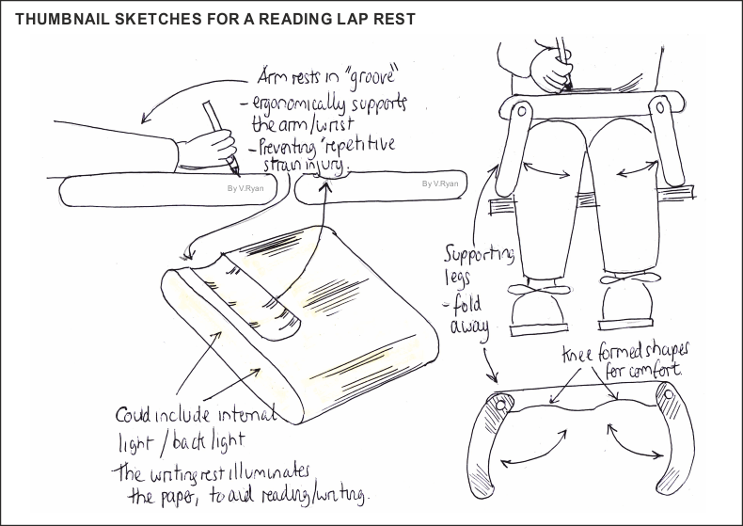
Thumbnail Drawings
Used in the brainstorming process.
These are relatively quick sketches that are used to record an idea.
Thumbnail sketches are not used for plans to build something. They are used to develop ideas.
Thumbnail sketches are rough drafts used to make a more detailed drawing later.
Click HERE to draw an example thumbnail drawing along with me. When you are done, come back to this presentation.

Slide 7
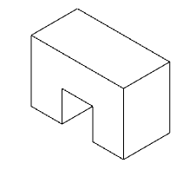
Isometric Drawings
Isometric drawings are the only 3D drawings that have accurate dimensions and scale.
Dimension is a technical term for measurements. Isometric drawings contain accurate measurements
Scale on a drawing is like scale on a map. It is how the size of the drawing on paper compares to the size of the real thing.
Isometric drawings CAN be used as plans to build something.
Click HERE to draw an example Isometric along with me. When you are done, come back to this presentation.

Slide 8
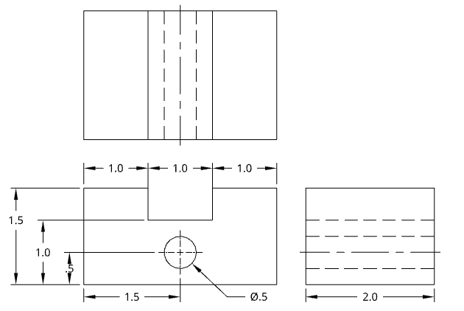
Orthographic Projection
Orthographic drawings have a front, top, and right side view.
They are not 3D.
Orthographic drawings are the most common drawings in manufacturing.
Manufacturing is building something inside of a factory. ex) computers, chairs, cars, etc.
Construction is building something on a site. ex) houses, schools, roads, bridges
Click HERE to draw an example orthographic drawing along with me. Come back to this presentation when you are finished.

Slide 9

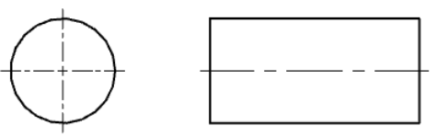
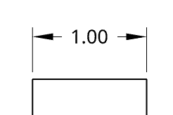
Types of Lines
Object Lines: Solid dark lines that show visible edges
Hidden Lines: Dashed lines showing edges that are NOT visible from that view.
Center Lines: Long-short-Long lines that mark the center point of a circular object
- Center lines also mark the center axis of a symmetrical object, like a hole or a cylinder
Dimension Lines: Lines that show a measurement. Arrows point to Extension lines.
Extension Lines: Show the start and end point of the measurement.

Slide 10
What types of lines are in this orthographic drawing?
Work with your neighbor to identify the line types shown in the front, top, and right side view.
Label an example of each line type in the orthographic projection you made in your notes.
Add in two dimension lines to show the height and the width of the front view on your drawing.

Slide 11
The purpose of technical drawings is to be able to share technical information with other people without errors in understanding,
Thumbnails are used for brainstorming.
Isometric drawings are 3D and can be used as plans.
Orthographic projection is the most common drawing in manufacturing, and contains a front, top, and right side view.
Each line type has a specific purpose.
Key Understandings

