Slide 1
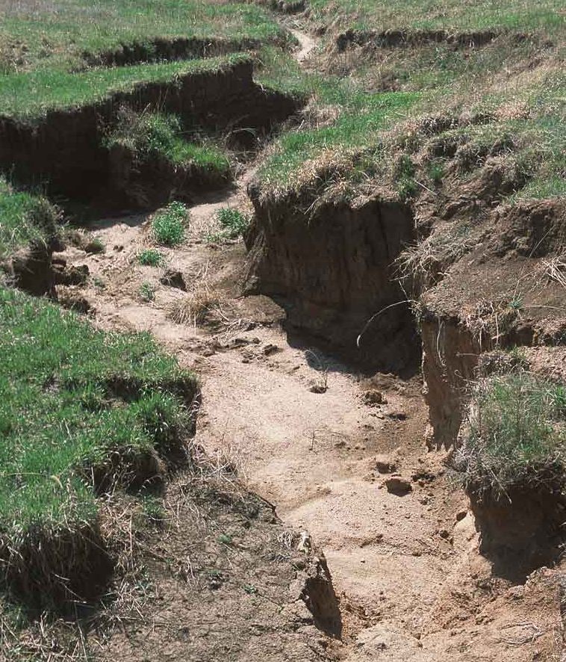
Soil
Erosion
Prevention
Photo: NRCS, UNL Plant and Soil Sciences Library

Slide 2
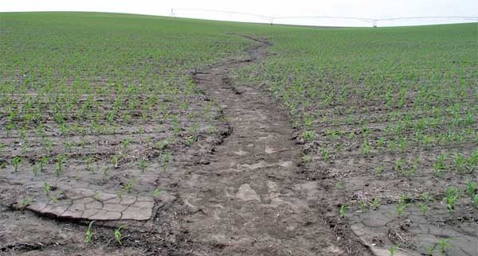
What is erosion?
Erosion - the process by which wind, water, or ice gradually remove the top layer of soil, called topsoil
Erosion can be a natural process; however human activities can increase the rate of erosion up to 1000 times faster.
Deforestation – cutting down forest areas
Overgrazing - Allowing livestock to graze too long in one area
Intensive Farming
Improper & Irresponsible Land Use
Photo: University of Nebraska - Lincoln

Slide 3
Why does it matter?
Erosion moves soil and sediment to places we don't want it to be - like roadways, and business or living spaces. The soil sediments eventually end up in our water supply, decreasing water quality for drinking and aquatic life.
Topsoil holds key nutrients plants & crops need to grow. Those plants feed the world – humans, livestock animals, & wildlife.
Wildfires, dust storms, and avalanches are more likely in areas suffering from erosion.
During extreme rainfall, mudslides, washed out roads, collapsed bridges, and structural damage to buildings can occur.

Slide 4
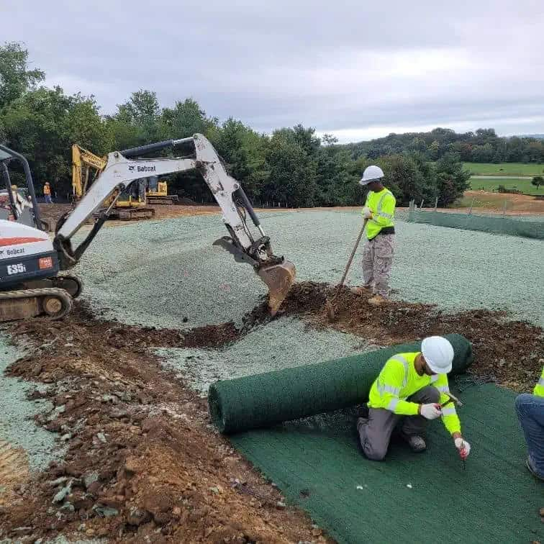
Prevention &
Land Management
It is extremely difficult to restore an area that has suffered extreme erosion. Taking action to prevent erosion is much more effective.
Responsible Farm & Ranch Owners, Agricultural & Environmental Engineers, Land Use Planners, Construction Managers, and other professionals work to prevent erosion and protect our soil resources –
you can too!
Photo: Miller, Inc

Slide 5
Preventing Erosion in Agriculture
Farm & Ranch owners do many different things to protect & preserve soil.
Pasture Rotation
to prevent livestock from
overgrazing plants
Crop Rotation & Fertilizing to preserve & add nutrients to the soil
Using innovative equipment & practices such as no-till farming where seeds are inserted into the soil without tilling the soil
Innovative field structures
(see following slides)

Slide 6
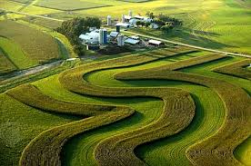
Strip Farming – planting strips of crops that are less likely to experience erosion next to crops that are more likely to experience erosion
How does it help? The plants with deeper & stronger root structures "catch" and hold the soil in place when rain washes soil away from the nearby crops with shallow root systems.
Photo: solvingforearth.org

Slide 7
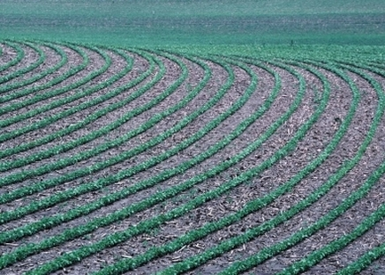
Contour Farming – tilling land and planting rows of crops that follow the shape of the land instead of planting straight rows
How does it help? Ridges are created that run perpendicular to the flow of water down a slope. Those ridges and plants catch the water, slowing it down and giving it more time to absorb .
Photo: managing-earth-changes.weebly.com

Slide 8
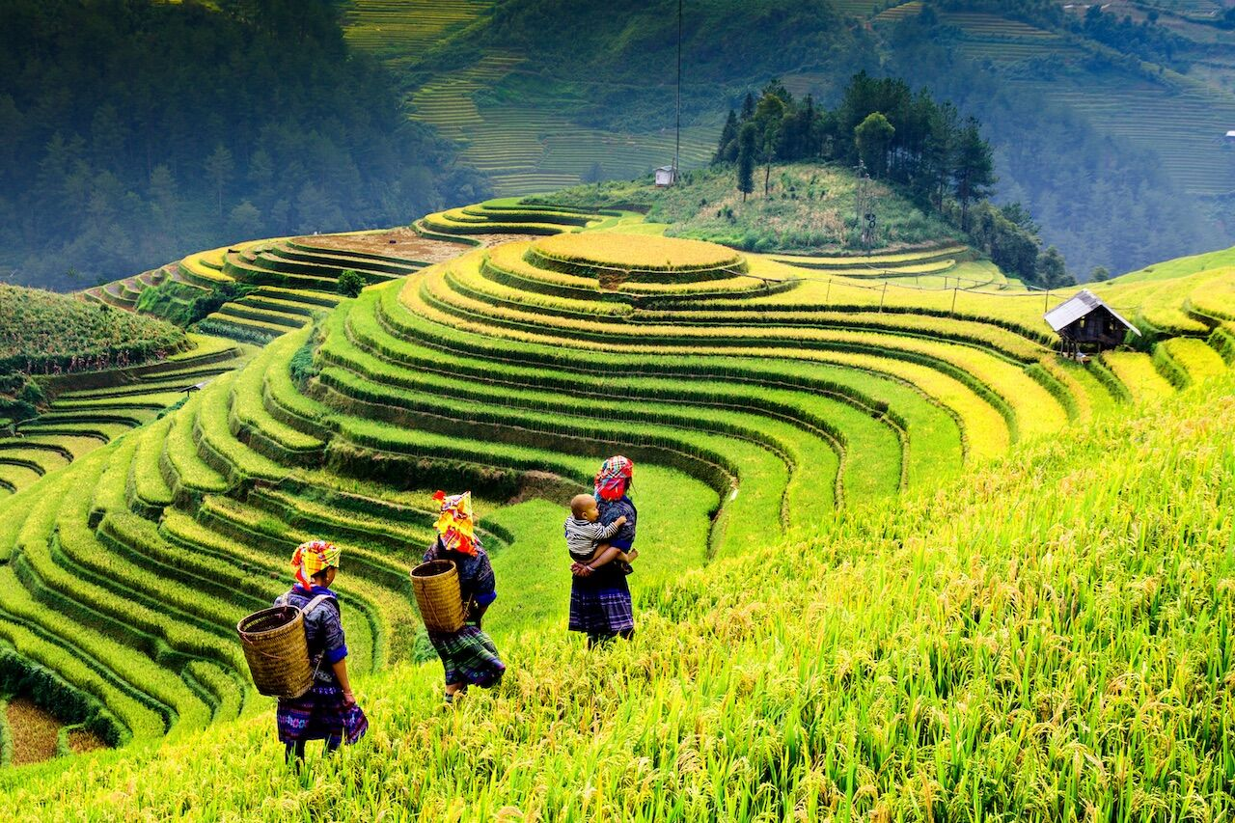
Terrace Farming – steps built into hill or mountain sides to create flat spaces to plant crops
How does it help? Water stays on each flat area where it can be absorbed, rather that running down the slope and taking soil with it.
Photo: JunPhoto/Shutterstock

Slide 9
Erosion Prevention in Urban & Residential Areas
Soil erosion can be dangerous to areas other than farmland. A wide variety of professionals work together to prevent erosion from roadways and parking areas, new construction, in cities and our neighborhoods.
Environmental Engineers
Civil Engineers
Soil Scientists
Construction Managers
Land Use Planners
Hydrologists

Slide 10
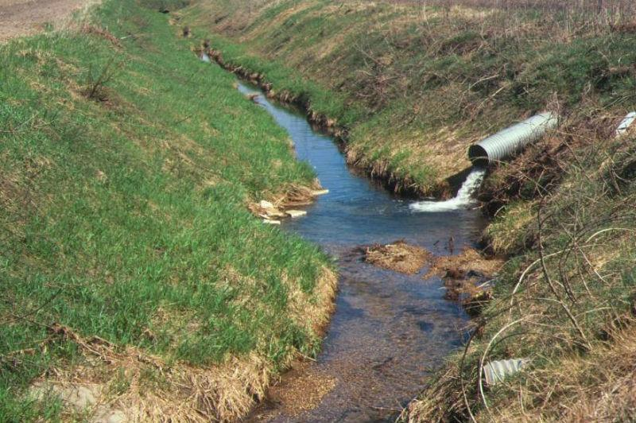
Drainage Systems
Digging ditches or channels
Installing culverts, pipes,
or tunnels`
How does it help?
Water is directed to flow through these areas and away from areas where it could do damage.
Photo: University of Minnesota Extension

Slide 11
Retention Ponds & Underground Water Detention Systems
Digging to create ponds or wetlands near areas of high run off like parking lots
Storm drains leading to catch basins or sewer systems
How does it help?
Water is directed in a safe path to an area that can hold large volumes of water.
Photo: Filepic

Slide 12
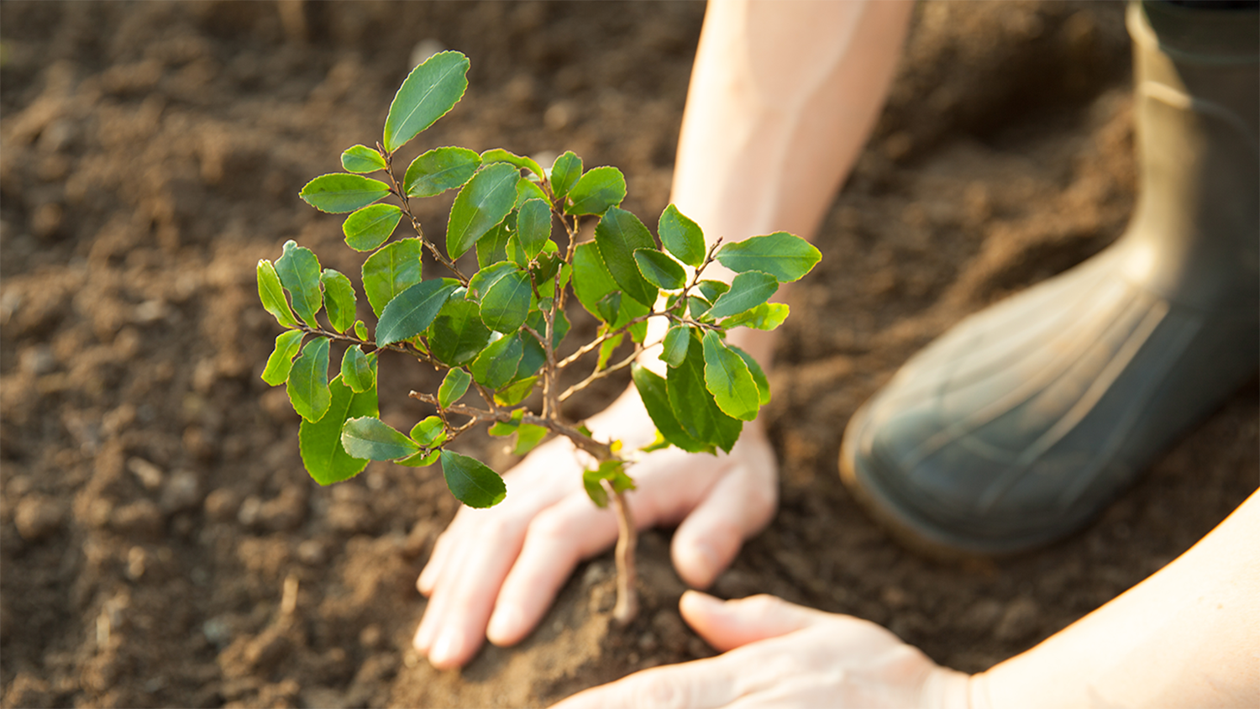
What Can You Do?
Even on a small scale in your own community or yard, you can help prevent soil erosion.
Planting trees, shrubs, flowers, or grass
Using gutters, down spouts, and rain barrels
How does it help?
Roots absorb rainfall and hold soil in place. Home structures can direct water into a safe location or hold it for other use.
Photo: NC State College of Natural Resources

