Slide 1
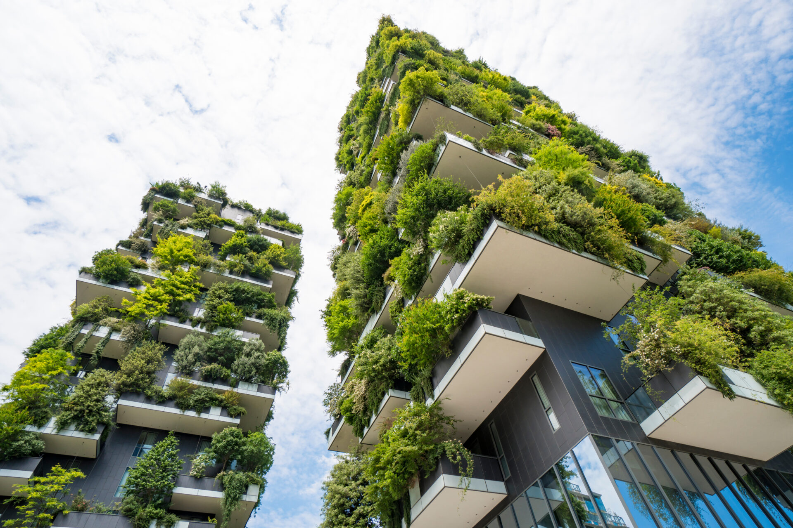
Environmentally Friendly Buildings:
Building a
Greener Future

Slide 2
What Are Environmentally Friendly Buildings?
Also called green buildings.
Designed to use less energy, water, and materials.
Protect the environment and improve health.
Examples:
Schools with solar panels.
Homes made from recycled materials.

Slide 3
Why Do We Need Them?
Climate change: Buildings cause 40% of carbon emissions.
Save resources: Reduce electricity and water use.
Healthier living: Cleaner air and fewer toxic materials.

Slide 4
Features of Environmentally Friendly Buildings
Renewable Energy
- Solar panels or wind turbines.
2. Recycled Materials
- Walls made from recycled wood
or metal.
3. Green Roofs
- Plants on rooftops to keep the building cool.
4. Energy-Efficient Design
- Big windows for sunlight.
- LED lights.
5. Water-Saving Tech
- Rainwater collection systems.
- Low-flow faucets.

Slide 5
Benefits of Green Buildings
For the Environment:
- Less pollution and waste.
- Save energy and water.
For People:
- Lower electricity bills.
- Better air quality and health.
For the Community:
- Jobs for green architects and engineers.
- Inspire others to care for the planet.

Slide 6
How Can We Help?
Learn about green designs.
2. Reuse and recycle materials at home.
3. Save energy:
- Turn off lights when not in use.
4. Support green projects in your community.

Slide 7
Cool Facts About Green Buildings!
The Empire State Building was redesigned to be more energy-efficient.
Some schools grow their own food on green roofs.
Green buildings can even clean polluted air!

Slide 8
Discussion Time!
What do you think is the coolest green building feature?
What could you do to make your home more eco-friendly?

Slide 9
How Technology Helps Green Buildings
Renewable Energy Technology
Solar Panels: Convert sunlight into electricity.
  Wind Turbines: Use wind power to generate energy.
  Geothermal Systems: Use underground heat for heating and cooling.

Slide 10
How Technology Helps Green Buildings
2. Smart Building Systems
Smart Thermostats: Adjust temperature automatically to save energy.
Motion-Sensor Lights: Turn off when no one is in the room.
Energy Monitoring Apps: Track and reduce energy use.

Slide 11
How Technology Helps Green Buildings
3. Advanced Building Materials
Insulated Panels: Keep heat in during winter and out during summer.
Self-Healing Concrete: Repairs cracks by itself, reducing waste.
Recycled Materials: Plastic bottles turned into carpets or walls.

Slide 12
How Technology Helps Green Buildings
4. Water-Saving Technology
Rainwater Collection Systems: Store rain for watering plants or flushing toilets.
Greywater Systems: Reuse sink and shower water for irrigation.

Slide 13
How Technology Helps Green Buildings
5. Construction Technology
3D Printing: Builds homes faster using less material.
Drones: Help architects design better, more eco-friendly buildings.

Slide 14
How Technology Helps Green Buildings
6. AI and Machine Learning
Predict energy use and optimize building systems.
Suggest ways to reduce waste and improve sustainability.

Slide 15
Conclusion:
Technology has made it easier, faster, and more affordable to build environmentally friendly buildings, helping us create a greener future!

