Slide 1
Experimentation

Slide 2
Experimentation
The process of performing tests, trials, or tentative procedures for the purpose of discovering something unknown or of testing a principle, supposition, etc.

Slide 3

Problem Solving through Experimentation

Slide 4

Assume as Little as Possible

Slide 5
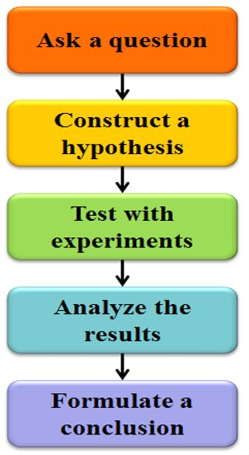
The Scientific Method

Slide 6

Asking your Question

Slide 7

The Hypothesis
An educated guess, or proposed explanation.
Given the question: Will there be more Avengers movies?
My hypothesis: Since there were a lot of cues at the end of the movie setting up for further plot development, yes there will be some more Avengers movies.

Slide 8
The Experiment
If successful, it answers your question and is easily replicated.
If a failure, then it failed to produce any usable data, and needs to be rethought and redone until usable data is acquired.

Slide 9

Analyzing Results

Slide 10

Don’t be afraid to Backtrack
Often, your conclusion will be that you’ve got to retry your hypothesis or even your question was wrong.
It's not a bad thing.

