Slide 1
Dynamics of flight
NASA Ultra Efficient Engine Technology
http://www.ueet.nasa.gov

Slide 2
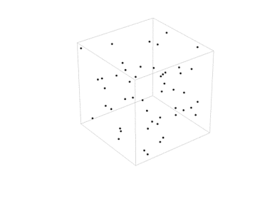
What is Air?
Air is a physical substance which has weight. It has molecules which are constantly moving. Air pressure is created by the molecules moving around. Moving air has a force that will lift kites and balloons up and down. Air is a mixture of different gases; oxygen, carbon dioxide and nitrogen. All things that fly need air. Air has power to push and pull on the birds, balloons, kites and planes.
In 1640, Evagelista Torricelli discovered that air has weight. When experimenting with measuring mercury, he discovered that air put pressure on the mercury.
Hot air expands and spreads out and it becomes lighter than cool air. When a balloon is full of hot air it rises up because the hot air expands inside the balloon. When the hot air cools and is let out of the balloon the balloon comes back down.
Notes:
Francesco Lana used this discovery to begin to plan for an airship in the late 1600s. He drew an airship on paper that used the idea that air has weight. The ship was a hollow sphere which would have the air taken out of it. Once the air was removed, the sphere would have less weight and would be able to float up into the air. Each of four spheres would be attached to a boat-like structure and then the whole machine would float. The actual design was never tried.

Slide 3
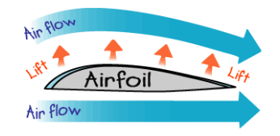
How Wings Lift the Plane
Airplane wings are curved on the top which make air move faster over the top of the wing. The air moves faster over the top of a wing. It moves slower underneath the wing.
The slow air pushes up from below while the faster air pushes down from the top. This forces the wing to lift up into the air.

Slide 4
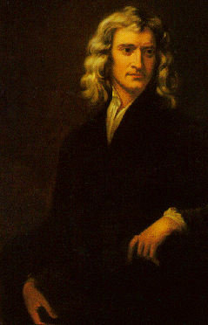
Laws of Motion
Sir Isaac Newton proposed three laws of motion in 1665. These Laws of Motion help to explain how a planes flies.
1. If an object is not moving, it will not start moving by itself. If an object is moving, it will not stop or change direction unless something pushes it.
2. Objects will move farther and faster when they are pushed harder.
3. When an object is pushed in one direction, there is always a resistance of the same size in the opposite direction.
Notes:
http://www.mcasco.com/Physics-1/p1nlm.html

Slide 5
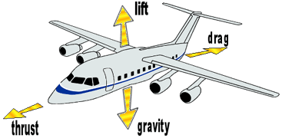
Forces of Flight
Four forces of flight
Lift - upward
Drag - down and backward
Weight - downward
Thrust - forward

Slide 6
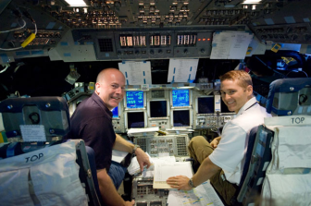
Controlling the Flight of the Plane
How does a plane fly? Let's pretend that our arms are wings. If we place one wing down and one wing up we can use the roll to change the direction of the plane. We are helping to turn the plane by yawing toward one side.
If we raise our nose, like a pilot can raise the nose of the plane, we are raising the pitch of the plane. All these dimensions together combine to control the flight of the plane.
A pilot of a plane has special controls that can be used to fly the plane. There are levers and buttons that the pilot can push to change the yaw, pitch and roll of the plane.
Notes:
Commander Alan Poindexter and pilot Jim Dutton in shuttle simulator. Credit: NASA

Slide 7
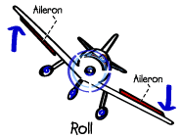
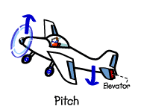
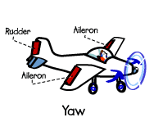
Controlling the Flight of the Plane
To roll the plane to the right or left, the ailerons are raised on one wing and lowered on the other. The wing with the lowered aileron rises while the wing with the raised aileron drops.
Pitch is to make a plane descend or climb. The pilot adjusts the elevators on the tail to make a plane descend or climb. Lowering the elevators caused the airplane's nose to drop, sending the plane into a down. Raising the elevators causes the airplane to climb.
Yaw is the turning of a plane. When the rudder is turned to one side, the airplane moves left or right. The airplane's nose is pointed in the same direction as the direction of the rudder. The rudder and the ailerons are used together to make a turn

Slide 8
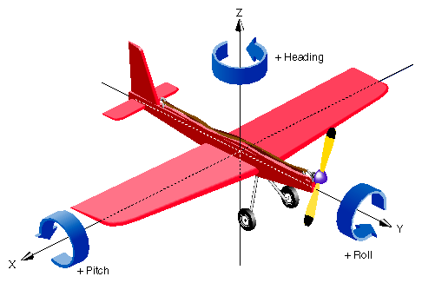
Controlling the Flight of the Plane
Notes:
http://techpubs.sgi.com/library/dynaweb_docs/0630/SGI_Developer/books/Perf_PG/sgi_html/ch02.html

Slide 9
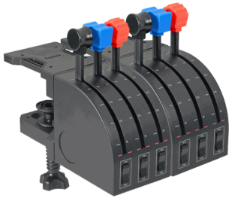
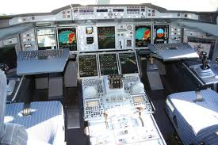
Controlling the Flight of the Plane
To control a plane a pilot uses several instruments...
The pilot controls the engine power using the throttle. Pushing the throttle increases power, and pulling it decreases power.
The pilot of the plane pushes the top of the rudder pedals to use the brakes. The brakes are used when the plane is on the ground to slow down the plane and get ready for stopping it. The top of the left rudder controls the left brake and the top of the right pedal controls the right brake.
Notes:
http://www.fspilotshop.com/product_info.php?products_id=1264

Slide 10
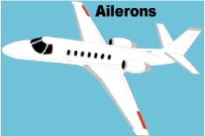
Ailerons
The ailerons raise and lower the wings. The pilot controls the roll of the plane by raising one aileron or the other with a control wheel. Turning the control wheel clockwise raises the right aileron and lowers the left aileron, which rolls the aircraft to the right.

Slide 11
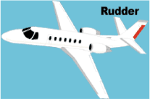
Rudder
The rudder works to control the yaw of the plane. The pilot moves rudder left and right, with left and right pedals. Pressing the right rudder pedal moves the rudder to the right. This yaws the aircraft to the right. Used together, the rudder and the ailerons are used to turn the plane.

Slide 12
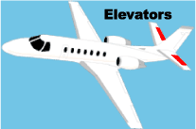
Elevators
The elevators which are on the tail section are used to control the pitch of the plane. A pilot uses a control wheel to raise and lower the elevators, by moving it forward to back ward. Lowering the elevators makes the plane nose go down and allows the plane to go down. By raising the elevators the pilot can make the plane go up.

