Slide 1
History of flight
NASA Ultra Efficient Engine Technology
http://www.ueet.nasa.gov

Slide 2
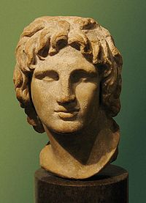
Myths and Legends of Flight
Greek Legend – Pegasus
Bellerophon the Valiant, son of the King of Corinth, captured Pegasus, a winged horse. Pegasus took him to a battle with the triple headed monster, Chimera.
Icarus and Daedalus - An Ancient Greek Legend
Daedalus was an engineer who was imprisoned by King Minos. With his son, Icarus, he made wings of wax and feathers. Daedalus flew successfully from Crete to Naples, but Icarus, tired to fly too high and flew too near to the sun. The wings of wax melted and Icarus fell to his death in the ocean.
King Kaj Kaoos of Persia
King Kaj Kaoos attached eagles to his throne
and flew around his kingdom.
Alexander the Great
Alexander the Great harnessed four mythical winged
animals, called Griffins, to a basket and flew around his realm.

Slide 3
Early Efforts of Flight
Around 400 BC - China
The discovery of the kite that could fly in the air by the Chinese started humans thinking about flying. Kites were used by the Chinese in religious ceremonies. They built many colorful kites for fun, also. More sophisticated kites were used to test weather conditions. Kites have been important to the invention of flight as they were the forerunner to balloons and gliders.
Humans try to fly like birds
For many centuries, humans have tried to fly just like the birds. Wings made of feathers or light weight wood have been attached to arms to test their ability to fly. The results were often disastrous as the muscles of the human arms are not like a birds and can not move with the strength of a bird.

Slide 4
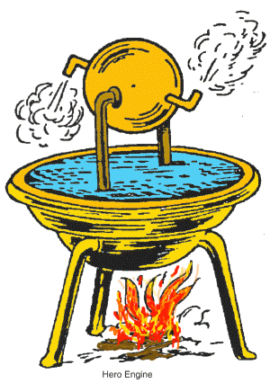
Early Efforts of Flight
Hero and the Aeolipile
The ancient Greek engineer, Hero of Alexandria, worked with air pressure and steam to create sources of power. One experiment that he developed was the aeolipile which used jets of steam to create rotary motion.
Hero mounted a sphere on top of a water kettle. A fire below the kettle turned the water into steam, and the gas traveled through pipes to the sphere. Two L-shaped tubes on opposite sides of the sphere allowed the gas to escape, which gave a thrust to the sphere that caused it to rotate.
Notes:
http://library.thinkquest.org/J0112188/history_of_rocketry.htm

Slide 5
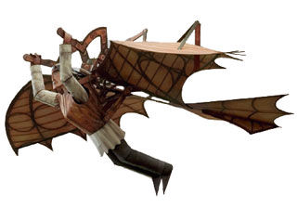
Early Efforts of Flight
1485 Leonardo da Vinci - The Ornithopter
Leonardo da Vinci made the first real studies of flight in the 1480's. He had over 100 drawings that illustrated his theories on flight.
The Ornithopter flying machine was never actually created. It was a design that Leonardo da Vinci created to show how man could fly. The modern day helicopter is based on this concept.
Notes:
http://paperkraft.blogspot.com/2009/08/ornithopter-papercraft-leonardo-da.html

Slide 6
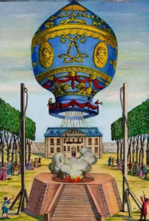
Early Efforts of Flight
1783 - Joseph and Jacques Montgolfier- the First Hot Air Balloon
The brothers, Joseph Michel and Jacques Etienne Montgolfier, were inventors of the first hot air balloon. They used the smoke from a fire to blow hot air into a silk bag. The silk bag was attached to a basket. The hot air then rose and allowed the balloon to be lighter-than-air.
In 1783, the first passengers in the colorful balloon were a sheep, rooster and duck. It climbed to a height of about 6,000 feet and traveled more than 1 mile.
After this first success, the brothers began to send men up in balloons. The first manned flight was on November 21, 1783, the passengers were Jean-Francois Pilatre de Rozier and Francois Laurent.
Notes:
The first balloon, a hot-air balloon, was made by Joseph and Jaques Montgolfier on 4th April 1783. It was made from cloth. The balloon flew a distance of 2km and was unmanned. With this flight the aviation era started.

Slide 7
Early Efforts of Flight
1799 - 1850's - George Cayley
George Cayley worked to discover a way that man could fly. He designed many different versions of gliders that used the movements of the body to control. A young boy, whose name is not known, was the first to fly one of his gliders.
Over 50 years he made improvements to the gliders. He changed the shape of the wings so that the air would flow over the wings correctly. He designed a tail for the gliders to help with the stability. He tried a biplane design to add strength to the glider. He also recognized that there would be a need for power if the flight was to be in the air for a long time.
Cayley wrote On Ariel Navigation which shows that a fixed-wing aircraft with a power system for propulsion and a tail to assist in the control of the airplane would be the best way to allow man to fly.

Slide 8
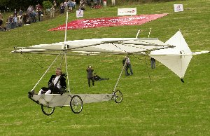
Early Efforts of Flight
Sir Richard Branson flew a replica of Sir George Cayley's glider to commemorate the first manned flight.
Notes:
The Virgin chief was appropriately dressed as a coachman for the occasion as the original flight in 1853 was made by Sir George's coachman, John Appleby. Although he made history, Appleby clearly didn't enjoy the experience; after flying some 200 yards and crashing on landing he resigned on the spot, memorably saying: "Sir George I wish to give notice. I was hired to drive, not to fly".
Saturday's flight took place from the same field at Brompton Dale, near Scarborough, where the original flight launched 50 years before the Wright brothers made their record-breaking first flight of a manned powered aircraft.
Sir Richard, who flew at 6ft for 50 yards, clearly enjoyed it more than Appleby and said afterwards: "Brilliant. We've done it, we've done it. That was exhilarating, magnificent. I can retire knowing that I can fly."
http://www.flyer.co.uk/news/newsfeed.php?artnum=57

Slide 9
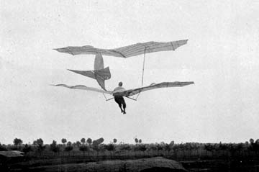
19th and 20th Century Efforts
1891 Otto Lilienthal
German engineer, Otto Lilienthal, studied aerodynamics and worked to design a glider that would fly. He was the first person to design a glider that could fly a person and was able to fly long distances.
He was fascinated by the idea of flight. Based on his studies of birds and how they fly, he wrote a book on aerodynamics that was published in 1889 and this text was used by the Wright Brothers as the basis for their designs.
After more than 2500 flights, he was killed
when he lost control because of a sudden
strong wind and crashed into the ground.
Notes:
http://www.flyingmachines.org/lilthl.html

Slide 10
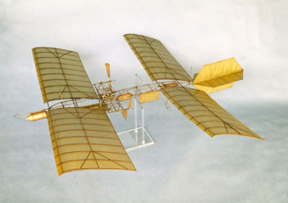
19th and 20th Century Efforts
1891 Samuel P. Langley
Samuel Langley was an astronomer, who realized that power was needed to help man fly. He built a model of a plane, which he called an aerodrome, that included a steam-powered engine. In 1891, his model flew for 3/4s of a mile before running out of fuel.
Langley received a $50,000 grant to build a full sized aerodrome. It was too heavy to fly and it crashed. He was very disappointed. He gave up trying to fly.
His major contributions to flight involved
attempts at adding a power plant to a glider.
He was also well known as the director of
the Smithsonian Institute in Washington, DC
Notes:
http://feixinghistory.blogspot.com/2009/05/last-unsuccessful-attempts-at-flight.html

Slide 11
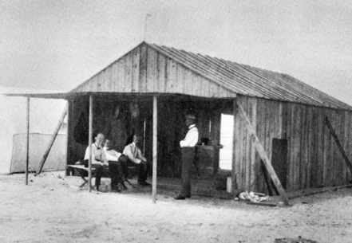
19th and 20th Century Efforts
1894 Octave Chanute
Octave Chanute published Progress in Flying Machines in 1894. It gathered and analyzed all the technical knowledge that he could find about aviation accomplishments. It included all of the world's aviation pioneers. The Wright Brothers used this book as a basis for much of their experiments. Chanute was also in contact with the Wright Brothers and often commented on their technical progress.
Octave Chanute With Wilbur and Orville at Kitty Hawk
Notes:
http://www.flyandrive.com/wright02.htm

Slide 12
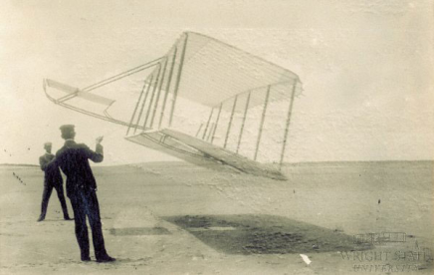
19th and 20th Century Efforts
1903 Orville and Wilbur Wright and the First Flight
Orville and Wilbur Wright were very deliberate in their quest for flight. First, they spent many years learning about all the early developments of flight. They completed detailed research of what other early inventors had done. They read all the literature that was published up to that time. Then, they began to test the early theories with balloons and kites. They learned about how the wind would help with the flight and how it could affect the surfaces once up in the air.
The first Kite of the 2 brothers being experimented
Notes:
http://www.flyandrive.com/wright02.htm

Slide 13
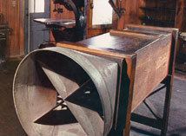
19th and 20th Century Efforts
1903 Orville and Wilbur Wright and the First Flight
The next step was to test the shapes of gliders much like George Cayley did when he was testing the many different shapes that would fly. They spent much time testing and learning about how gliders could be controlled.
They designed and used a wind tunnel to test the shapes of the wings and the tails of the gliders. After they found a glider shape that consistently would fly in the tests in the North Carolina Outer Banks dunes, then they turned their attention to how to create a propulsion system that would create the lift needed to fly.
The wind tunnel of the Wright brothers
Notes:
http://www.flyandrive.com/wright02.htm

Slide 14
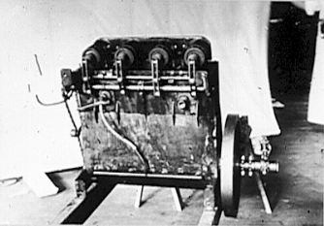
19th and 20th Century Efforts
1903 Orville and Wilbur Wright and the First Flight
The Wright brothers ran into serious trouble because at that time there wasn't any power source suited to their contraption.
Hence, Wilbur and Orville decided to produce their own engine, with the help of the mechanic Charles Taylor. In merely six weeks' time he finalized in the brothers' workshop a 4-cylinder 12 HP engine with a simple drill and a lathe.
Picture of the actual 12 horsepower engine used in flight
Notes:
http://www.flyandrive.com/wright02.htm

Slide 15
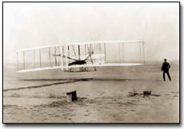
19th and 20th Century Efforts
1903 Orville and Wilbur Wright and the First Flight
The "Flyer" lifted from level ground to the north of Big Kill Devil Hill, at 10:35 a.m., on December 17, 1903. Orville piloted the plane which weighed six hundred and five pounds.
The first heavier-than-air flight traveled one hundred twenty feet in twelve seconds. The two brothers took turns during the test flights. It was Orville's turn to test the plane, so he is the brother that is credited with the first flight.
Actual Flight of The Flyer at Kitty Hawk
Notes:
http://www.flyandrive.com/wright02.htm

Slide 16
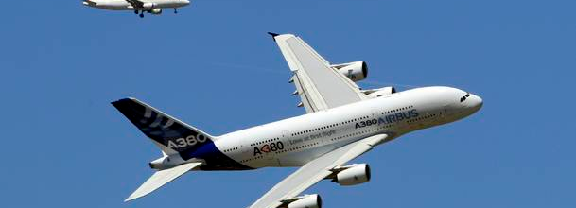
21st Century Efforts
Humankind was now able to fly! During the next century, many new airplanes and engines were developed to help transport people, luggage, cargo, military personnel and weapons. The 20th century's advances were all based on this first flight at Kitty Hawk by the American Brothers from Ohio.

