Slide 1
Parts of a plane
NASA Ultra Efficient Engine Technology
http://www.ueet.nasa.gov

Slide 2
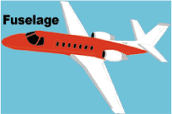
Fuselage
The body of the plane is called the fuselage. It is generally a long tube shape

Slide 3
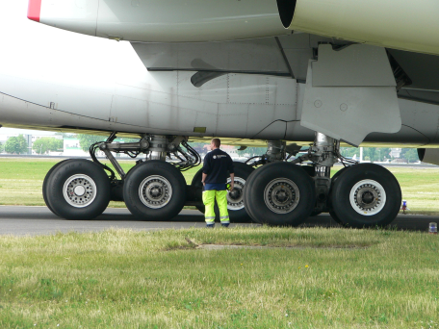
Landing Gear
The wheels of a plane are called the landing gear. There are two main wheels on either side of the plane fuselage. Then there is one more wheel near the front of the plane. The brakes for the wheels are like the brakes for cars. They are operated by pedals, one for each wheel. Most landing gear can be folded into the fuselage during the flight and opened for landing.

Slide 4
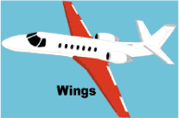
Wings
All planes have wings. The wings are shaped with smooth surfaces. There is a curve to the wings which helps push the air over the top more quickly than it goes under the wing.
As the wing moves, the air flowing over the top has farther to go and it moves faster than the air underneath the wing. So the air pressure above the wing is less than below it. This produces the upward lift. The shape of the wings determines how fast and high the plane can fly. Wings are called airfoils.

Slide 5
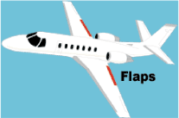
Flaps
The hinged control surfaces are used to steer and control the airplane. The flaps and ailerons are connected to the backside of the wings. The flaps slide back and down to increase the surface of the wing area. They also tilt down to increase the curve of the wing.
The slats move out from the front of the wings to make the wing space larger. This helps to increase the lifting force of the wing at slower speeds like takeoff and landing.

Slide 6
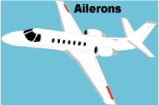
Ailerons
The ailerons are hinged on the wings and move downward to push the air down and make the wing tilt up. This moves the plane to the side and helps it turn during flight. After landing, the spoilers are used like air brakes to reduce any remaining lift and slow down the airplane.

Slide 7
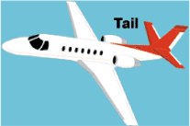
Tail
The tail at the rear of the plane provides stability. The fin is the vertical part of the tail. The rudder at the back of the plane moves left and right to control the left or right movement of the plane. The elevators are found at the rear of the plane. They can be raised or lowered to change the direction of the plane's nose. The plane will go up or down depending on the direction of that the elevators are moved.

Slide 8
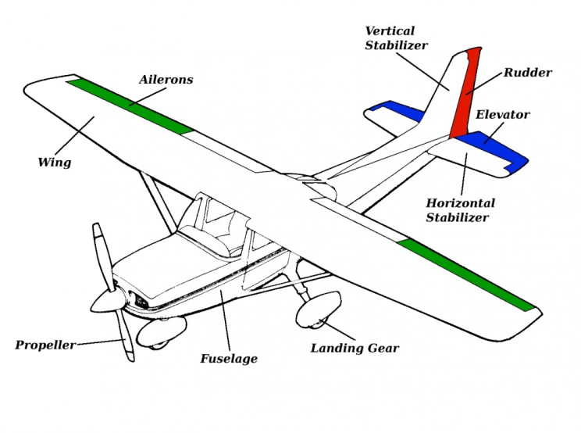
Basic parts Summary
Notes:
http://www.startflyingrc.com/basics/

