Slide 1
Dependent, independent, and controlled variables
Flight Level 2

Slide 2
1
INDEPENDENT VARIABLE

Slide 3
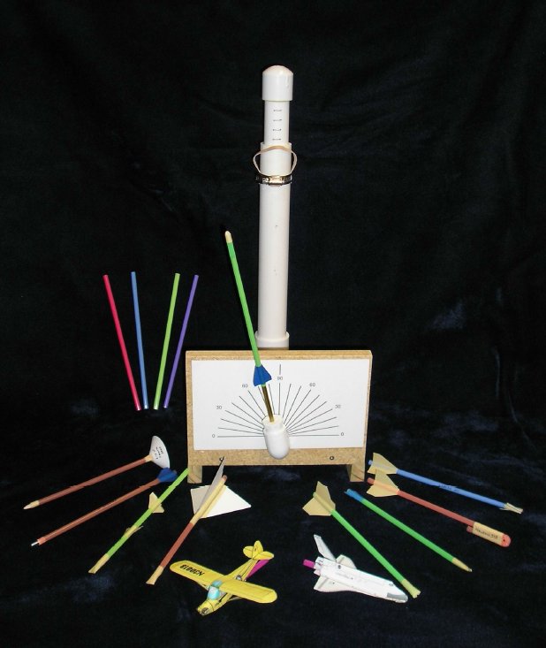
INDEPENDENT VARIABLE
The independent variable is the
variable that is purposely changed.
In this case, that could include the fin number and shape, the nose cone shape and mass, the plunger depth, and the straw length.

Slide 4
2
DEPENDENT VARIABLE

Slide 5
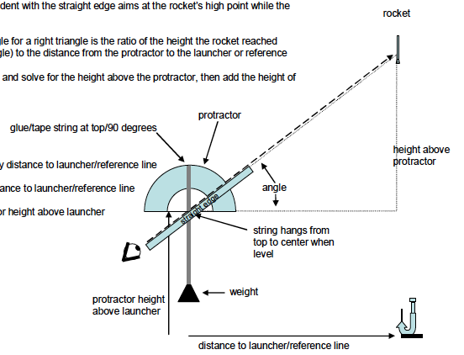
DEPENDENT VARIABLE
The dependent variable is the variable being observed.
In this case, that is how far the rocket flies. Measuring changes in the dependent variable should answer the question the experiment was designed to investigate.

Slide 6
3
CONTROLLED VARIABLE

Slide 7
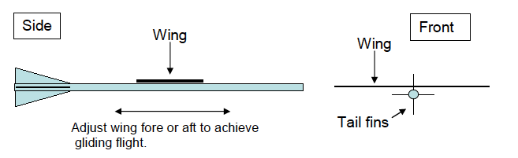
CONTROLLED VARIABLE
A variable that is not changed during the experiment is called a controlled variable.

Slide 8
4
DOCUMENTATION

Slide 9
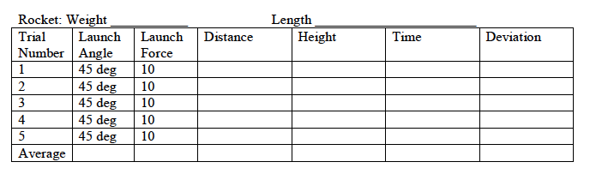
DOCUMENTATION
Much of engineering design depends on good documentation of the design process.
For an experiment to be valid, it must be designed so that only the independent variable can cause the change in the dependent variable.
To find the optimum straw rocket, all variables except one independent variable must be controlled, or kept the same during each test.
Also, in any experiment, students should perform multiple tests on each variable.

