Slide 1
History and how hot air balloons work
Lighter Than Air Vehicles
Contributions by Tom Harris and Pete McConnellc

Slide 2

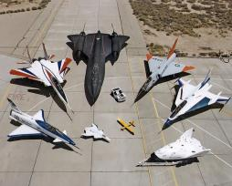
What is a lighter than Air Vehicle?
Lighter than air vehicles are called aerostats
Aerostats use buoyancy to float in the air in much the same way that ships float on the water. They are characterized by one or more large gasbags or canopies, filled with a relatively low-density gas such as helium, hydrogen, or hot air, which is less dense than the surrounding air.
When the weight of this is added to the weight of the aircraft structure, it adds up to the same weight as the air that the craft displaces.
Heavier than air vehicles are called aerodynes
Notes:
http://en.wikipedia.org/wiki/Aircraft
http://en.wikipedia.org/wiki/File:LK_03_loy_krathong_yi_peng_san_sai.jpg
http://en.wikipedia.org/wiki/File:Collection_of_military_aircraft.jpg

Slide 3
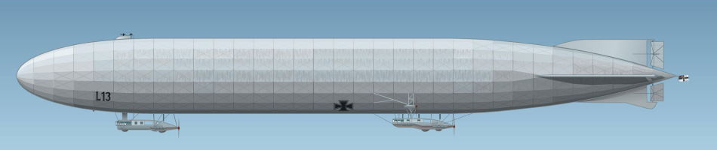
Dirigibles
A dirigible is any lighter-than-air craft that is both powered and steerable (as opposed to free floating, like a balloon).
Blimps like the Goodyear blimp, rigid airships like the Hindenburg, and semi-rigid airships like the Zeppelin NT are all dirigibles.
The word “dirigible” is often associated with large rigid airships, but the term does not come from the word “rigid,” but rather the French verb “diriger” (“to steer”).
Notes:
http://www.airships.net/dirigible

Slide 4
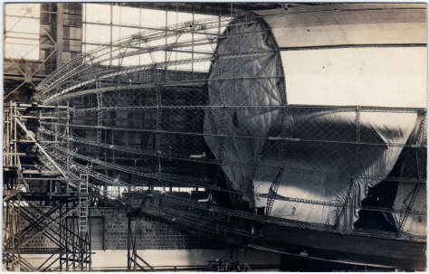
Rigid Airship
A rigid airship has a framework surrounding one or more individual gas cells, and maintains its shape by virtue of its rigid framework and not the pressure of its lifting gas.
The photograph is the United States Navy airship USS Shenandoah under construction shows its rigid metal framework; a partially inflated gas cell; and the fabric covering applied over the frame to protect the gas cells and provide aerodynamic streamlining.
Count Ferdinand von Zeppelin is considered the father of the rigid airship but not all rigid airships are “zeppelins.”
Notes:
http://www.airships.net/dirigible

Slide 5
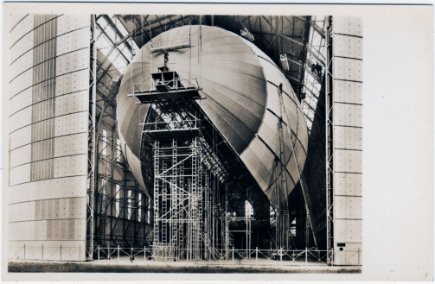

Zeppelin
Hindenburg and Boeing 707
A zeppelin is a rigid airship manufactured by a particular company, the Luftschiffbau Zeppelin of Germany (the “Zeppelin Airship Construction Company”), which was founded by Count Ferdinand von Zeppelin.
The LZ-129 Hindenburg was a zeppelin; “LZ” stands for “Luftschiff Zeppelin” and the Hindenburg was the 129th airship designed by the Zeppelin Company.
Notes:
http://www.airships.net/dirigible
http://www.airships.net/hindenburg
Airship Hindenburg under construction.
Hindenburg and Boeing 707

Slide 6
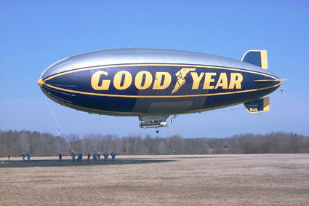
Blimp
A blimp (technically called a “pressure airship”) is a powered, steerable, lighter-than-air vehicle whose shape is maintained by the pressure of the gases within its envelope. A blimp has no rigid internal structure; if a blimp deflates, it loses its shape.

Slide 7

Hot Air Balloons
The basic idea behind hot air balloons has been around for a long time. Archemedes, one of the greatest mathematicians in Ancient Greece, figured out the principle of buoyancy more than 2,000 years ago, and may have conceived of flying machines lifted by the force. In the 13th century, the English scientist Roger Bacon and the German philosopher Albertus Magnus both proposed hypothetical flying machines based on the principle.
Nothing really got off the ground until the summer of 1783, when the Montgolfier brothers sent a sheep, a duck and a chicken on an eight-minute flight over France
Notes:
http://www.theadventurecompany.com/colorado-vacation-packages/hot-air-balloons/

Slide 8
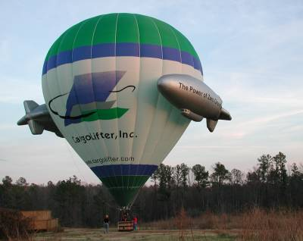
Introduction to how hot air balloons work
If you actually need to get somewhere, a hot air balloon is a fairly impractical vehicle. You can't really steer it, ­and it only travels as fast as the wind blows.
Hot air balloons are based on a very basic scientific principle: warmer air rises in cooler air.
A cubic foot of air weighs roughly 28 grams (about an ounce). If you heat that air by 100 degrees F, it weighs about 7 grams less.
Notes:
If you actually need to get somewhere, a hot air balloon is a fairly impractical vehicle.You can't really steer it, ­and it only travels as fast as the wind blows. But if you simply want to enjoy the experience of flying, there's nothing quite like it. Many people describe flying in a hot air ballo­on as one of the most serene, enjoyable activities they've ever experienced.

Slide 9
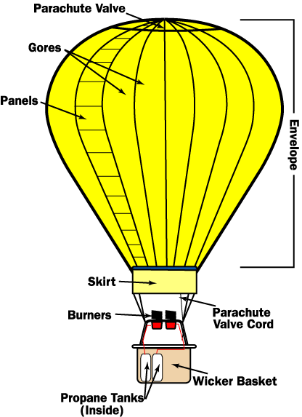
Rising Balloons
A hot air balloon has three essential parts:
the burner, which heats the air
the balloon envelope, which holds the air
the basket, which carries the passengers
Notes:
Rising Balloons
To keep the balloon rising, you need a way to reheat the air. Hot air balloons do this with a burner positioned under an open balloon envelope. As the air in the balloon cools, the pilot can reheat it by firing the burner.
Modern hot air balloons heat the air by burning propane, the same substance commonly used in outdoor cooking grills. The propane is stored in compressed liquid form, in lightweight cylinders positioned in the balloon basket. The intake hose runs down to the bottom of the cylinder, so it can draw the liquid out.
Because the propane is highly compressed in the cylinders, it flows quickly through the hoses to the heating coil. The heating coil is simply a length of steel tubing arranged in a coil around the burner. When the balloonist starts up the burner, the propane flows out in liquid form and is ignited by a pilot light. As the flame burns, it heats up the metal in the surrounding tubing. When the tubing becomes hot, it heats the propane flowing through it. This changes the propane from a liquid to a gas, before it is ignited. This gas makes for a more powerful flame and more efficient fuel consumption.
In most modern hot air balloons, the envelope is constructed from long nylon gores, reinforced with sewn-in webbing. The gores, which extend from the base of the envelope to the crown, are made up of a number of smaller panels. Nylon works very well in balloons because it is lightweight, but it is also fairly sturdy and has a high melting temperature. The skirt, the nylon at the base of the envelope, is coated with special fire-resistant material, to keep the flame from igniting the balloon.
The hot air won't escape from the hole at the bottom of the envelope because buoyancy keeps it moving up. If the pilot continually fires the fuel jets, the balloon will continue to rise. There is an upper altitude limit, however, since eventually the air becomes so thin that the buoyant force is too weak to lift the balloon. The buoyant force is equal to the weight of air displaced by the balloon, so a larger balloon envelope will generally have a higher upper altitude limit than a smaller balloon.
The basket holds the passengers, propane tanks and navigation equipment.
Most hot air balloons use a wicker basket for the passenger compartment. Wicker works very well because it is sturdy, flexible and relatively lightweight. The flexibility helps with balloon landings: In a basket made of more rigid material, passengers would feel the brunt of the impact force. Wicker material flexes a little, absorbing some of the energy.

Slide 10
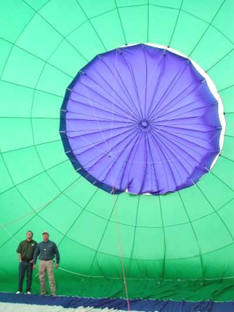
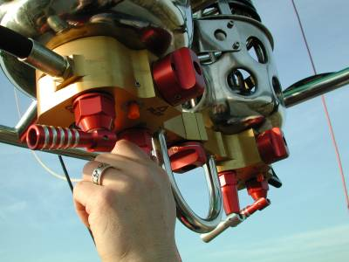
Piloting a Balloon
To blast the burner, the pilot opens the propane valve.
The parachute valve, from the inside of the balloon. A Kevlar cord runs from the valve at the top of the balloon, down to the basket, through the center of the envelope.
Notes:
Piloting a Balloon
Piloting a balloon takes skill, but the controls are actually very simple. To lift the balloon, the pilot moves a control that opens up the propane valve. This lever works just like the knobs on a gas grill or stove: As you turn it, the flow of gas increases, so the flame grows in size. The pilot can increase the vertical speed by blasting a larger flame to heat the air more rapidly.
Additionally, many hot air balloons have a control that opens a second propane valve. This valve sends propane through a hose that bypasses the heating coils. This lets the pilot burn liquid propane, instead of propane in gas form. Burning liquid propane produces a less efficient, weaker flame, but is much quieter than burning gas. Pilots often use this second valve over livestock farms, to keep from scaring the animals.
Hot air balloons also have a cord to open the parachute valve at the top of the envelope. When the pilot pulls the attached cord, some hot air can escape from the envelope, decreasing the inner air temperature. This causes the balloon to slow its ascent. If the pilot keeps the valve open long enough, the balloon will sink.
The parachute valve, from the inside of the balloon. A Kevlar cord runs from the valve at the top of the balloon, down to the basket, through the center of the envelope.
Essentially, these are the only controls -- heat to make the balloon rise and venting to make it sink. This raises an interesting question: If pilots can only move hot air balloons up and down, how do they get the balloon from place to place? As it turns out, pilots can maneuver horizontally by changing their vertical position, because wind blows in different directions at different altitudes. To move in a particular direction, a pilot ascends and descends to the appropriate level, and rides with the wind. Since wind speed generally increases as you get higher in the atmosphere, pilots can also control horizontal speed by changing altitude.
To maneuver the balloon horizontally, the pilot ascends or descends in altitude, catching different wind currents.
Of course, even the most experienced pilot doesn't have complete control over the balloon's flight path. Usually, wind conditions give the pilot very few options. Consequently, you can't really pilot a hot air balloon along an exact course. And it's very rare that you would be able to pilot the balloon back to your starting point. So, unlike flying an airplane, hot air balloon piloting is largely improvised, moment to moment. For this reason, some members of a hot air balloon crew have to stay on the ground, following the balloon by car to see where it lands. Then, they can be there to collect the passengers and equipment.

Slide 11
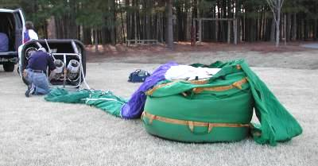
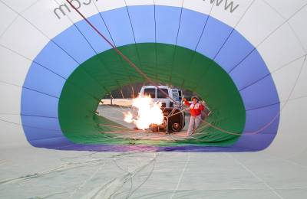
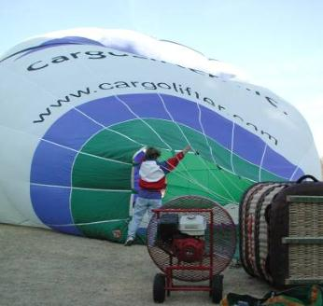
Launching and Landing
Notes:
Launching and Landing
A lot of the work in hot air ballooning comes at the beginning and the end of the flight, when the crew inflates and deflates the balloon. For the spectator, this is a much more spectacular show than the actual balloon flight.
Once the crew has found a suitable launching point, they attach the burner system to the basket. Then they attach the balloon envelope and begin laying it out on the ground.
Once the envelope is laid out, the crew begins inflating it, using a powerful fan at the base of the envelope.
When there is enough air in the balloon, the crew blasts the burner flame into the envelope mouth. This heats the air, building pressure until the balloon inflates all the way and starts to lift off the ground.
The ground crew members hold the basket down until the launch crew is on board. The balloon basket is also attached to the ground crew vehicle until the last minute, so the balloon won't be blown away before it is ready to launch. When everything is set, the ground crew releases the balloon and the pilot fires a steady flame from the burner. As the air heats up, the balloon lifts right off the ground.­
Amazingly, this entire process only takes 10 or 15 minutes. The landing process, combined with deflating and re-packing the balloon envelope, takes a while longer.
When the pilot is ready to land, he or she discusses possible landing sites with the ground crew (via an onboard radio). They need to find a wide open space, where there are no power lines and plenty of room to lay out the balloon. As soon as the balloon is in the air, the pilot is constantly looking for suitable landing sites, in case there is an emergency.
The balloon landing can be a little rough, but an experienced pilot will bump along the ground to stop the balloon gradually, minimizing the impact. If the ground crew has made it to the landing site, they will hold the basket down once it has landed. If the balloon isn't in a good position, the crew pulls it along the ground to a better spot.
The ground crew sets out a ground tarp, to protect the balloon from wear and tear. Then the pilot opens the parachute valve all the way, so the air can escape out the top of the balloon. The ground crew grabs a cord attached to the top of the balloon, and pulls the envelope over onto the tarp.
Once the balloon envelope is down on the ground, the crew begins pushing the air out. When the balloon is flattened, the crew packs it into a stuff sack. This whole process is a lot like packing up a giant sleeping bag.

Slide 12
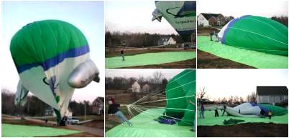
Launching and Landing
Notes:
Launching and Landing
A lot of the work in hot air ballooning comes at the beginning and the end of the flight, when the crew inflates and deflates the balloon. For the spectator, this is a much more spectacular show than the actual balloon flight.
Once the crew has found a suitable launching point, they attach the burner system to the basket. Then they attach the balloon envelope and begin laying it out on the ground.
Once the envelope is laid out, the crew begins inflating it, using a powerful fan at the base of the envelope.
When there is enough air in the balloon, the crew blasts the burner flame into the envelope mouth. This heats the air, building pressure until the balloon inflates all the way and starts to lift off the ground.
The ground crew members hold the basket down until the launch crew is on board. The balloon basket is also attached to the ground crew vehicle until the last minute, so the balloon won't be blown away before it is ready to launch. When everything is set, the ground crew releases the balloon and the pilot fires a steady flame from the burner. As the air heats up, the balloon lifts right off the ground.­
Amazingly, this entire process only takes 10 or 15 minutes. The landing process, combined with deflating and re-packing the balloon envelope, takes a while longer.
When the pilot is ready to land, he or she discusses possible landing sites with the ground crew (via an onboard radio). They need to find a wide open space, where there are no power lines and plenty of room to lay out the balloon. As soon as the balloon is in the air, the pilot is constantly looking for suitable landing sites, in case there is an emergency.
The balloon landing can be a little rough, but an experienced pilot will bump along the ground to stop the balloon gradually, minimizing the impact. If the ground crew has made it to the landing site, they will hold the basket down once it has landed. If the balloon isn't in a good position, the crew pulls it along the ground to a better spot.
The ground crew sets out a ground tarp, to protect the balloon from wear and tear. Then the pilot opens the parachute valve all the way, so the air can escape out the top of the balloon. The ground crew grabs a cord attached to the top of the balloon, and pulls the envelope over onto the tarp.
Once the balloon envelope is down on the ground, the crew begins pushing the air out. When the balloon is flattened, the crew packs it into a stuff sack. This whole process is a lot like packing up a giant sleeping bag.

Slide 13

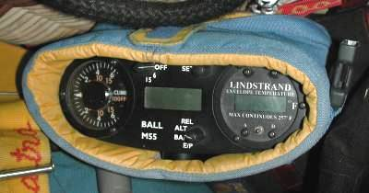
Wind and Weather
The pilot releases a helium-filled piball to see which way the wind is blowing.
The pilot carries several instruments onboard the balloon.
Notes:
Wind and Weather
Before launching, pilots will call a weather service to find out about climate and wind conditions in an area. Cautious pilots only fly when the weather is close to ideal -- when skies are clear and wind conditions are normal. Storms are extremely hazardous for hot air balloons, because of the danger of a lightning strike. Even rain is a problem, because it decreases visibility and damages the balloon material (of course, it's not much fun to fly around in wet weather anyway). And while you need a nice wind current to have a good flight, very strong winds could easily wreck the balloon.
Pilots also call the weather service to get a rough idea of which way the balloon will travel, and how they should maneuver once they're in the air. Additionally, a pilot might send up a piball (short for pilot balloon). A piball is just a balloon filled with helium that the pilot releases to see the exact direction of the wind at a prospective launch site. If it looks like the wind would take the balloon into prohibited air space, the crew needs to find a new launch spot.
In the air, the pilot will use an onboard altimeter, variometer and their own observations to find the right altitude. Reaching the right altitude is pretty tricky because there is at least a 30-second delay between blasting the burners and the balloon actually lifting. Balloon pilots have to operate the appropriate controls just a little bit before they want to rise, and shut them off a little bit before they want to stop rising. Inexperienced pilots often overshoot, rising too high before leveling off. Controlled operation comes only with many hours of ballooning experience.
The pilot carries several instruments onboard the balloon.
Now that we've seen how a hot air balloon flies through the air, let's look at the forces that make this possible. As it turns out, hot air balloons are a remarkable demonstration of some of the most fundamental forces on earth.

Slide 14
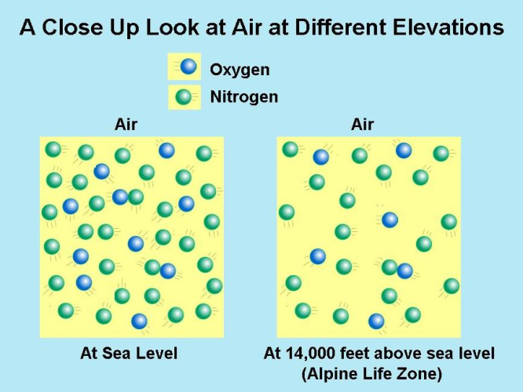
Air: A High-pressure Fluid
Hows the air up the there? Did you know that air has different density. Air is made of lots and lots and lots of tiny atoms (way more than anyone could count) that are flying around and bouncing off one another. As you get higher in elevation there are less of the atoms bouncing off one another. This means there is less oxygen for you to breathe.
Notes:
Air: A High-pressure Fluid
One amazing thing about living on earth is that we are constantly walking around in a high-pressure fluid -- a substance with mass and no shape. The air around us is composed of several different elements in a gaseous state. In this gas, the atoms and molecules of the elements fly around freely, bumping into each other and everything else. As these particles collide against an object, each of them pushes with a tiny amount of energy. Because there are so many particles in the air, this energy adds up to a considerable pressure level (at sea level, about 14.7 pounds of pressure per square inch (psi), or 1 kg per square centimeter (kg/cm²!).
The force of air pressure depends on two things:
The rate of particle collision -- if more particles collide in a period of time, then more energy is transferred to an object.
The force of the impact -- if the particles hit with greater force, more energy is transferred to an object.
These factors are determined by how many air particles there are in an area and how fast they are moving. If there are more particles, or if they are travelling more quickly, there will be more collisions, and so greater pressure. Increasing particle speed also increases the force of the particle's impact.
Most of the time we don't notice air pressure because there is air all around us. All things being equal, air particles will disperse evenly in an area so that there is equal air density at every point. Without any other forces at work, this translates to the same air pressure at all points. We aren't pushed around by this pressure because the forces on all sides of us balance one another out. For example, 14.7 psi is certainly enough to knock over a chair, or crush it from the top, but because the air applies roughly the same pressure from the right, left, top, bottom and all other angles, every force on the chair is balanced by an equal force going in the opposite direction. The chair doesn't feel substantially greater pressure from any particular angle.
So, with no other forces at work, everything would be completely balanced in a mass of air, with equal pressure from all sides. But on Earth, there are other forces to consider, chiefly gravity. While air particles are extremely small, they do have mass, and so they are pulled toward the Earth. At any particular level of the Earth's atmosphere, this pull is very slight -- the air particles seem to move in straight lines, without noticeably falling toward the ground. So, pressure is fairly balanced on the small scale. Overall, however, gravity pulls particles down, which causes a gradual increase in pressure as you move toward the earth's surface.
In the next section, we'll explore how this works.
http://shelledy.mesa.k12.co.us/staff/computerlab/ColoradoLifeZonesInformation_Elevation_Climate.html

Slide 15
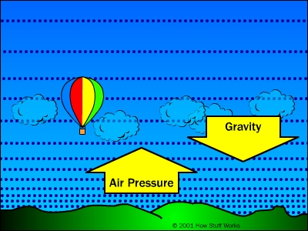
Air Pressure + Gravity = Buoyancy
All air particles in the atmosphere are drawn by the downward force of gravity. But the pressure in the air creates an upward force working opposite gravity's pull.
Notes:
Air Pressure + Gravity = Buoyancy
All air particles in the atmosphere are drawn by the downward force of gravity. But the pressure in the air creates an upward force working opposite gravity's pull. Air density builds to whatever level balances the force of gravity, because at this point gravity isn't strong enough to pull down a greater number of particles.
This pressure level is highest right at the surface of the Earth because the air at this level is supporting the weight of all the air above it -- more weight above means a greater downward gravitational force. As you move up through levels of the atmosphere, the air has less air mass above it, and so the balancing pressure decreases. This is why pressure drops as you rise in altitude.
This difference in air pressure causes an upward buoyant force in the air all around us. Essentially, the air pressure is greater below things than it is above things, so air pushes up more than it pushes down. But this buoyant force is weak compared to the force of gravity -- it is only as strong as the weight of the air displaced by an object. Obviously, most any solid object is going to be heavier than the air it displaces, so buoyant force doesn't move it at all. The buoyant force can only move things that are lighter than the air around them.
For buoyancy to push something up in the air, the thing has to be lighter than an equal volume of the air around it. The most obvious thing that is lighter than air is nothing at all. A vacuum can have volume but does not have mass, and so, it would seem, a balloon with a vacuum inside should be lifted by the buoyancy of the air around it. This doesn't work, however, because of the force of surrounding air pressure. Air pressure doesn't crush an inflated balloon, because the air inside the balloon pushes out with the same force as the outside air pushing in. A vacuum, on the other hand, doesn't have any outward pressure, since it has no particles bouncing against anything. Without equal pressure balancing it out, the outside air pressure will easily crush the balloon. And any container strong enough to hold up to the air pressure at the earth's surface will be much too heavy to be lifted by the buoyant force.
Another option would be to fill the balloon with air that is less dense than the surrounding air. Because the air in the balloon has less mass per unit of volume than the air in the atmosphere, it would be lighter than the air it was displacing, so the buoyant force would lift the balloon up. But again, fewer air particles per volume means lower air pressure, so the surrounding air pressure would squeeze the balloon until the air density inside was equal to the air density outside.
There are fewer air particles per unit of volume inside the balloon, but because those particles are moving faster, the inside and outside air pressure are the same.
All of this is assuming that the air in the balloon and the air outside the balloon exist under exactly the same conditions. If we change the conditions of the air inside the balloon, we can decrease density, while keeping air pressure the same. As we saw in the last section, the force of air pressure on an object depends on how often air particles collide with that object, as well as the force of each collision. We saw that we can increase overall pressure in two ways:
Increase the number of air particles so there is a greater number of particle impacts over a given surface area.
Increase the speed of the particles so that the particles hit an area more often and each particle collides with greater force.
So, to lower air density in a balloon without losing air pressure, you simply need to increase the speed of the air particles. You can do this very easily by heating the air. The air particles absorb the heat energy and become more excited. This makes them move faster, which means they collide with a surface more often, and with greater force.
For this reason, hot air exerts greater air pressure per particle than cold air, so you don't need as many air particles to build to the same pressure level. So a hot air balloon rises because it is filled with hot, less dense air and is surrounded by colder, more dense air.

Slide 16
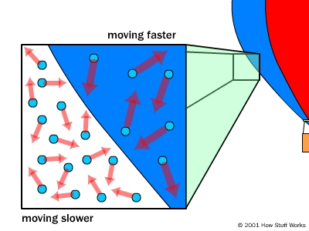
Air Pressure + Gravity = Buoyancy
There are fewer air particles per unit of volume inside the balloon, but because those particles are moving faster, the inside and outside air pressure are the same.
Notes:
Air Pressure + Gravity = Buoyancy
All air particles in the atmosphere are drawn by the downward force of gravity. But the pressure in the air creates an upward force working opposite gravity's pull. Air density builds to whatever level balances the force of gravity, because at this point gravity isn't strong enough to pull down a greater number of particles.
This pressure level is highest right at the surface of the Earth because the air at this level is supporting the weight of all the air above it -- more weight above means a greater downward gravitational force. As you move up through levels of the atmosphere, the air has less air mass above it, and so the balancing pressure decreases. This is why pressure drops as you rise in altitude.
This difference in air pressure causes an upward buoyant force in the air all around us. Essentially, the air pressure is greater below things than it is above things, so air pushes up more than it pushes down. But this buoyant force is weak compared to the force of gravity -- it is only as strong as the weight of the air displaced by an object. Obviously, most any solid object is going to be heavier than the air it displaces, so buoyant force doesn't move it at all. The buoyant force can only move things that are lighter than the air around them.
For buoyancy to push something up in the air, the thing has to be lighter than an equal volume of the air around it. The most obvious thing that is lighter than air is nothing at all. A vacuum can have volume but does not have mass, and so, it would seem, a balloon with a vacuum inside should be lifted by the buoyancy of the air around it. This doesn't work, however, because of the force of surrounding air pressure. Air pressure doesn't crush an inflated balloon, because the air inside the balloon pushes out with the same force as the outside air pushing in. A vacuum, on the other hand, doesn't have any outward pressure, since it has no particles bouncing against anything. Without equal pressure balancing it out, the outside air pressure will easily crush the balloon. And any container strong enough to hold up to the air pressure at the earth's surface will be much too heavy to be lifted by the buoyant force.
Another option would be to fill the balloon with air that is less dense than the surrounding air. Because the air in the balloon has less mass per unit of volume than the air in the atmosphere, it would be lighter than the air it was displacing, so the buoyant force would lift the balloon up. But again, fewer air particles per volume means lower air pressure, so the surrounding air pressure would squeeze the balloon until the air density inside was equal to the air density outside.
There are fewer air particles per unit of volume inside the balloon, but because those particles are moving faster, the inside and outside air pressure are the same.
All of this is assuming that the air in the balloon and the air outside the balloon exist under exactly the same conditions. If we change the conditions of the air inside the balloon, we can decrease density, while keeping air pressure the same. As we saw in the last section, the force of air pressure on an object depends on how often air particles collide with that object, as well as the force of each collision. We saw that we can increase overall pressure in two ways:
Increase the number of air particles so there is a greater number of particle impacts over a given surface area.
Increase the speed of the particles so that the particles hit an area more often and each particle collides with greater force.
So, to lower air density in a balloon without losing air pressure, you simply need to increase the speed of the air particles. You can do this very easily by heating the air. The air particles absorb the heat energy and become more excited. This makes them move faster, which means they collide with a surface more often, and with greater force.
For this reason, hot air exerts greater air pressure per particle than cold air, so you don't need as many air particles to build to the same pressure level. So a hot air balloon rises because it is filled with hot, less dense air and is surrounded by colder, more dense air.

Slide 17


