Slide 1
1
DESIGN

Slide 2
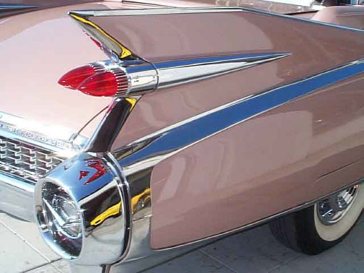
Designing a product
To sell products, manufacturers must first design products that people will buy. As time passes, the needs and desires of customers change. To keep up with the demands of customers, manufacturers need to work efficiently and save on costs whenever possible.
Over the years, designs not only change for automobiles, but for clothing, appliances, and other products as well. Can you explain why designs continue to change over the years?
Engineers have to design the product to meet a specific need or want. They choose what materials are needed and often direct the process used to make the product.

Slide 3
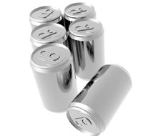
What is Design for Manufacturability?
One way engineers save on cost and time is by designing products for manufacturability. What does this mean? It means engineers design products that will be easier to manufacture. Engineers have developed many ways to improve efficiency and keep costs down. For example, engineers might:
Use Materials that are readily available instead of ones that are harder to obtain.
Use Materials that can eventually be recycled once a product's life cycle has ended. (A product's life cycle is how long a product should last.)
Design the Product to fit into an existing production process instead of having to create a whole new process.
Aluminum cans are a good example of
recyclable products.

Slide 4
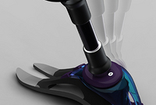
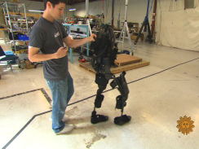
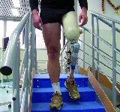
Computers in Manufacturing
Computers play an important role in all stages of manufacturing. They are used to design products, to control processes and machines, and to manage businesses.
What is CAD? CAD is computer-aided design. Engineers use CAD software to show what the product will look like, how it will work, how it should be made, and what materials will be used to make it. CAD is faster to do than manual drafting. Life-like three-dimensional models made by using CAD can also give more accurate details than 2d models.

Slide 5


