Slide 1
2
PURCHASING

Slide 2
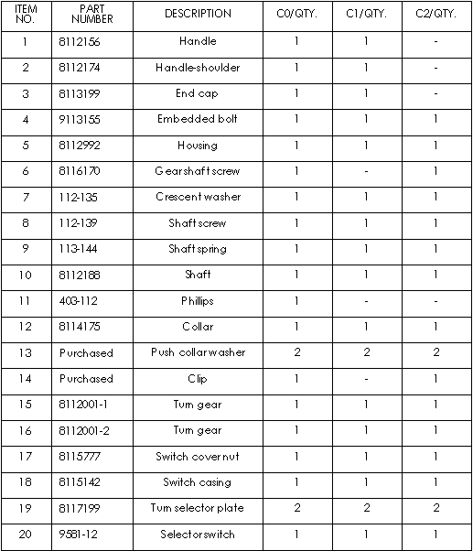
PURCHASING MATERIALS
Once a design has been chosen, materials needed to make the product must be ordered. Designers give purchasers a bill of materials. A bill of materials is a list of all the materials or parts needed to make the product.

Slide 3

PURCHASING AGENT
What is a purchasing agent? People whose job is to purchase materials for a company are called purchasing agents.
A good purchasing agent knows how to purchase raw materials at the best price and have them delivered at exactly the right time.
Many different materials are used in manufacturing. Depending upon the product being made, a purchasing agent might buy raw materials or industrial materials.

Slide 4

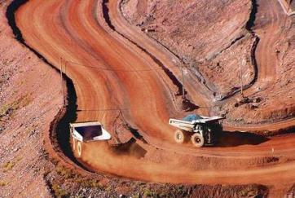
RAW MATERIALS
What are raw materials? Raw materials are materials as they occur in nature. For example, a tree is raw material. Iron ore is a raw material. Most raw materials cannot be used until after they are processed into industrial materials.

Slide 5
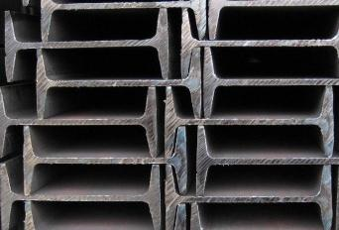

INDUSTRIAL MATERIALS
What are industrial materials? Industrial materials are materials that are used to make products. Industrial materials are made from raw materials. Steel beams are industrial materials. Steel beams are made from iron ore, which is a raw material. Steel beams are used to build skyscrapers, bridges, and many other types of structures.

Slide 6
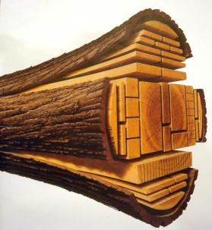
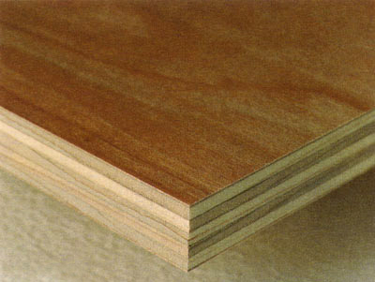
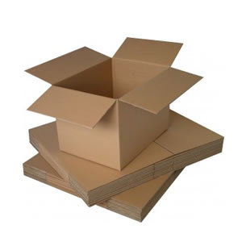
INDUSTRIAL MATERIALS
Trees are cut down and turned into logs, boards, or planks called lumber. Lumber then becomes an industrial material. Trees are also made into plywood, paper and cardboard. Lumber is purchased by many types of companies and turned into many types of products.

Slide 7



WHICH MATERIALS?
What materials might purchasers order?
A sawmill needs raw materials such as logs.
A manufacturer of metal products requires industrial materials such as sheet metal.
Automobile manufacturers need finished products such as tires, batteries, and window glass to produce their own finished products - automobiles.
A good purchasing agent knows where and how to obtain these important materials.

