Slide 1
3
Manufacturing Processing

Slide 2
Processing Materials
Once materials are purchased and received, they need to be processed. The processing of materials can be divided into two types of processes. These two types of processes are Primary Processes and Secondary Processes.

Slide 3
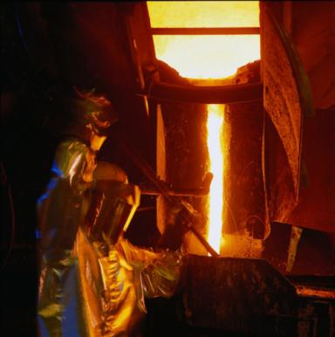
Secondary Processes
What are Secondary Processes? Secondary processes are processes that turn industrial materials into finished products. These processes include forming, separating, combining, and conditioning.
Here pure metal and scrap metal is melted in a huge furnace and poured
into molds to create large slabs that will later be formed into metal sheets.

Slide 4
MANUFACTURING PROCESSING
FORMING
Forming changes the shape of a material. Nothing is added to or taken away from the material during this process. Forming is done in several ways:

Slide 5
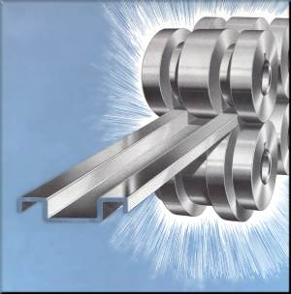
MANUFACTURING PROCESSING
ROLLING
Rolling squeezes the material between rollers. Sheet metal is made this way.

Slide 6
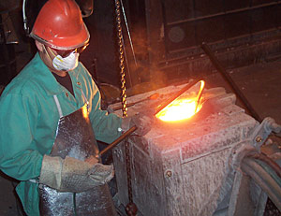
MANUFACTURING PROCESSING
CASTING
Casting involves pouring or forcing softened material into a hollow mold

Slide 7
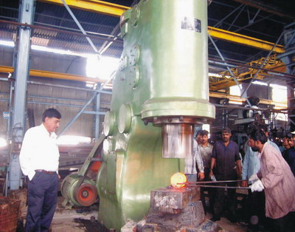
MANUFACTURING PROCESSING
FORGING
Forging hammers or squeezes material into shape. Blacksmiths used to shape horse shoes this way. Most hand wrenches are shaped by forging.
Notes:
bombayharbor.com

Slide 8
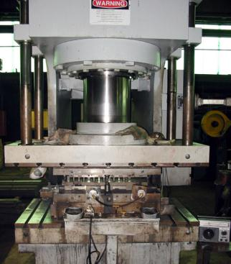
MANUFACTURING PROCESSING
STAMPING
Stamping squeezes sheet metal between dies to give it shape. Stamping is used to shape some automobile body parts like fenders and doors.

Slide 9
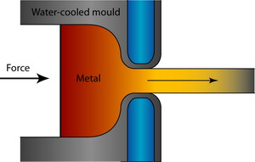
MANUFACTURING PROCESSING
EXTRUSION
Extrusion pushes the material into a shape similar to the way icing is pushed through a cake decorator. The shape of the opening in the dies determines the shape of the material.
Notes:
http://www.doitpoms.ac.uk/tlplib/metal-forming-2/extrusion.php

Slide 10
MANUFACTURING PROCESSING
SEPERATING
Separating is the cutting of materials to size and shape. Some material is usually lost during a separating process. Sawing, sanding, and filing are traditional forms of separating. However, heat, light, chemicals, and even water can also be used to separate certain materials.

Slide 11
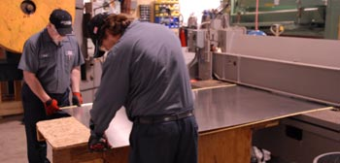
MANUFACTURING PROCESSING
SHEARING
Shearing is separating a part of a solid material from the rest of the material.
Shearing is one separating process where no material is destroyed. Thin materials like paper and sheet metal can be separated by shearing.

Slide 12
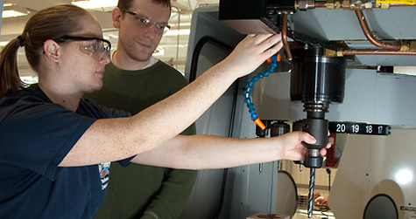
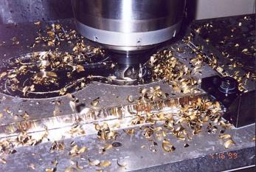
MANUFACTURING PROCESSING
CUTTING
Material can also be separated by cutting. Usually, cutting a material involves chip removal.
Notes:
sliceofstainless.com

Slide 13
MANUFACTURING PROCESSING
COMBINING
Combining is the process of joining materials.
Combining is done in a variety of ways:

Slide 14
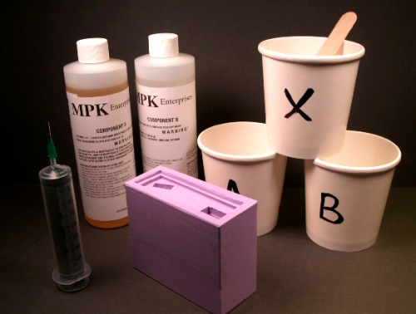
MANUFACTURING PROCESSING
MIXING
Mixing. Materials may be mixed together to form new materials. Food products such as cake mixes and soup mixes are made this way.
Notes:
hobbysilicone.com

Slide 15
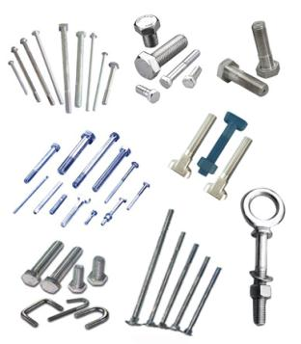
MANUFACTURING PROCESSING
MECHANICAL FASTENERS
Mechanical fasteners. These include nails, screws, staples, and nuts and bolts. Automobiles and many other products are assembled using removable mechanical fasteners. Doing this makes it possible to replace parts.
Notes:
There are many types of mechanical fasteners
used in the manufacture of products.

Slide 16
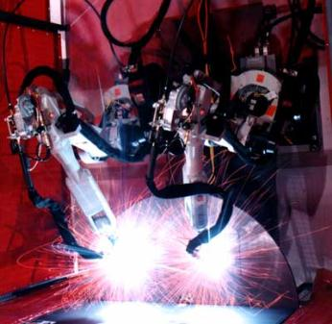
MANUFACTURING PROCESSING
SOLDERING, BRAZING and WELDING
Soldering, brazing, and welding. These are processes that involve heat. In soldering and brazing, a filler material is melted along a joint between pieces of metal.
The metal pieces themselves do not melt but soak up the molten material which hardens when cooled, thus joining the parts together. In welding, the heat melts the two pieces together.
Notes:
Robots performing a welding
process on a modern assembly line.

Slide 17
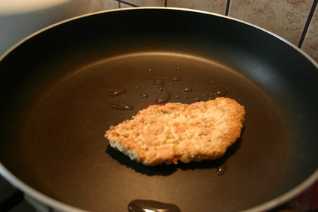
MANUFACTURING PROCESSING
COATING
Coating. This process uses one material to cover another.
It may be done to decorate or protect the covered material. Some coatings do both. Painting is the most common coating process.
Notes:
dohow.info

Slide 18
Computer Aided Manufacturing
We saw earlier how computers play an important role in the design of products by using CAD, or computer-aided design to produce drawings and plans. Computers also play an important role in the processing of materials.
What is CAM? CAM stands for computer aided manufacturing. We have already learned about CAD. After CAD is used to design a product and make the drawings, there are two ways to make the finished product. One method is to give the drawings to a skilled machinist who could make the product using a machine tool such as a lathe or milling machine.
However, a good thing about CAD drawings is that they can also be downloaded into a computer on a CAM machine. The CAM machine can then talk to the computer and follow the computer's directions to make the part.

Slide 19
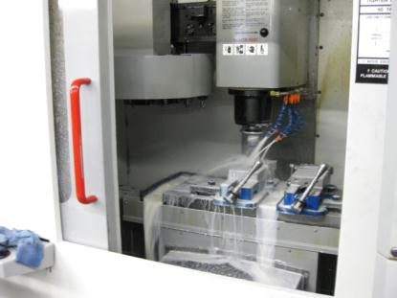
Computer Aided Manufacturing
This machine tool is one CAM machine used to cut metal into shapes. Notice the computer on the right. Design plans and cutting instructions are downloaded into the machine directly from the CAD system.
Once the machine begins its process, it does not require an operator. It even changes cutting tools by itself. The CAD/CAM system is a very valuable tool in modern manufacturing facilities.
Notes:
meridianmachinery.com

