Slide 1
4
PRODUCTION

Slide 2
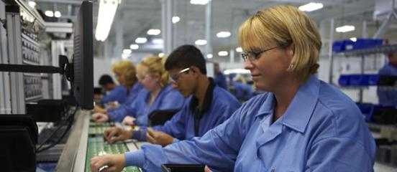
Producing a product
We just learned that both primary and secondary processes are used in manufacturing. Many different processing techniques may be needed to produce one type of product. Products with a number of different parts, such as appliances and computers must also be assembled.
What is production? A simple definition is creating goods by using human effort. Production is a key component of any manufacturing system.
There are four types of production. The kind of production used depends upon the kind of product and the number of products needed.

Slide 3
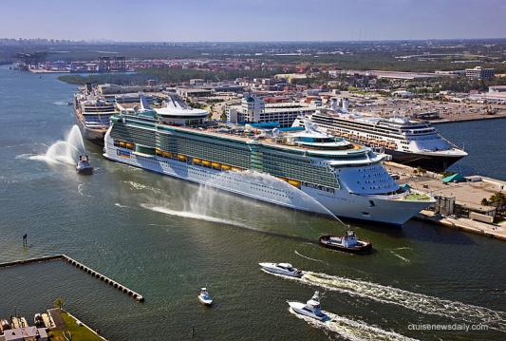
What is Custom Production?
In custom production, products are made to order. For example, a cake made according to a buyer's choice of size, flavor, shape, and icing is a custom-made product. A custom-made product need not be a small item. A cruise ship that costs $300 million and is designed for 2,500 passengers is also a custom-made product.
Oasis of the Seas is one of the largest cruise ships in the world
Notes:
Class and type:Oasis class cruise shipTonnage:225,282 GT^{[1]}Length:360 m (1,181 ft) overall^{[7]}Beam:47 m (154 ft) waterline
60.5 m (198 ft) extreme^{[7]}Height:72 m (236 ft) above water line^{[8]}Draught:9.3 m (31 ft)^{[7]}Depth:22.55 m (74 ft)^{[7]}Decks:16 passenger decks^{[2]}Installed power:3 × Wärtsilä 12V46D engines (13,860 kW/18,590 hp each)
3 × Wärtsilä 16V46D engines (18,480 kW/24,780 hp each)^{[8][9]}Propulsion:3 × 20 MW ABB Azipod, all azimuthing^{[8]}
4 × 5.5 MW Wärtsilä CT3500 bow thrusters^{[10]}Speed:22.6 knots (41.9 km/h; 26.0 mph)^{[2]}Capacity:5,400 passengers at double occupancy; 6,296 maximum^{[2]}Crew:2,165^{[2]}

Slide 4
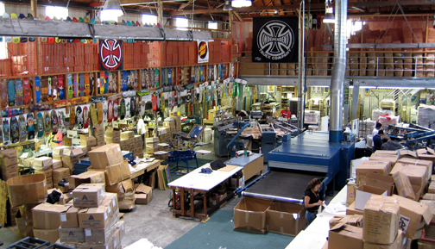
What is Job-Lot Production?
In job-lot production, a specific quantity of a product is made. For example, suppose a manufacturer received an order for exactly 10,000 skateboards. Job-lot production would be used. Many job-lot manufacturers make products on a seasonal basis. A company making skateboards used mostly in the summer might also make skis for use during the winter.
Using Job Lot production, the Santa Cruz skateboard factory . . .

Slide 5
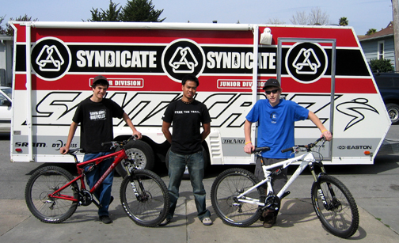
…also manufactures Santa Cruz bikes.

Slide 6
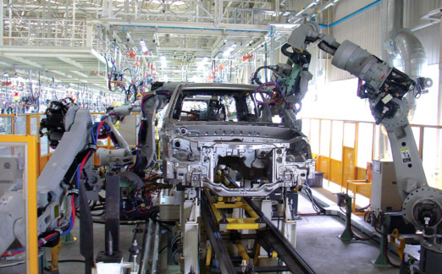
What is Continuous Production?
In continuous production, products are mass-produced, usually on an assembly line. What is an assembly line? An assembly line is a manufacturing process in which products move from one work station to the next.
Interchangeable parts are added as a product moves past each worker. Each worker is usually responsible for one specific job. The workers' work related movements are reduced to a minimum. Some mass-production systems make thousands of identical items each day.
Robots have replaced many of the difficult and monotonous
jobs on the modern assembly line.

Slide 7
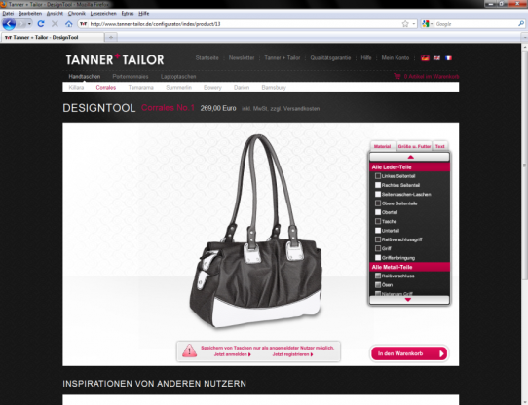
What is mass customization?
Mass customization is the use of flexible computer-aided manufacturing systems to mass-produce products that are custom designed for the individual customer.
In other words, it combines the advantages of continuous production with custom production. Mass customization is a new approach to manufacturing.
Companies that use mass customization produce standard products that are modified for individual customers.
For example, eye glasses are made of standardized parts that may be modified to fit the particular user.

Slide 8
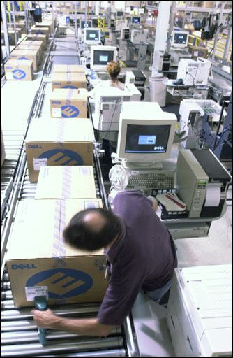
What is mass customization?
Dell Computer Company uses the mass customization system of production.
The worker here is checking bar codes with a scanner as a new computer exits the assembly line.
The finished computer is already packaged and ready for shipment directly to the customer.

Slide 9

What is Quality Assurance?
Quality assurance is the system used by companies to verify that their products are being made correctly. With quality assurance, companies are sure their products are made according to required plans and meets all specifications.
Quality assurance focuses on prevention and detection. Companies try to find and correct defects early, before the products are finished.

Slide 10
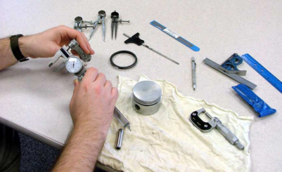
What is Quality Assurance?
When a product is designed, engineers will provide specifications or standards a product must meet. Then the manufacturing process will be set up to monitor quality.
Materials coming into a factory will be checked. Often, inspectors will check a product by hand or with a machine as the product is manufactured. Other times, programmed machines monitor the quality throughout the entire manufacturing process.
A finished product will be checked for any defects before being packaged. Even the packaging will be checked to confirm the overall product is of the highest quality.
Quality Assurance workers use many types of precision measuring instruments.

Slide 11
