Slide 1
5
PACKAGING

Slide 2
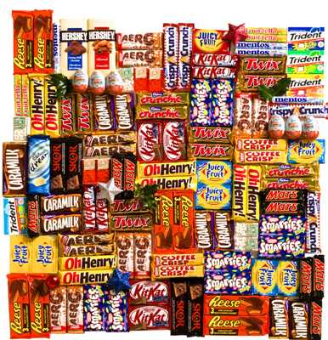
PACKAGING
Products must be prepared for shipping and then transported to customers. Industrial materials are usually shipped to other manufacturers without being individually packaged. Most consumer products are packaged.
What is the purpose of packaging? It must protect the product. It should also attract attention on a store shelf. Have you ever seen packaging that makes you want to buy a product? If so, the packaging department has done its job.

Slide 3
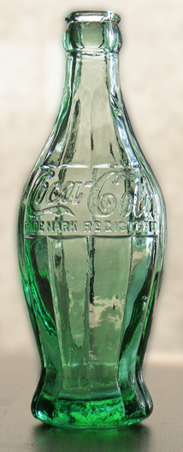
HISTORY
The first packages used the natural materials available at the time: Baskets of reeds, wineskins (Bota bags), wooden boxes, pottery vases, ceramic amphorae, wooden barrels, woven bags, etc. Processed materials were used to form packages as they were developed: for example, early glass and bronze vessels. The study of old packages is an important aspect of archaeology.
The earliest recorded use of paper for packaging dates back to 1035, when a Persian traveler visiting markets in Cairo noted that vegetables, spices and hardware were wrapped in paper for the customers after they were sold.^{[2]}
Iron and tin plated steel were used to make cans in the early 19th century. Paperboard cartons and corrugated fiberboard boxes were first introduced in the late 19th century.
Notes:
http://en.wikipedia.org/wiki/File:Codorniu_-_Raventos_1.jpg
http://en.wikipedia.org/wiki/File:Packing_salt_packages.jpg
http://en.wikipedia.org/wiki/File:1915_contour_Coca-Cola_contour_bottle_prototype.png

Slide 4
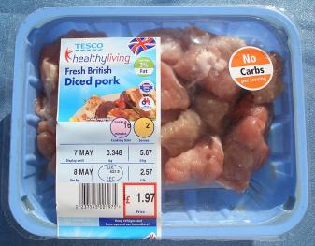
PACKAGING PURPOSE
Packaging and package labeling have several objectives
Physical Protection
Barrier Protection
Containment or agglomeration
Information Transportation
Marketing
Security
Convenience
Portion Control
Diced pork in tray and film overwrap. Label indicates net weight, composition, preparation, etc. The Union Flag, British Farm Standard tractor logo, and British Meat Quality Standard logo are also present
Notes:
http://en.wikipedia.org/wiki/File:No-carb_pork.jpg

Slide 5
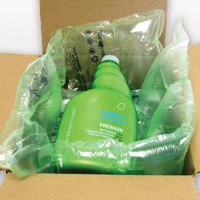
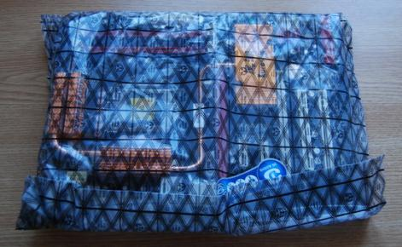
PHYSICAL PROTECTION
The objects enclosed in the package may require protection from, among other things, mechanical shock, vibration, electrostatic discharge, compression, temperature, etc.
Notes:
http://www.pcshoptalk.com/staff/stefan_m/bi700/8.jpg
http://www.voidfillpackaging.com/

Slide 6
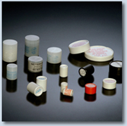
BARRIER PROTECTION
A barrier from oxygen, water vapor, dust, etc., is often required. Permeation is a critical factor in design.
Some packages contain desiccants or Oxygen absorbers to help extend shelf life. Modified atmospheres ^{[8]} or controlled atmospheres are also maintained in some food packages.
Keeping the contents clean, fresh, sterile^{[9]} and safe for the intended shelf life is a primary function.
Notes:
http://www.sud-chemie.com/scmcms/web/binary.jsp?nodeId=5984&binaryId=6082&preview=&disposition=inline&lang=en

Slide 7
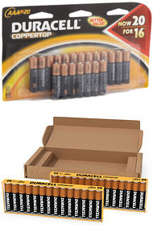
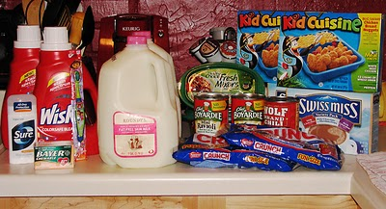
CONTAINMENT
Small objects are typically grouped together in one package for reasons of efficiency. For example, a single box of 1000 pencils requires less physical handling than 1000 single pencils. Liquids, powders, and granular materials need containment.
Notes:
http://www.girvin.com/blog/wp-content/uploads/2010/09/lifebox_02.jpg
http://3.bp.blogspot.com/_-7ENnkYVvMI/TMj1sMT7j6I/AAAAAAAABAI/f8EEZQv-9fs/s400/IMG_0318.jpg

Slide 8
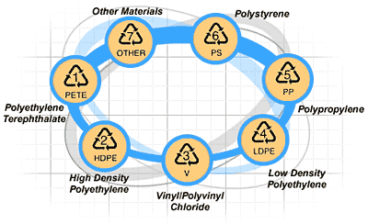
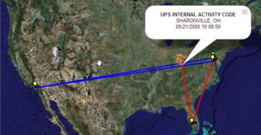
INFORMATION TRANSMIT
Packages and labels communicate how to use, transport, recycle, or dispose of the package or product. With pharmaceuticals, food, medical, and chemical products, some types of information are required by governments. Some packages and labels also are used for track and trace purposes.
Notes:
http://livewirepst.wordpress.com/category/where-to-recycle-everything-and-other-trash-talk/
http://labnol.blogspot.com/2007/03/track-shipments-from-ups-dhl-or-fedex.html

Slide 9
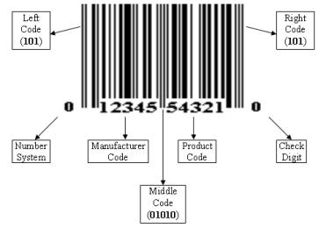
UPC
Have you ever looked at a packaged product and wondered what those white and black parallel bars were for? That is a universal product code, or a UPC.
It is often called a bar code, and it contains information about the product and its manufacturer.

Slide 10
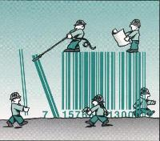
UPC
Universal product codes help out in both the distribution and sales of a product. For example, UPCs are used for inventory purposes. A manufacturer or seller has equipment that can read the code.
Each item that leaves the factory or store is scanned. The information is sent to a computer system that tracks how many products are in stock. When supplies run low, more products are ordered or manufactured.
You have probably been to many stores in which items were scanned at the checkout lane. You were part of the stores' inventory process.

Slide 11
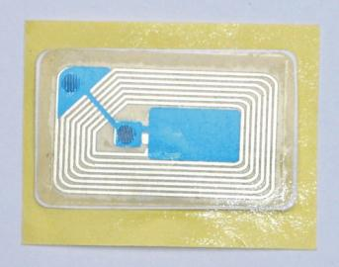
RFID
Radio Frequency Identification Devices ("RFID" tags) are used to track products or their containers, pallets that hold products, and the trucks and trailers that transport products.
For example, when a vehicle needs to be located, a transceiver transmits radio signals to locate the transponder. Since products may be moved in warehouses all the time, an RFID is a good way to find what you need quickly. You have probably seen RFIDs on consumer products such as CDs.

Slide 12
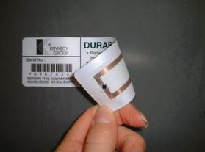
RFID
RFIDs consist of a computer chip attached to a loop of wire and encased in a plastic film. When they pass through a magnetic field, an electrical current is generated in the wire that powers the chip to transmit its identity and potentially other information to an antenna.
Tags can have data written to them that can be read and amended by the antennas. Unlike a barcode, which can only be scanned by a reader pointing directly at it, any antenna within range can read an RFID tag.
In this way, hundreds of tags can be read every second, unlike barcodes that must be read one-at-a-time. This is the key benefit of RFID in relation to multi-item processing applications.

Slide 13
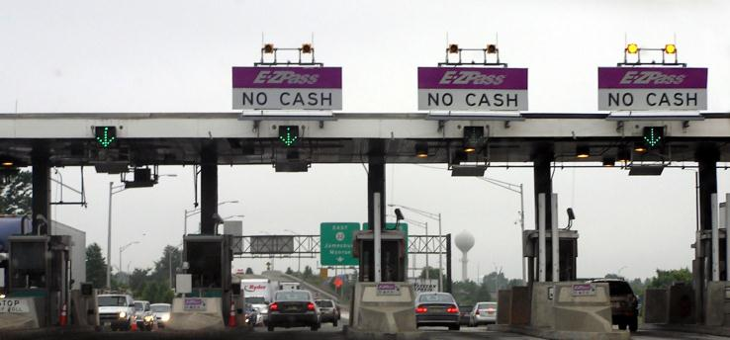
RFID
If you live near a toll road, many prepaid passes are basically RFID tags you attach to your windshield. As you pass by the toll booth, the RFID tag is read and the proper amount of toll is deducted from your account. All without stopping your car.

Slide 14
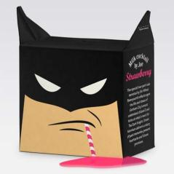
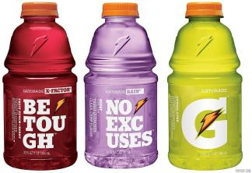
MARKETING
The packaging and labels can be used by marketers to encourage potential buyers to purchase the product. Package graphic design and physical design have been important and constantly evolving phenomenon for several decades.
Marketing communications and graphic design are applied to the surface of the package and (in many cases) the point of sale display.
Notes:
http://www.lushlee.com/images/food/09/7/hattomonkey-design.jpg
http://www.cdn-inc.com/blog/wp-content/uploads/2010/05/gatorade_pepsico_new_packaging_2009.jpg

Slide 15
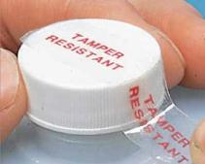
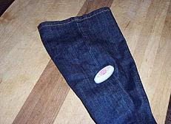
SECURITY
Packaging can play an important role in reducing the security risks of shipment. Packages can be made with improved tamper resistance to deter tampering and also can have tamper-evident^{[10]} features to help indicate tampering.
Packages can be engineered to help reduce the risks of package pilferage: Some package constructions are more resistant to pilferage and some have pilfer indicating seals. Packages may include authentication seals and use security printing to help indicate that the package and contents are not counterfeit.
Packages also can include anti-theft devices, such as dye-packs, RFID tags, or electronic article surveillance^{[11]} tags that can be activated or detected by devices at exit points and require specialized tools to deactivate. Using packaging in this way is a means of loss prevention.
Notes:
http://3.bp.blogspot.com/_osrVjnPbdEM/THog8pjIuzI/AAAAAAAAfFQ/_5n-wUwbl_w/s1600/Annoying_Time-Wasters_2.jpg
http://www.scottkoval.com/images/0.jpg

Slide 16
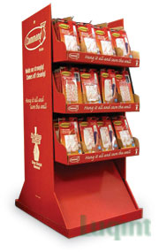
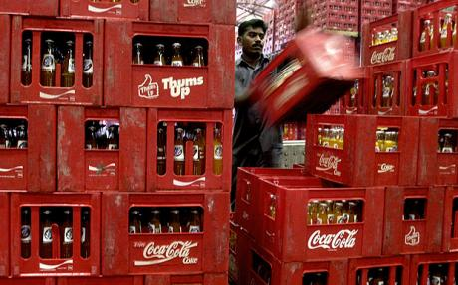
CONVENIENCE
Packages can have features that add convenience in distribution, handling, stacking, display, sale, opening, reclosing, use, dispensing, reuse, recycling, and ease of disposal
Notes:
http://www.wdbiz.net/productimage/90/99613.jpg
http://www.dimensionsguide.com/wp-content/uploads/2010/03/Coke-Case.jpg

Slide 17
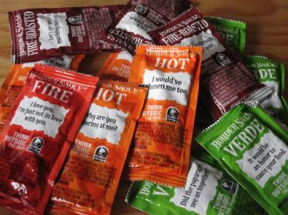
PORTION CONTROL
Single serving or single dosage packaging has a precise amount of contents to control usage.
Bulk commodities (such as salt) can be divided into packages that are a more suitable size for individual households. It is also aids the control of inventory: selling sealed one-liter-bottles of milk, rather than having people bring their own bottles to fill themselves.
Notes:
http://2.bp.blogspot.com/_AAD_EJN_smY/TToFtvRTqSI/AAAAAAAAADI/XDjEKUe9pqI/s1600/Food%2B104.JPG

