Slide 1
6
DISTRIBUTION AND SALES

Slide 2
Distribution and Sales
Where does a product go once it is made? Again, it depends on the product. Products can go to another manufacturer, a wholesaler, a retailer, or directly to the customer.
If one factory makes a specific component, it may then ship the part to the manufacturer of the overall product. The Visteon plant in Bedford, Indiana, for example, makes electronic fuel tank devices for automobiles. Their products are shipped directly to the Ford Motor Company.

Slide 3
Wholesaler or Distributor
A wholesaler, sometimes called a distributor, is a company that purchases large quantities of a product and then sells smaller numbers to a retailer.
The WW Grainger Company is an example of a wholesaler. Grainger has stores throughout the United States, including several locations in Indiana. They sell all types of industrial supplies.
They purchase large quantities of electric motors, tools, shop equipment, electrical supplies, etc. directly from the manufacturers. Then they resell the items to other businesses in lower quantities at a profit. The general public cannot purchase from a wholesaler.

Slide 4
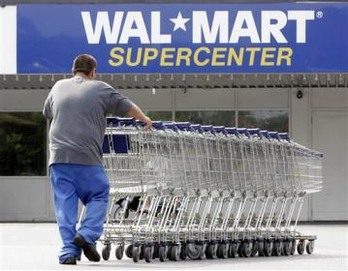
SALES
RETAIL
Retailers are the stores that sell products directly to the customer. Some examples of retailers are Wal-Mart, CarQuest, Foods Plus, Bigfoot, Goody's and Radio Shack.

Slide 5

SALES
DIRECT ORDER
Consumers can sometimes order directly from the manufacturer. For example, some computers, such as Dell can be ordered, manufactured, and shipped directly from the factory to the consumer
Notes:
Dell.com

Slide 6
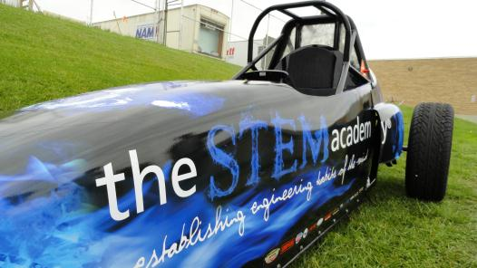
SALES
SALES PROMOTION
To promote sales, manufacturers will usually advertise their products.
For consumer products, television, newspaper, magazine, and Internet ads are often used. Even the sides of some vehicles, such as trucks and buses, display ads to catch the eye of consumers.

Slide 7

SALES
SALES FORCE
Salespeople are employed by many companies. They are sometimes called manufacturer representatives, or sales representatives.
A sales rep. may represent many different companies at once, and sell several product lines. Sales representatives are usually paid a commission. In other words, the more they sell, the more they are paid.

Slide 8

SALES
SALES FORCE
Many companies will hire an experienced sales force to visit other manufacturers and wholesalers to persuade them to use their products.
Some companies have a staff of one or more salespeople who work for only that company. Although they are sometimes paid a commission, these salespeople are usually paid a salary.

Slide 9


