Slide 1
SAFETY

Slide 2
Manufacturing safety
While industrial robots can often be used for dangerous jobs and to handle dangerous materials, safety is still of the highest importance in manufacturing plants. The Occupational Safety and Health Administration (OSHA) was created by the Federal government and is part of the U.S. Department of Labor. OSHA makes safety rules called safety standards for the workplace.
Manufacturers are required by law to follow these rules that OSHA sets up. OSHA makes unannounced visits to factories to carry out inspections to determine if the safety rules are being followed. If violations are discovered, the manufacturer is fined.

Slide 3
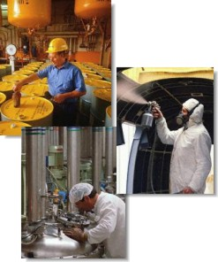
OSHA provides training for factory inspectors and factory workers.

Slide 4
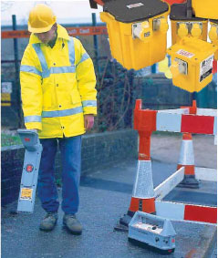
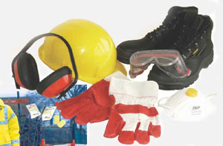
Manufacturing safety
Most work places today have safety managers. Part of their job is to monitor the work place for safety hazards, keep safety records, and train other workers in safe practices. To reduce injuries, workers are required to wear safety equipment. Safety glasses, hard hats, and steel-toed shoes are commonly required. Most factories today are very safe places to work.

Slide 5
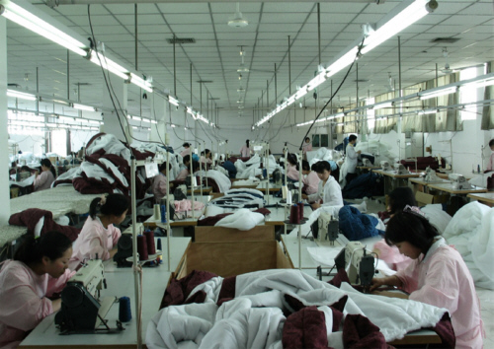
Workers who perform the same task all day long can develop repetitive motion injuries. To reduce the risk of this happening, workers are often rotated through several different jobs each day.

Slide 6
Manufacturing safety
SAFETY MESSAGES
Color | Meaning
Red | Danger or emergency
Orange | Be on guard
Yellow | Watch out
White | Storage
Green | First Aid
Blue | Information
Below is a chart that shows colors that signal safety messages. A safe work environment is necessary for an efficient manufacturing system.

Slide 7
Always remember:
SAFETY IS #1

Slide 8


