Slide 1
Introducing manufacturing a Brief look

Slide 2
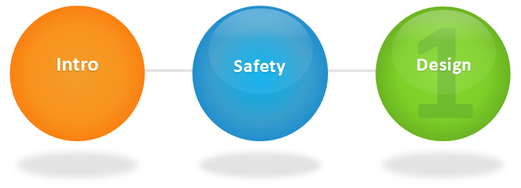
Manufacturing Outline
Steps in Learning Manufacturing

Slide 3
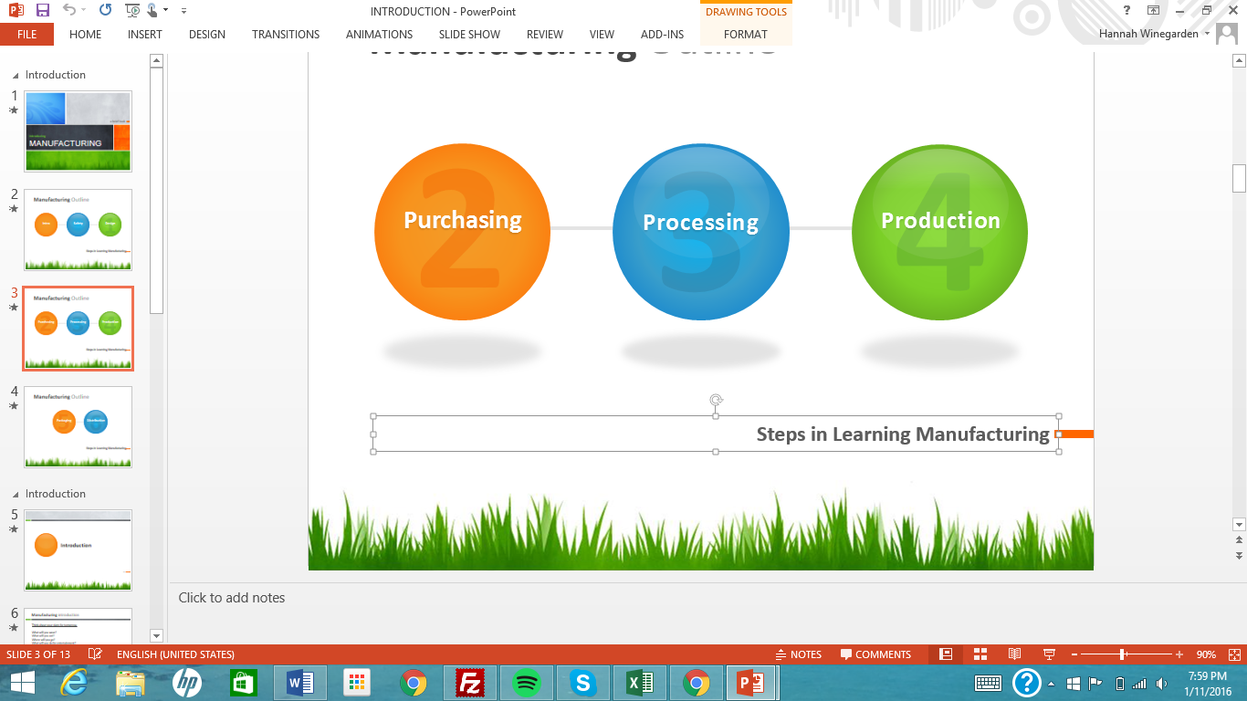
Manufacturing Outline
Steps in Learning Manufacturing

Slide 4
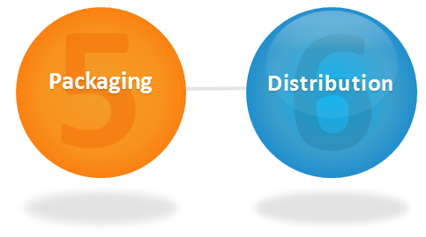
Manufacturing Outline
Steps in Learning Manufacturing

Slide 5
Introduction

Slide 6
Manufacturing introduction
Think about your plans for tomorrow.
What will you wear?
What will you eat?
Where will you go?
What will you do for entertainment?
Your clothing, many of your favorite foods, and the television you watch all have something in common. Can you guess what it is?
They are all products of manufacturing.

Slide 7
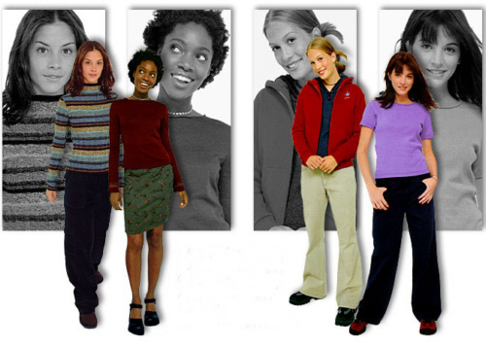
Manufacturing introduction
Teen fashion is a huge industry.
Of course, almost all clothing is a product of manufacturing.

Slide 8
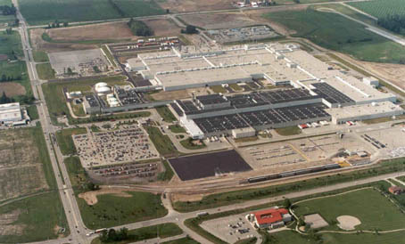
Manufacturing introduction
What is manufacturing?
Manufacturing is the changing of raw or processed materials into usable products. Manufacturing occurs in manufacturing plants, or factories.
Factories like the one pictured below are buildings where many of the products you use and own are made.
A Modern Manufacturing Complex

Slide 9
Manufacturing introduction
Today's manufactured items are either consumer products or industrial products.
What are consumer products? Consumer products are purchased by consumers like you and me and "used up." Consume means to use up. Televisions, cereal, clothing, and books are some examples of consumer products.
What are industrial products? Industrial products are purchased by industries and used to make other products. Lumber, steel beams, and machine tools are examples of industrial products. For example, a furniture manufacturer might buy lumber. A bridge builder might buy steel beams.

Slide 10
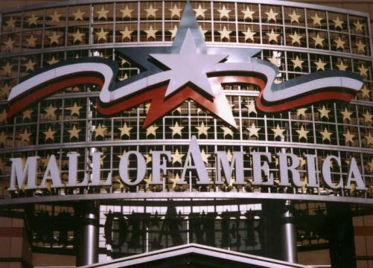
Manufacturing introduction
Shopping malls like the Mall of America in Bloomington, Minnesota are full of consumer products like clothing, hardware, electronics, and toys.

Slide 11
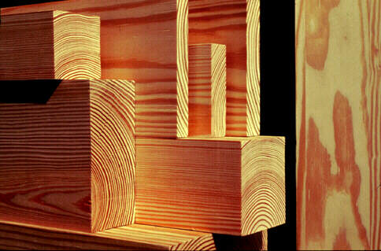
Manufacturing introduction
A common industrial product, lumber is used to manufacture other products such as furniture, cabinets, paneling, and flooring.

Slide 12
Manufacturing introduction
While products vary, the manufacturing processes are similar. Manufacturing is a system. A system is an organized way of achieving a goal. Like all technology systems, manufacturing needs resources.
These resources are People, Information, Materials, Tools and Machines, Energy, Capital, and Time. All tasks, from sharpening a pencil to manufacturing a jumbo jet require these same seven resources.
There are also seven parts to a manufacturing system. They are:
1. Designing a product
2. Purchasing materials
3. Processing materials
4. Production
5. Packaging
6. Distribution
7. Sales

Slide 13


