Slide 1
Manufacturing and Design

Slide 2
ENGINEERING DESIGN. To create, fashion, execute, or construct according to plan.
THE DESIGN PROCESS. Practicing engineers do not follow a single uniform approach to engineering design.
SIGNIFICANT FACTORS. Design is a process used by engineers to generate products, processes, and systems based on the recognition of a need.

Slide 3
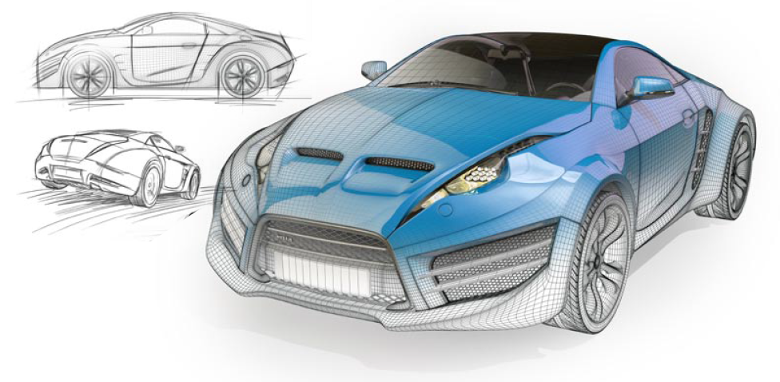
Engineering design is the process of devising a system, component, or process to meet desired needs.
It is a decision-making process.

Slide 4

THE DESIGN PROCESS
Some firms approach engineering design as a short, simple process with only a few steps.
Others use a more complex, multi-step method with several stages.

Slide 5
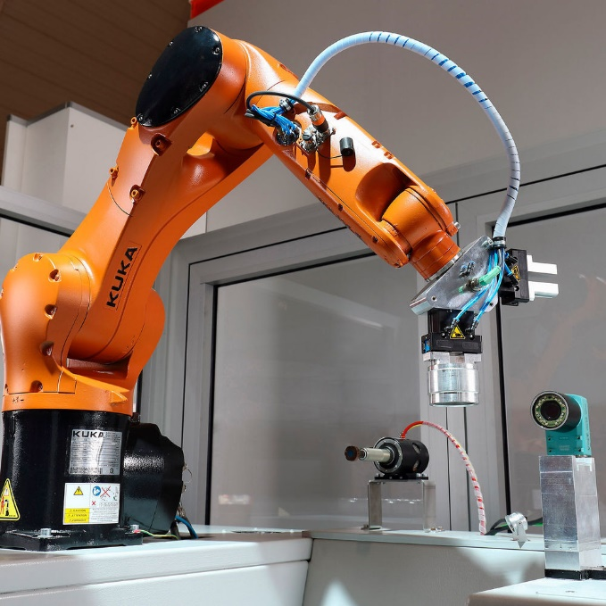
RESEARCH
Having good, reliable background information is necessary for the team to begin exploring all relevant aspects of the problem.
Team members must determine what information will be needed and the best sources of that information.

Slide 6

The basic concept is to develop as many potential, creative solutions to the problem as possible.

Slide 7
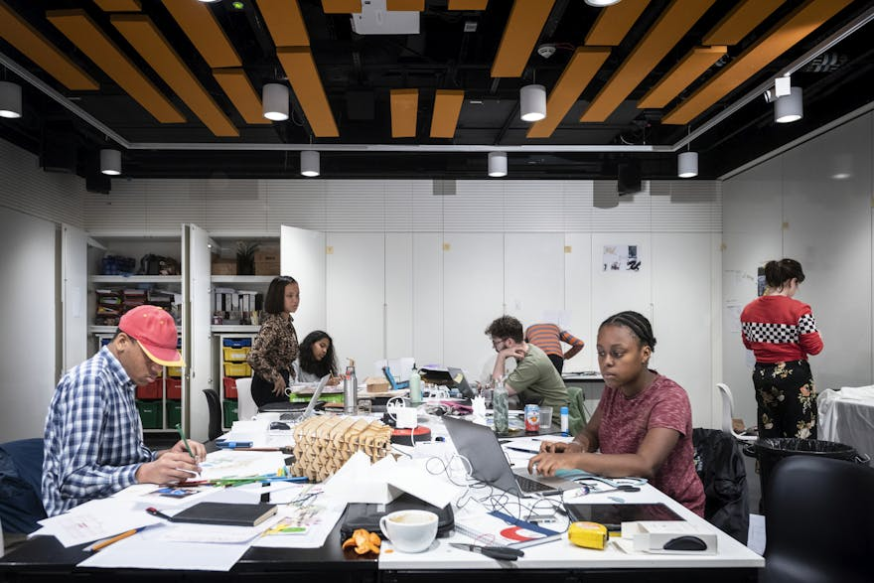
Take your ideas and analyze potential solutions
Design and Model potential solutions. Three is a good number.
Some types of modeling are: descriptive, functional, mathematical, computer, scale, and diagram/graphical.

Slide 8
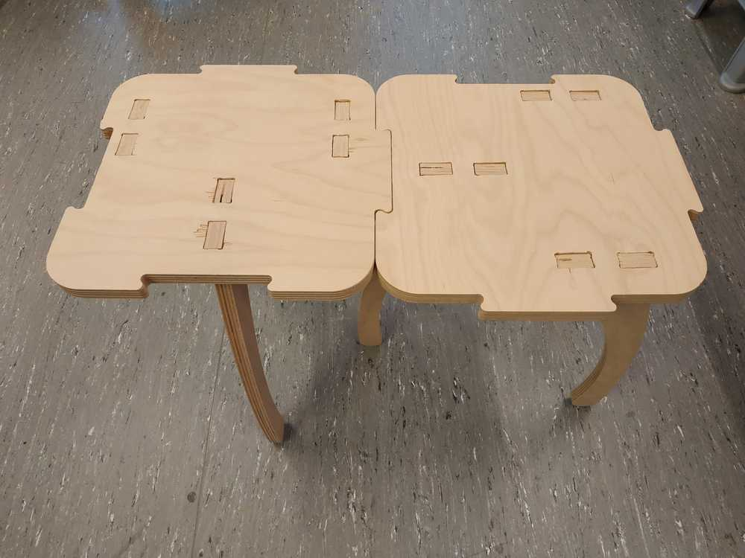
MODEL TESTING
Performing various tests on each of the models allows for comparison and evaluation.
Examples of testing are:
  Durability
  Ease of Assembly
  Reliability
  Strength
  Functionality
  Environmental Consideration
  Quality and Consistency
  Safety
  Consistency of Testing
  Ergonomics

Slide 9

COMMUNICATE AND SPECIFY
Complete and thorough communication is critical before a part, product, or structure can be manufactured.
Diagrams, drawings and sketches, computer printouts, charts, graphs, and any other relevant and documented material will be presented.

Slide 10

SIGNIFICANT FACTORS
FUNCTIONALITY
  The product or solution must fulfill its intended purpose.
QUALITY
  The product or solution must be designed to meet certain minimum standards.

Slide 11
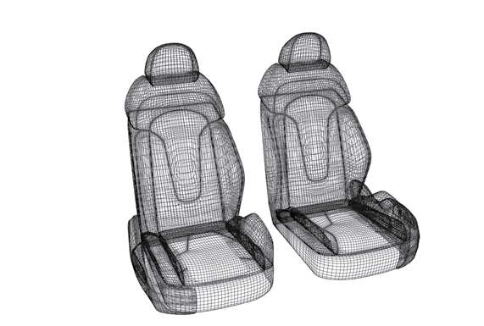
SIGNIFICANT FACTORS
SAFETY
  The product must be designed to comply with codes and regulations to provide safe user operation.
ERGONOMICS
  The product must be designed so the user can operate it with ease and maximum efficiency.

Slide 12

SIGNIFICANT FACTORS
APPEARANCE
  The appeal of a product to a customer may be based on the selection of materials, processes, finish, color, or shape.
ENVIRONMENTAL CONSIDERATION
  The product must be designed so it does not adversely affect the environment.
ECONOMICS
  The product must be produced at the lowest cost without sacrificing safety or effectiveness.

