Slide 1
manufacturing and engineering

Slide 2
This unit will define some of the important “soft skills” or “interpersonal skills” non-technically-oriented characteristics people and employers desire. It will also explain what engineers do.

Slide 3

KEY SKILLS
You should:
Communicate clearly with supervisor and others
Act professionally
Learn effectively
Manage self responsibly
Plan for change (flexibility and adaptability)
Plan for personal and professional growth
Work productively
Recognize safe and unsafe work habits
Demonstrate proper safety procedures
Maintain a safe and healthy work environment

Slide 4

BE ON TIME
It is very important to be on time and to stay on schedule. This critical workplace issue is often overlooked.
Your responsibility is to be on time and having the materials needed to get the job done.

Slide 5

COMMUNICATE EFECTIVELY
A successful person will develop the ability to communicate well with others.
The ability to negotiate, to effectively make your case, to make clear presentations, to use appropriate body language, and to understand cultural differences are all valuable skills.

Slide 6

THINK OUTSIDE THE BOX
An engineer must be able to think logically, of course, but an engineer must also learn to be creative, and innovative, developing new means of looking for solutions to problems.
What if that box is a “sphere”?

Slide 7

HAVE A POSITIVE ATTITUDE
Have a positive attitude, a love for their job, and an ability to work alongside others.
Be excited about projects.
Become involved with the details.
Have a willingness to learn.

Slide 8

TAKE EDUCATED RISKS
Be comfortable asking, “What happens if? How would this work?”
Take educated risks that make sense, not risks that are long shots or that might have very bad consequences.

Slide 9

UNDERSTAND BUSINESS AND FINANCE
Many companies want their employees to have a solid understanding of business and finance as well as the ability to explain what they are doing throughout a project to people that are not necessarily engineers.

Slide 10

BE A LIFELONG LEARNER
As standards, practices, and the wants, and needs of society change and evolve, so must you and your company.
If the employees in a company do not stay up to date, it can hurt a company’s long-term success.

Slide 11

UNDERSTAND CONFLICT RESOLUTION
Conflict resolution can help you navigate those tough times when group members have issues with each other.
Everyone must consider the interests and suggestions of other people while working on a team.

Slide 12

WORK WELL WITH OTHERS
People who work with each other need not be best friends, but they might develop strong relationships.
Co-workers who do not get along with each other for personal reasons still must determine how to work well together no matter their feelings.

Slide 13

TAKE CRITICISM
You do not have to like what you hear, but you must be receptive to others comments, evaluate the comments made, and make a decision on whether to alter the area of question or not.
Constructive criticism can provide essential feed-back and help you improve your performance.

Slide 14

SENSE TENDENCIES
This is an attempt to develop the ability to “read” unspoken clues in other team members - their hidden signals and body language.

Slide 15

AVOID SARCASM
Sarcasm should never be used in a business or professional setting where people do not know each other well.
Even if the group discussion has only one unfamiliar person, be professional.

Slide 16

BE FLEXIBLE AND OPEN
A person must be able to adapt and improvise if necessary, which includes respecting another culture and its customs.
Staying open to new ideas and alternative perspectives may lead you to solutions and ideas you may not have developed on your own.

Slide 17

USE GOOD WRITTEN AND ORAL COMMUNICATION SKILLS
This may take the form of an e-mail to a supervisor, a technical memo, a presentation to a group of engineers and technicians, or even a formal presentation to a group of directors or executives.

Slide 18

NETWORK WITH OTHERS
Networking is a term that describes the ability to find opportunities and or meet new contacts by working through “chains” or “webs” of people you know.

Slide 19

HAVE SELF-DISCIPLINE
You will need to develop good time management, punctuality, and preparation and organizational skills.
As you acquire and develop these skills, you will find that you can apply them to many different situations, which in turn makes you more productive and successful.

Slide 20

INTERACT SOCIALLY
Your involvement in various social activities and organizations can be good preparation for future professional interactions.
Employers look for people who have activities in their lives out-side work.

Slide 21
WHAT DO ENGINEERS DO?

Slide 22
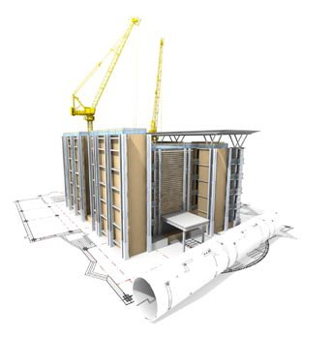
RESEARCH
The role of the engineering researcher is the closest to that of a scientist of all the engineering functions.
Engineering researchers differ from scientists in that they are interested in the application of a breakthrough, whereas scientists are concerned with the knowledge that accompanies a breakthrough.

Slide 23

DEVELOPMENT
Development engineers bridge the gap between laboratory research and full-scale production.
Development engineers are always looking for ways to include researchers’ findings into test products to test their likelihood for use in new products.

Slide 24
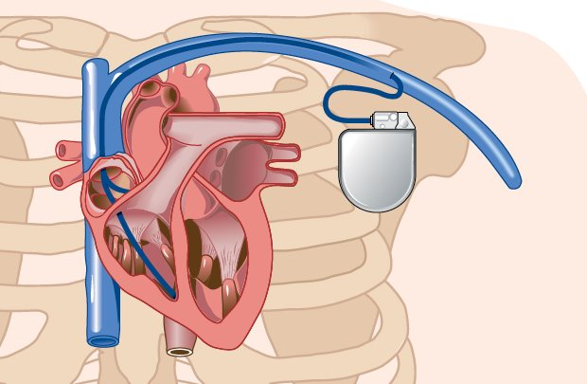
TESTING
Test engineering involves designing and implementing tests to verify the integrity, reliability, and quality of products before they are introduced to the public.

Slide 25

DESIGN
The design function is what many people think of when they think of engineering, and this is the focus of the largest number of engineers.
The design engineer is responsible for providing the detailed specifications of the products society uses.

Slide 26

ANALYSIS
Analysis is an engineering function performed in conjunction with design, development, and research.
Analysis engineers use mathematical models and computational tools to provide the necessary information to design, development, or research engineers to help them perform their function.

Slide 27

SYSTEMS
Systems engineering involves working with the overall design, development, manufacture and operation of a complete system or product.
Systems engineers are responsible for the integration of the components and systems into a functioning product.

Slide 28
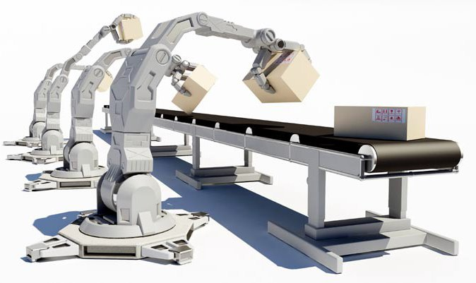
MANUFACTURING AND CONSTRUCTION
Manufacturing and Construction engineers work with diverse teams of individuals, from technicians on the assembly lines to management, to maintain the integrity and efficiency of the manufacturing process.

Slide 29
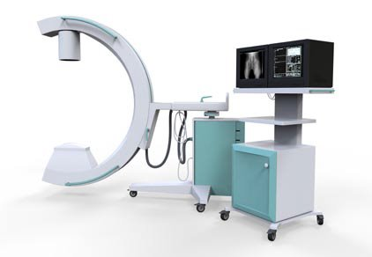
OPERATIONS AND MAINTENANCE
The engineer involved in operations engineering oversees the ongoing performance of the facility.
Operations and Maintenance Engineers must be able to interact with manufacturing engineers, line workers, and technicians who service the equipment.

Slide 30

TECHNICAL SUPPORT
An engineer involved in technical support serves as the link between customer and product and assists with installation and setup.
The technical support engineer may troubleshoot a product’s problems.

Slide 31

SALES
Engineers are valuable members of the sales force in numerous companies.
These engineers must have interpersonal skills conducive to effective selling.

Slide 32

CONSULTING
Engineers who provide consulting are self-employed or work for a firm that does not provide goods or services directly to consumers.
Many large companies do not have technical experts on staff in all areas of operation. Instead, they use consultants to handle issues in those technical areas.

Slide 33

MANAGEMENT
Engineers may manage other engineers or support personnel, or they may rise to oversee the business aspects of a corporation.
Prior to being promoted to this level of management, engineers may acquire some business or management training.

Slide 34

Common reasons for students to be interested in engineering include the following:
They like math and science.
A school counselor suggested it.
They have a relative who is an engineer.
They heard the field has great job opportunity.
They read that engineers make a lot of money.
They always took things apart when they were younger.
They like to build things

