Slide 1
Advances in medical technologies

Slide 2
Look Around. Count the people with…
Glasses
inhalers
mobility aids (wheelchair, crutches, etc)
braces
Notes:
All of these are medical technologies you might encounter every day. Some of them have been around relatively unchanged for decades, others have had major improvements in the past year. Many times other fields and technologies are brought together for the advancement of medical tech.

Slide 3
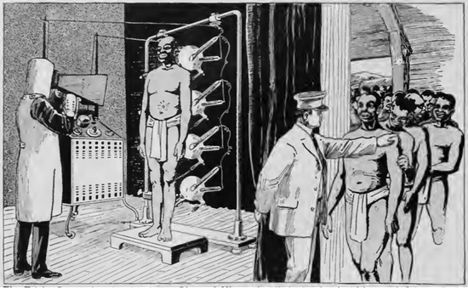
Diamond Smugglers
Notes:
In a south african diamond mine in 1919, there was a problem with people smuggling diamonds out of the mine. People swallowed them, and even stored them in self-inflicted incisions in their bodies. With a quick radiation-laden scan at the end of a shift, the presence of a diamond, or lack thereof, could be quickly discovered.
http://d1435t697bgi2o.cloudfront.net/wp-content/uploads/2013/02/1919-electrical-experimenter-xray-diamond-sm.jpeg

Slide 4
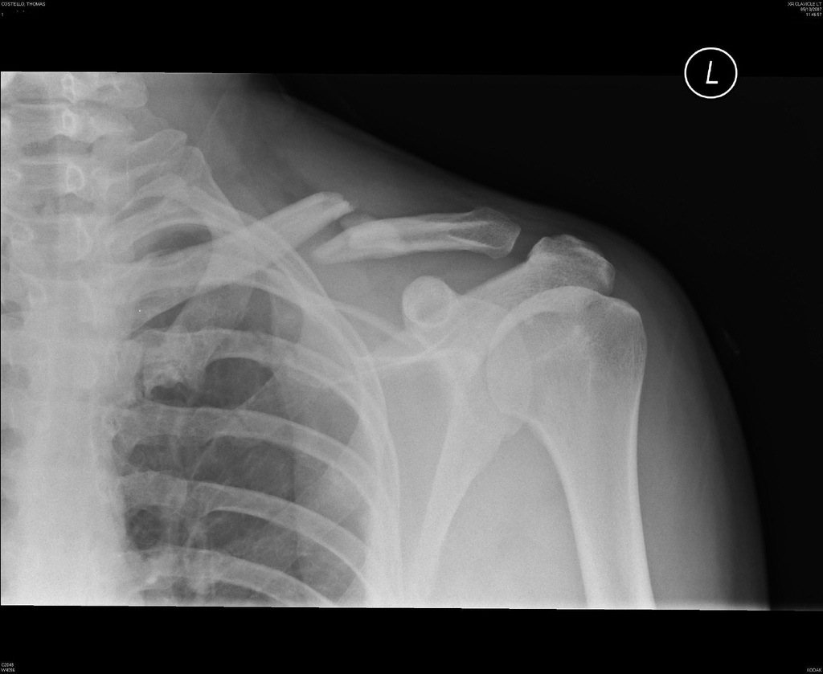
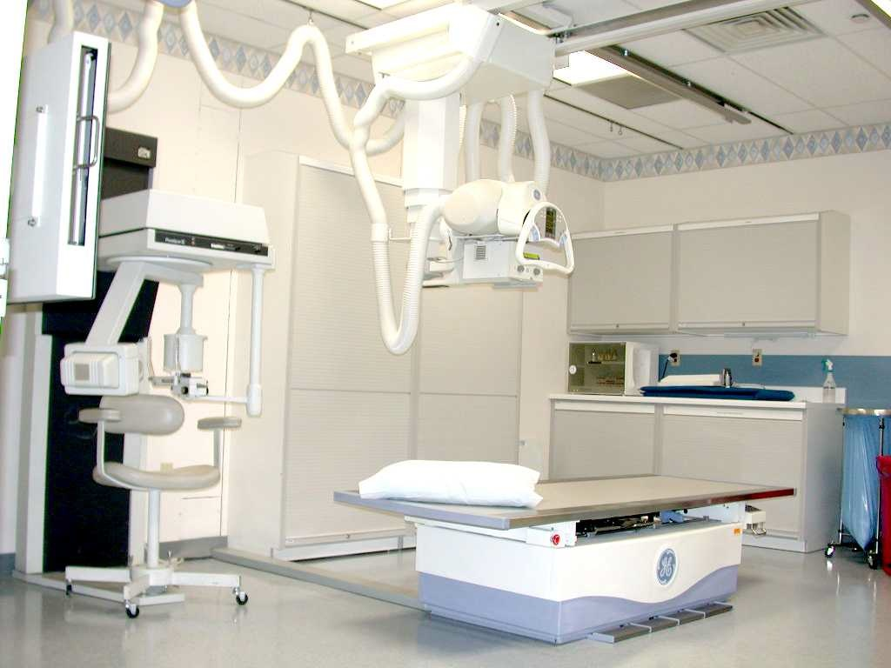
The Modern X-Ray
Notes:
This technology of detecting diamond thieves has become adapted to pinpoint and identify bone breaks and fractures. This has become an incredibly useful thing.
http://swanseagroup6.files.wordpress.com/2010/08/x-ray_machine.jpg
http://www.bike198.com/wp-content/uploads/2008/11/collar-bone-xray.jpg

Slide 5
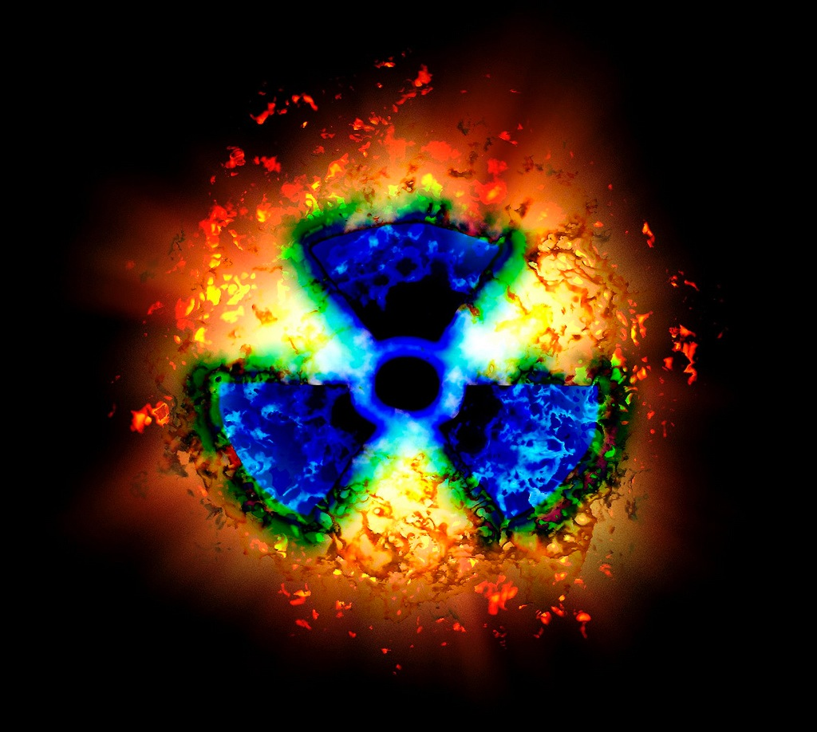
Diamond Smugglers
That benefit came with a price.
Notes:
Radiation is a buzzword to the core, and not without good reason. The radiation those diamond miners were exposed to ended up being harmful to them, they later discovered. Walter James Dodd, H.D. Hawks, Nikola Tesla, and Thomas Edison, all X-ray experimenters, were harmed by the radiation they exposed themselves to in their experiments. Modern X-ray machines were designed with this danger in mind, so you needn’t worry about getting radiation poisoning from going to the doctor, but it is valuable to recognize the sacrifices made by the pioneers of this technology.
http://www.organicsurvivalistsite.com/wp-content/uploads/2011/03/Radiation-Symbol.jpg

Slide 6

HIV
Human Immunodeficiency Virus
Notes:
Human Immunodeficiency Virus is a squirrelly virus that attacks the body’s natural defenses against infections and allows other nasty viruses and cancers to get going.
http://www.lgbtqnation.com/assets/2013/04/HIV.jpg

Slide 7

Bee Venom and HIV
Students at Washington University School of Medicine found nano particles with bee venom will destroy HIV cells and leave surrounding cells unharmed.
Notes:
Talk about unrelated fields. A bee’s natural defense venom has been found to destroy HIV virus, which will be extremely useful in areas HIV is currently running rampant, such as sub-saharan Africa.
http://www.hivplusmag.com/sites/hivplusmag.com/files/Beex400_HIVPlusMag.jpg

Slide 8
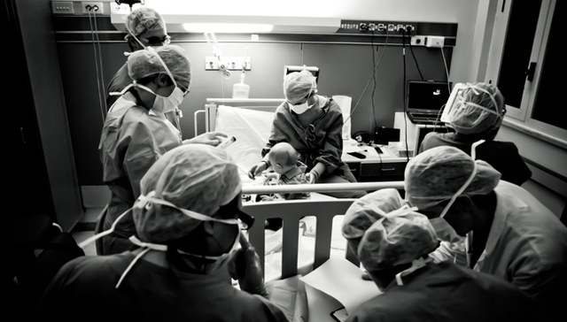
On the Flip Side…
HIV As a Cure?
Notes:
Definitely an almost novel approach to the virus, recently researchers in Italy have used modified versions of HIV to cure very serious genetic diseases in 6 children. This is a very young approach, but the possibilities unlocked by harnessing one of the most infectious diseases for our benefit are immense.
http://cdn3.vox-cdn.com/entry_photo_images/8571927/aids_large_verge_medium_landscape.jpg

Slide 9

Diabetes
Too much glucose in the blood
Notes:
Diabetes refers to the group of diseases that mess with the amount of glucose in your blood (commonly called blood sugar). Frequently, the problem lies with your body’s use or production of the hormone insulin, which allows your body to use glucose for energy or to store it for future use, and regulates the amount of glucose in your blood.
http://lipitorlawsuit.co/wp-content/uploads/2013/11/diabetes.jpg

Slide 10
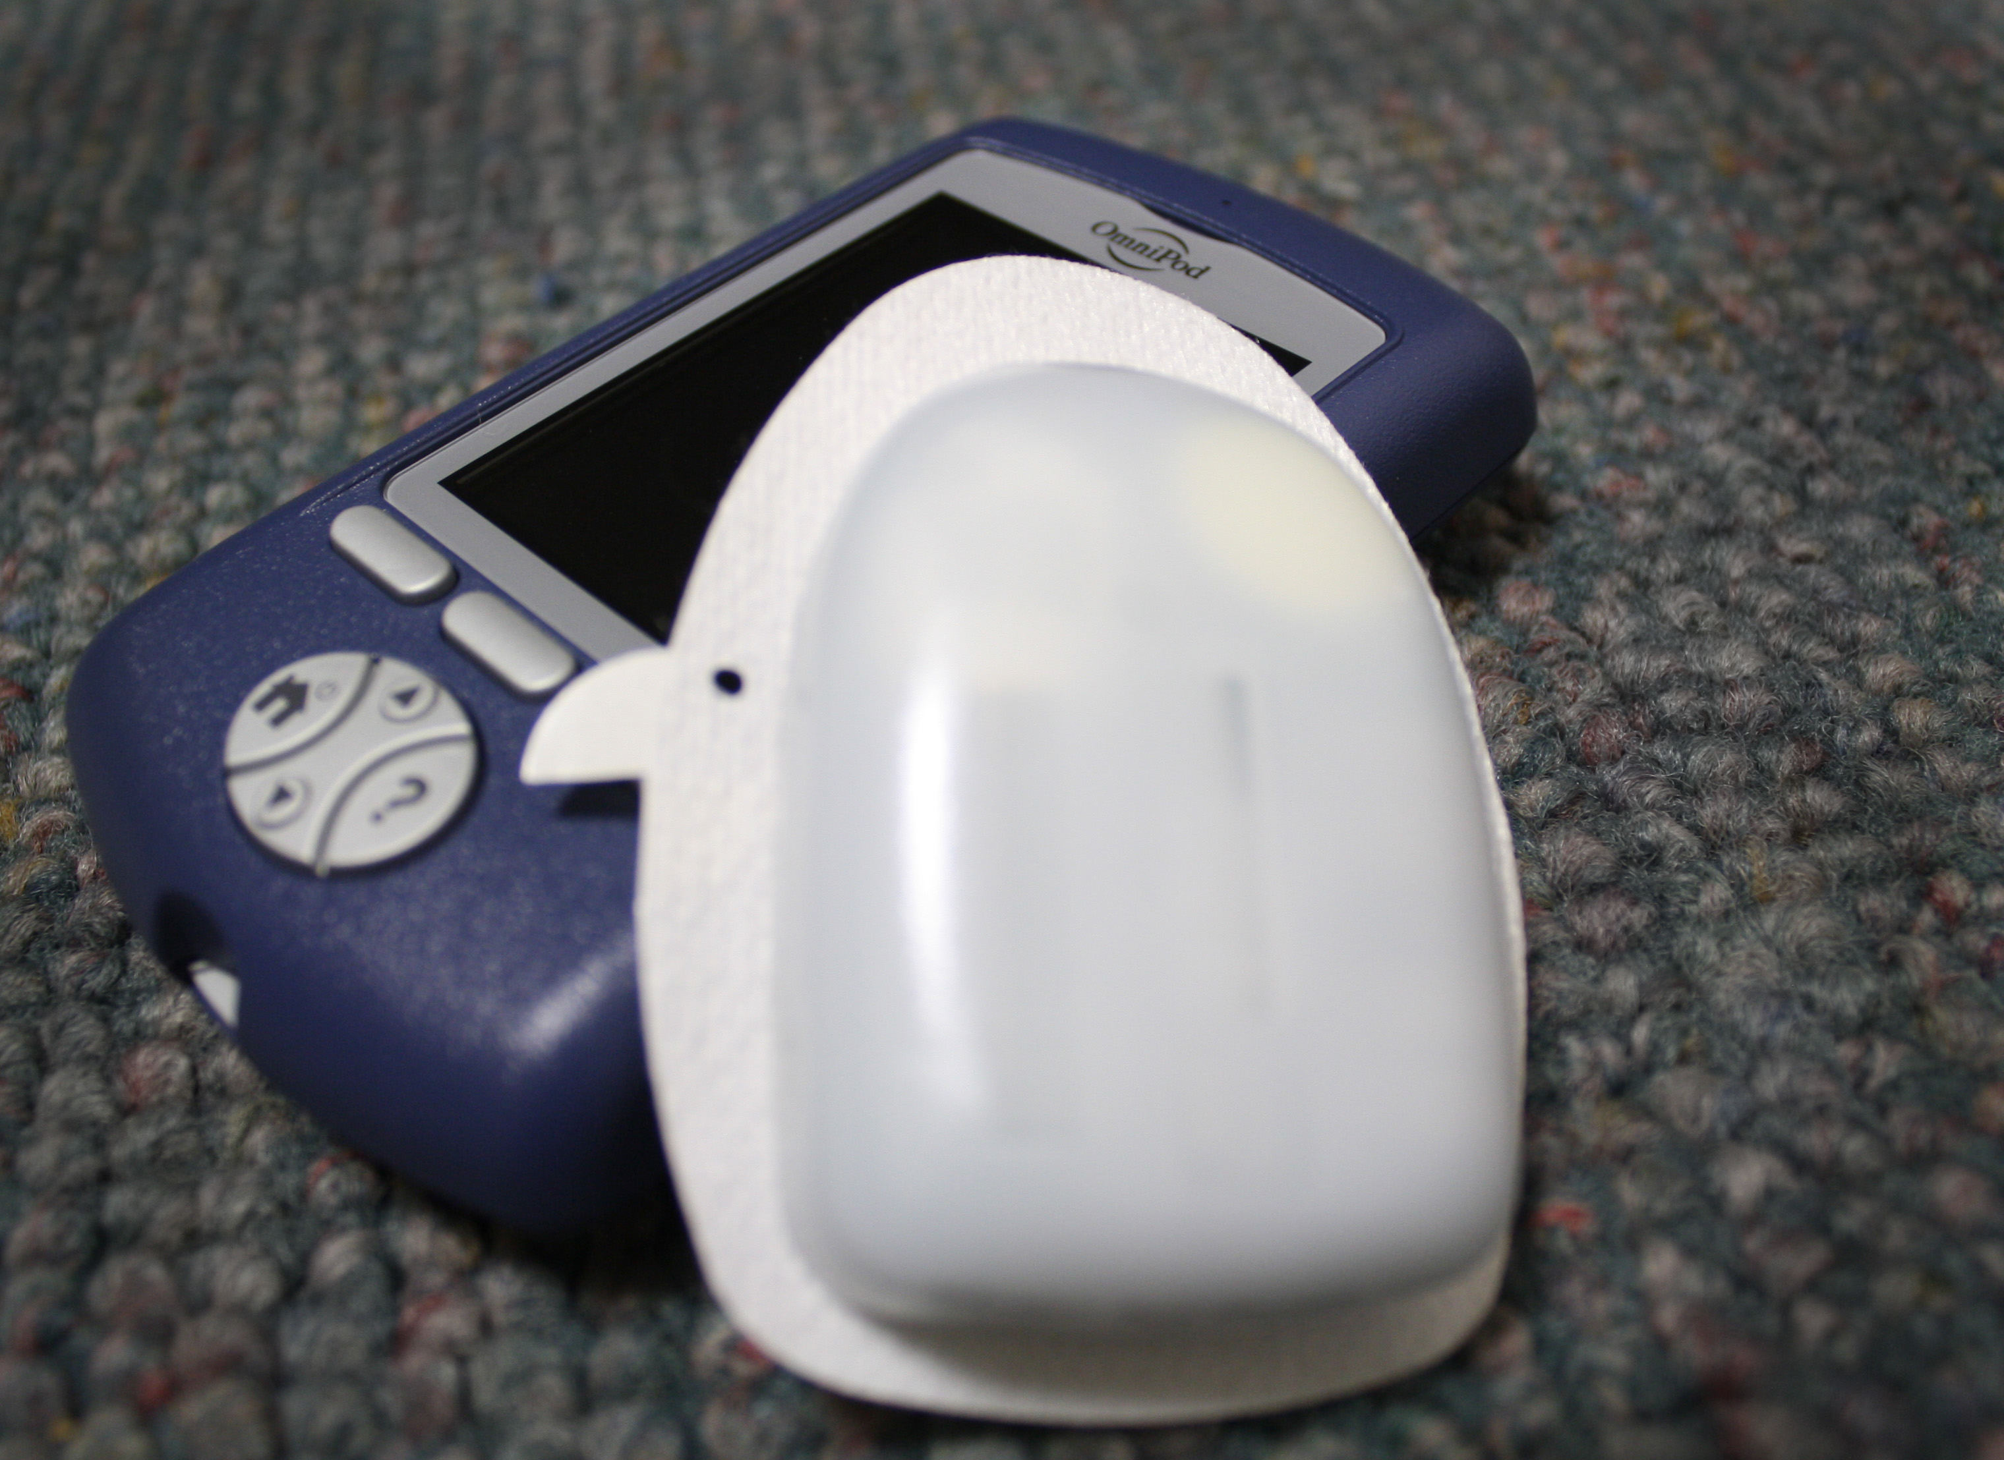
Insulin Pumps
A giant leap forward
Notes:
Since diabetes patients require high frequency injections of insulin to remain functional in society, often as much as 3 times a day, there has recently been a surge of innovation in portable monitors and insulin pumps. You take a blood sample from the tip of your finger, and the blue portable device takes a reading of your current blood sugar level. Then, it wirelessly and automatically updates the white pod, which sticks to you and has a little needle on the other side of it. The white pod contains insulin and will automatically give you the proper amount. Pretty cool.
http://blog.joslin.org/wp-content/uploads/2012/01/omnipod-005.jpg

Slide 11
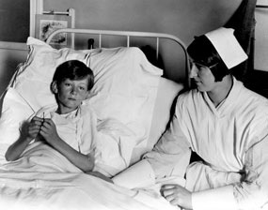
Healthcare: Then
Notes:
Within the last hundred years, most of medicine was primarily diagnostic. This means doctors and physicians would try to figure out what was specifically wrong with you, but had no real means of combating or fixing said problem.
http://www.wsna.org/Centennial/1920s/images/1920-2.jpg
http://www.medicalwebexperts.com/blog/wp-content/uploads/2012/11/doctors.jpg

Slide 12

Healthcare: Now
Notes:
Due largely to many innovations and developments in medical technology, medical care has evolved into being much better at detection, identification, and treatment of all kinds of medical problems.
http://www.medicalwebexperts.com/blog/wp-content/uploads/2012/11/doctors.jpg

