Slide 1
Genetic engineering

Slide 2
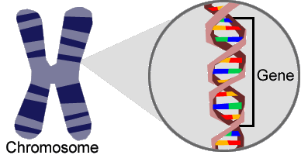
What are genes?
DNA is a really long strand of proteins that serve as instructions for the cells in your body.
A segment of the strand that pertains to a specific trait (like brown hair) is a gene. Many many genes group together to form a chromosome.
Notes:
http://people.wku.edu/darlene.applegate/introtobiological/project1/gene_on_chromosome.gif

Slide 3
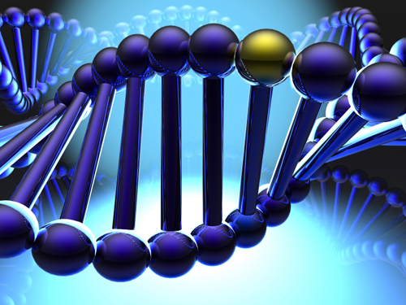
Why do genes matter?
Notes:
Since genes are partially responsible for who we are, the ability to change a gene or take desirable traits and move them around can have incredible implications.
http://www.geneticliteracyproject.org/wp/wp-content/uploads/2012/11/genetherapyjon.jpg

Slide 4
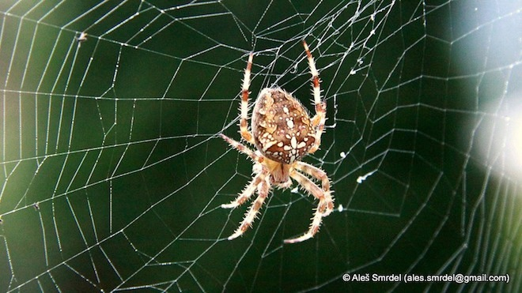
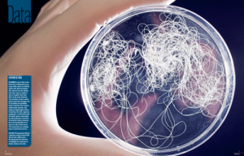
A Practical Example
Using E. Coli to make spider silk
Notes:
Take, for example, spider silk. Look at that fat scary looking spider being held up by its web. Its an intensely heavy load given how little web material there is.
What if we could take the gene responsible for spider silk production in any old spider and put it in
http://rosecreekvillage.com/shammah/wp-content/uploads/2011/09/discover-mag-synthetic-spider-silk-300x192.png
http://www.wired.com/images_blogs/wiredscience/2013/09/8026707769_258f948bee_c.jpg

Slide 5
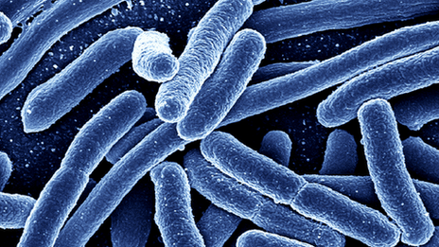
E. Coli Again
This time with insulin
Notes:
Again proving itself useful, e. coli is also being used to produce human-like insulin for diabetes sufferers. Until e. coli was used, people used insulin from pigs, which didn’t work as well for humans as it could cause the development of allergies.
http://news.bbcimg.co.uk/media/images/53234000/gif/_53234379_escherichia-coli.gif

Slide 6
Think About It…
If you could modify someone or something’s genetic makeup, what would you change?

