Slide 1
Sanitation in medicine

Slide 2
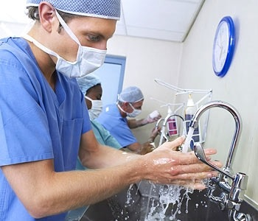
Why do doctors wash their hands so much?
Notes:
So you’ve been to the doctor’s office, at least a few times in your life for immunizations, regular checkups, or maybe to check out some unusually bad cold or if you got a concussion or something. You’ve noticed most hospital’s doctors have lotion at their desk, along with either a sink and soap or a bottle of hand sanitizer waiting at the ready. It might seem extreme, you wash your hands after you go to the bathroom or after you touch something notably dirty, but outside of that you’re pretty much clean. Right? Wrong.
http://blu.stb.s-msn.com/i/FA/5CE6739C5D41E554378738FBF1931B_h300_w350_m2_bblack_q99_p99_cDVZkhXUN.jpg

Slide 3
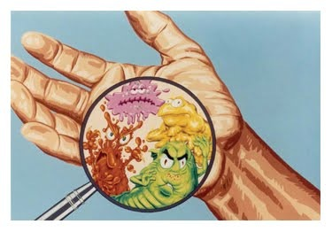
Hands are dangerous
Notes:
Even doctors who have very clean hands and wash them so frequently every room needs to have moisturizing lotion spread disease through their hands. This is especially true when they’re frequently around sick people who’s immune systems are already compromised.

Slide 4
Hospital procedures:
Before touching a patient
Before a procedure
After a procedure
After touching a patient
After touching a patient’s belongings or surroundings
After using the restroom
Notes:
Generally, a hospital will stipulate that any hospital staff must wash hands if any of the shown situations occur.

Slide 5
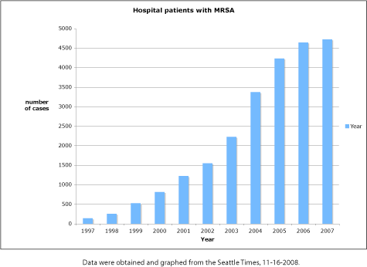
Exactly how necessary is this?
Notes:
Very necessary. The above graph shows a trend in the number of MRSA, or
methicillin resistant staphylococcus aureus, infections. This may not be too scary, if it wasn’t for the fact that 6 out of 7 people get that infection in some kind of health care facility (Seattle Times). Additionally, hospital acquired infections kill more americans every year than AIDS, breast cancer, and auto accidents combined. (http://www.lawyersandsettlements.com/lawsuit/hospital-infection.html?opt=b&utm_expid=3607522-6.CQR-xUqRR1-q6QXM5ItyxA.1&utm_referrer=http%3A%2F%2Fwww.google.com%2Furl%3Fsa%3Dt%26rct%3Dj%26q%3D%26esrc%3Ds%26source%3Dweb%26cd%3D6%26ved%3D0CFsQFjAF%26url%3Dhttp%253A%252F%252Fwww.lawyersandsettlements.com%252Flawsuit%252Fhospital-infection.html%26ei%3DoiWXU77THcKGyASqxYBo%26usg%3DAFQjCNFJSYG2HVkvSAsSv6MtZPwwsgmjQA%26sig2%3Dm7T9Gjj5nhyY53ynlFGIFQ%26bvm%3Dbv.68445247%2Cd.aWw#.U5clyy8WfGo)
http://scienceblogs.com/digitalbio/wp-content/blogs.dir/460/files/2012/04/i-399081440f526e1f98738c0efaec9f76-mrsa-cases.gif

Slide 6

A Responsibility Shift
Notes:
Until 2004, hospital acquired infections were thought to be mostly unavoidable. However, as more information is collected about them, it seems like many instances are avoidable, and hospitals are starting to be held accountable for malpractice.
http://www.radicalmentoring.com/wp-content/uploads/2014/02/responsibility.jpg

Slide 7
Is this a good thing?
Should hospitals be held accountable for hospital acquired infections?
Notes:
This is a kind of question you’ll need to ask yourself about many things throughout your life and professional career. Is this good? Some might argue that when people go to the doctor to get healthy they shouldn’t have to live in fear of becoming terminally ill. Others might argue that attacking the hospitals too much cripples them and robs them of their caregiving ability.
Have students consider and discuss their opinions on this.

