Slide 1
Vaccine technology

Slide 2
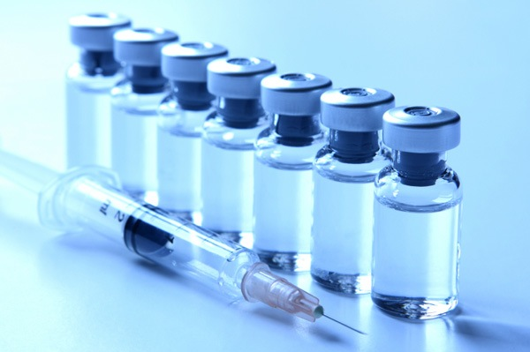
What is a vaccine?
a substance used to stimulate the production of antibodies and provide immunity against one or several diseases, prepared from the causative agent of a disease, its products, or a synthetic substitute, treated to act as an antigen without inducing the disease.
Notes:
In simplified terms, a vaccine is a weakened, dead, or fake copy of a disease that causes your body to prepare to fight that particular disease off. Vaccines are often required for travel between countries, and for attending public schools.
http://consciouslifenews.com/wp-content/uploads/2013/03/vaccine-bottle-syringe.jpg

Slide 3
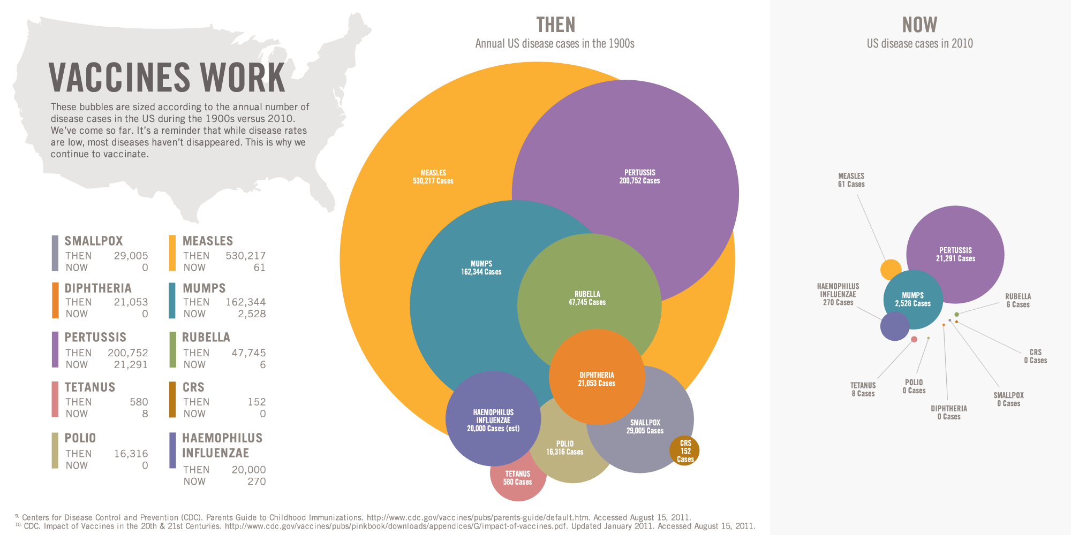
Why Immunize?
Notes:
Despite recent controversy, there is a clear association between vaccines and a reduction of cases of disease.
http://sciencebasedpharmacy.files.wordpress.com/2013/05/vaccine-infographic.gif

Slide 4
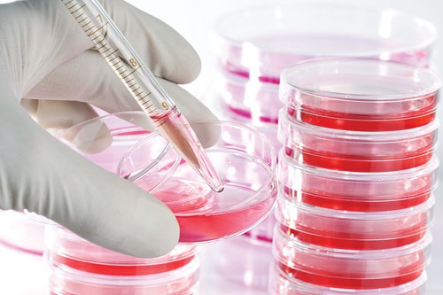
How Vaccines are Produced
Step 1: Generate the Antigen
Notes:
The first step in order to produce a vaccine is generating the antigen. An antigen is a fancy word for any part of a virus or bacteria that causes the body to produce antibodies. For this purpose the pathogen’s proteins or DNA need to be grown and harvested using the following mechanisms:
Viruses are grown on primary cells such as cells from chicken embryos or using fertilised eggs (e.g. influenza vaccine) or cell lines that reproduce repeatedly (e.g. hepatitis A).
Bacteria are grown in bioreactors which are devices that use a particular growth medium that optimizes the production of the antigens.
Recombinant proteins derived from the pathogen can be generated either in yeast, bacteria or cell cultures.
http://www.genengnews.com/Media/images/Article/LifeTech_CellCultureMedia7222217522.jpg

Slide 5

How Vaccines are Produced
Step 2: Purifying the Antigen
Notes:
This step is the most technical. The ways of isolating the antigen from other proteins and cells that have grown alongside it are through extremely fine filtration or by using tiny magnetic particles, or a number of other techniques used to sift out extras. This is usually specific to each antigen, as antigens frequently possess different properties specific to the disease they are associated with.
http://www.sophos.com/en-us/medialibrary/Images/Products/Features/secure-web-gateway-customizable-web-filtering.png

Slide 6
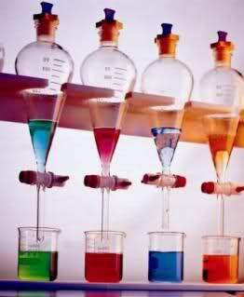
How Vaccines are Produced
Step 3: Addition of other Components
Notes:
In this step other chemicals or additives are put in, to prolong the vaccine’s shelf life or to help the body absorb it better.
http://i29.tinypic.com/2hfuhiu.jpg

Slide 7
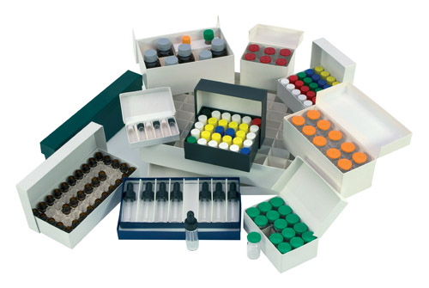
How Vaccines are Produced
Step 4: Packaging and Distribution
Notes:
The finished vaccines are put into vials, syringes, and finally boxes to be shipped out and distributed.
http://www.adelphi-hp.com/assets/images/vial-boxes.jpg

