Slide 1
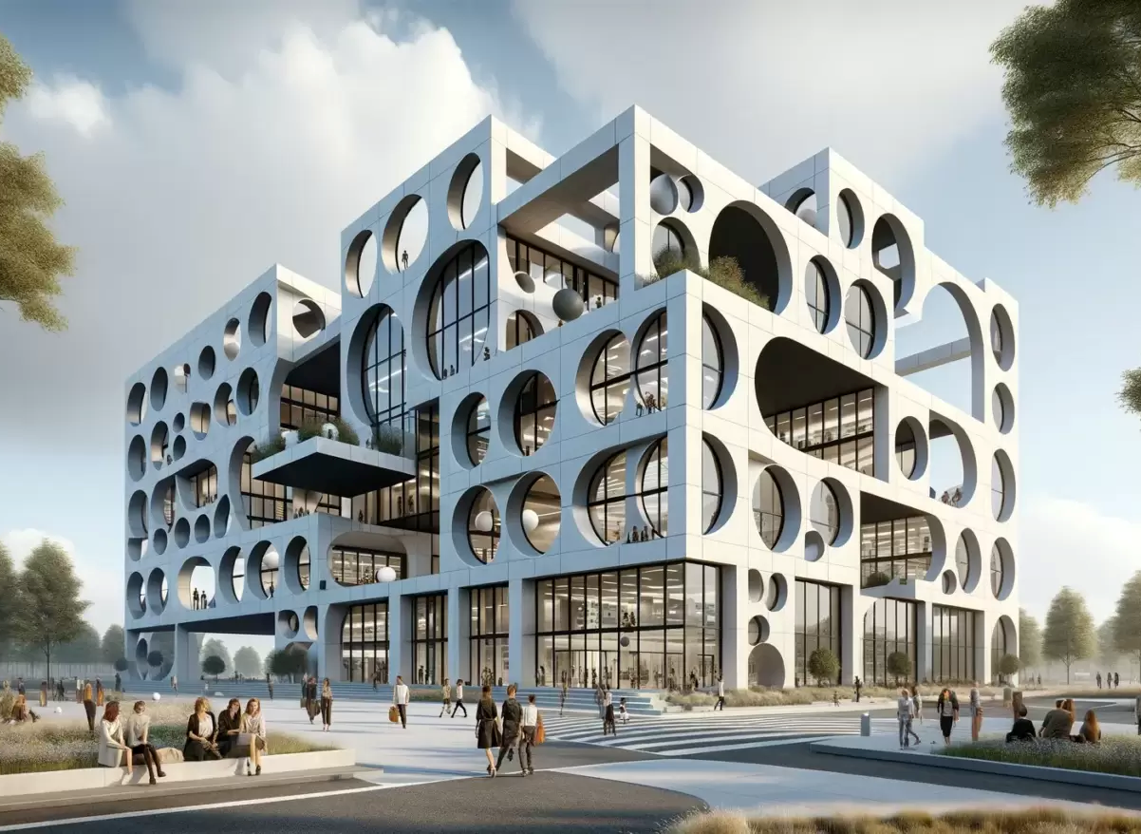
Shapes in Structures & Architecture
Image: Archovavisuals.com

Slide 2
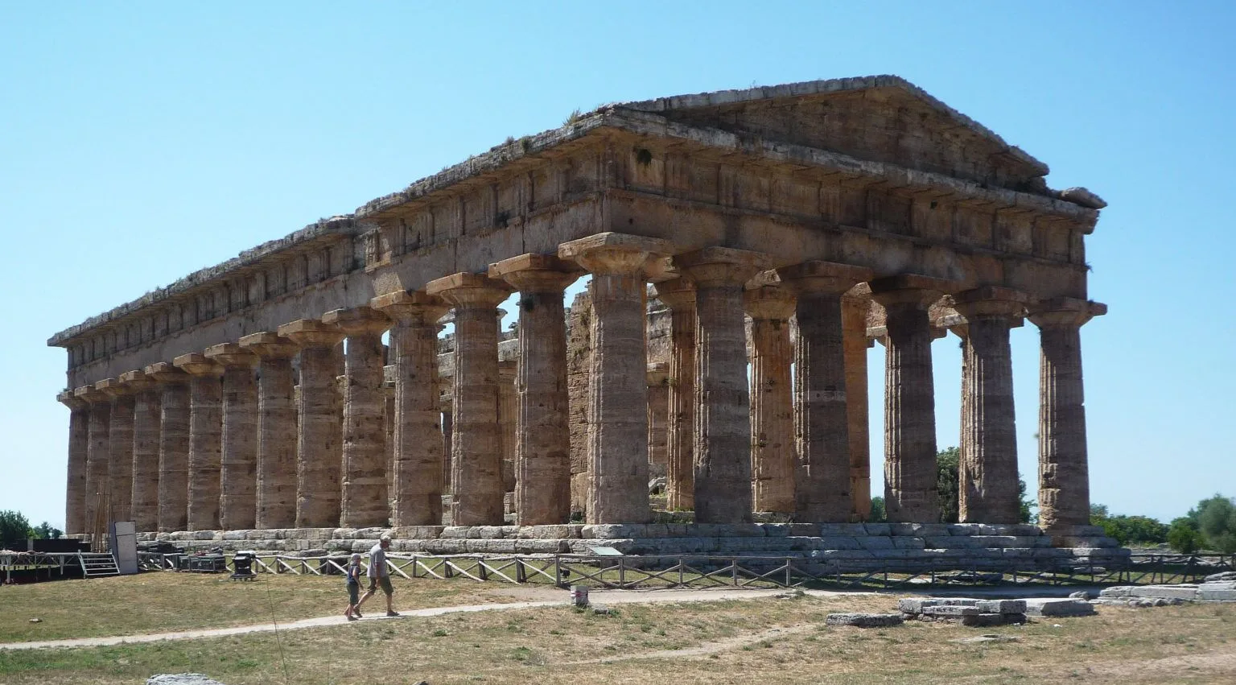
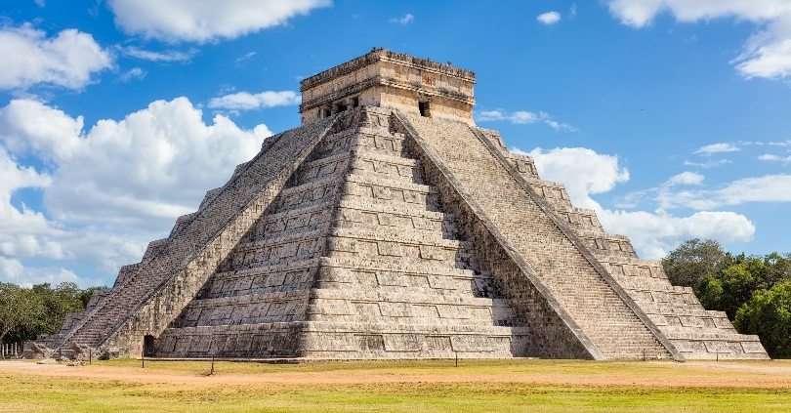
Ancient Examples
Geometric shapes have been used in building structures and architecture
since ancient times.
Photo: Tempio de Hera II - Steven Zucker smarthistory.org
architecture – the science & art of designing structures and buildings
Photo: Chichen Itza – istockphoto. gettyimages

Slide 3
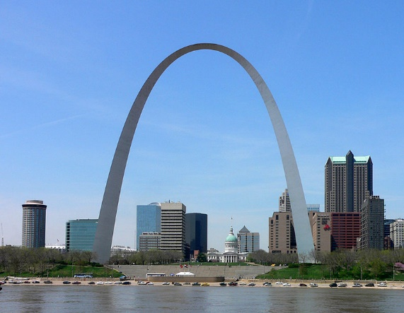
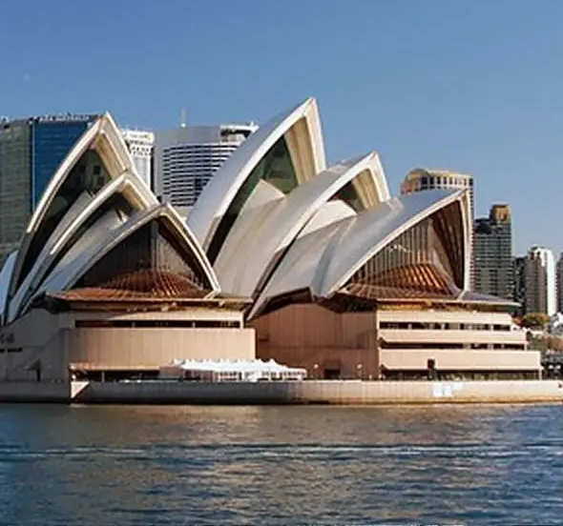
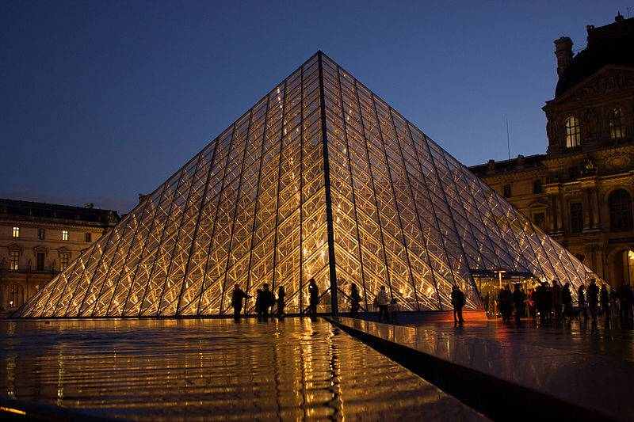
The use and repetition
of shapes is extremely common in present day structures & architecture.
Shapes provide:
Strength & Stability
Visual Interest & Style
Modern
Examples
Photos: Sydney Opera House, St. Louis Arch, Louvre Museum – interestingengineering.com

Slide 4
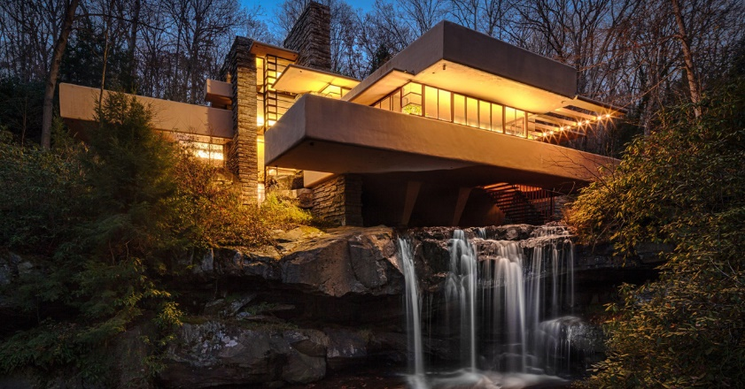
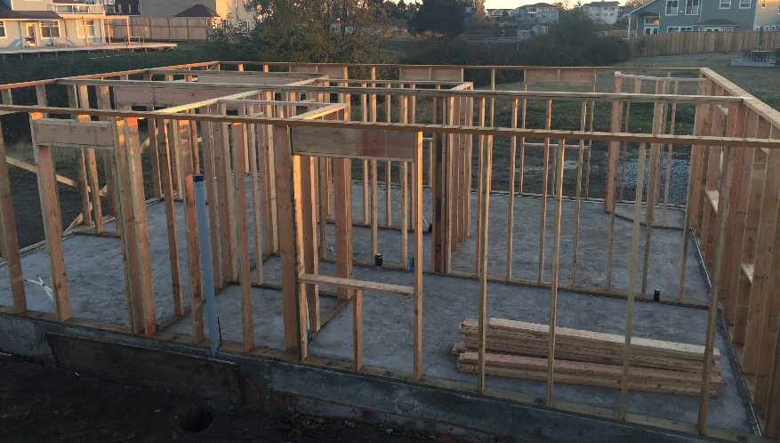
Squares & Rectangles
Most buildings and structures are built upon hundreds, if not thousands of square & rectangle shapes of all sizes. They are used anywhere a structure needs to be square.
square – including 90 degree, right angles, with lines perpendicular and parallel to one another.
Photo: Fallingwater, Frank Lloyd Wright- omrania.com
Most commonly used shapes
Gives structure stability & a base to build upon
Framing for walls, windows & doors, flooring, cabinets, walkways, brick work, etc.
Visually provide clean lines & order
Photo: savingsustainably.com

Slide 5
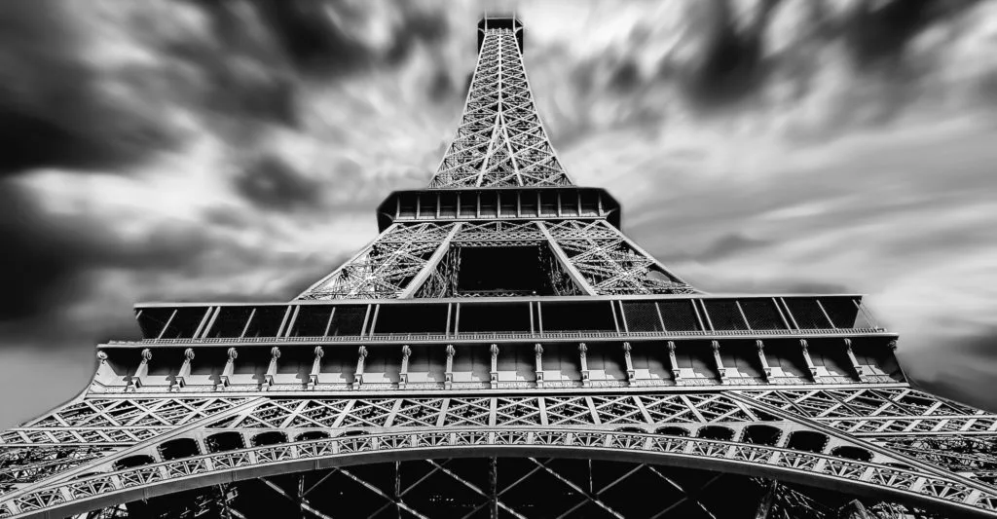
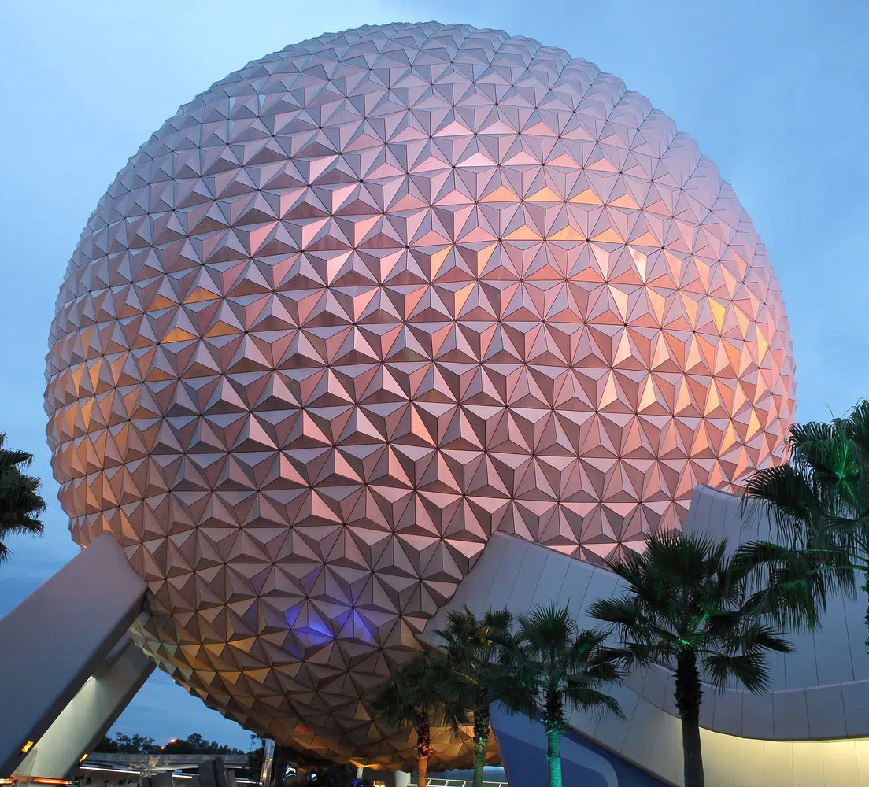
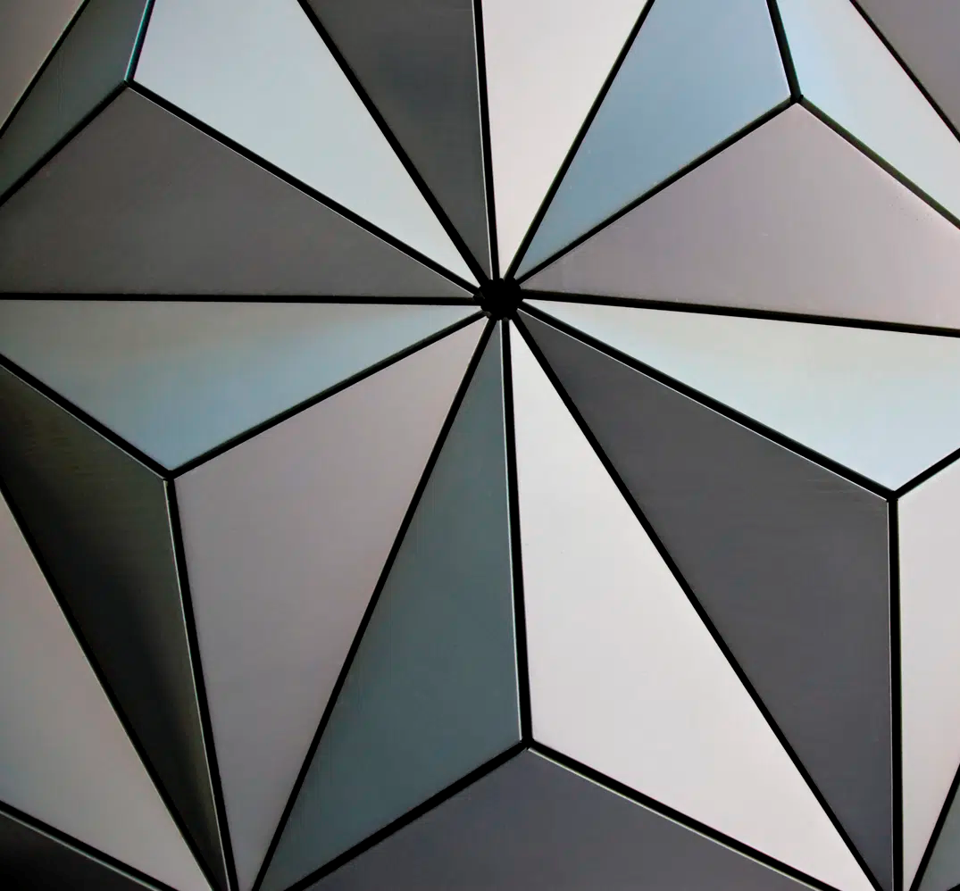
Triangles
Triangles are commonly used in structures all around you – from very small to extremely large.
While square and rectangle structures can bend & change shape under weight or pressure, triangles support great weight and pressure without changing shape.
Picture frames are assembled with 45 degree angles instead of 90 degree angles for this reason.
strongest structural shape – triangles equally distribute
(or spread out) weight &
pressure
Used in trusses & rafters for roofs, beams, bridges, frames, towers, heavy equipment structures, etc.
Many buildings take on a triangular shape with a wider base for stability – towers, pyramids, teepees
Repeated triangles create other shapes and unique visual interest
Photo: Eiffel Tower, behindagreatproject.com
Photos: Spaceship Earth, Epcot Walt Disney World, sgh.com

Slide 6
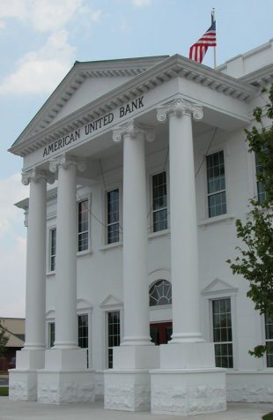
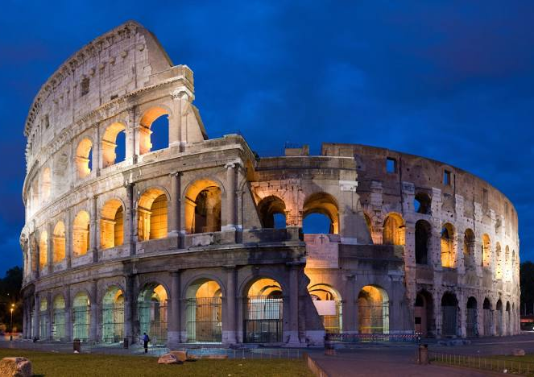
Circular Shapes
Circles and ovals may seem to be rare in structures and architecture, but they are used quite often as support. Like a triangle, circles distribute (spread out) weight and pressure along the circumference
circumference – distance around the
edge of a circle
One of the strongest shapes
Vertical pillars, columns, and posts are used to support massive structures from above
Arches use a half circle shape to distribute weight across wide openings
Furniture is often supported and stabilized by circular legs or circular structures under legs
Circles, ovals, spirals, columns, arches & rounded edges add creative and distinctive style to a structure
Photo: Colosseum - Rome, Italy, wikepedia.com
Photo: meltonclassics.com

Slide 7
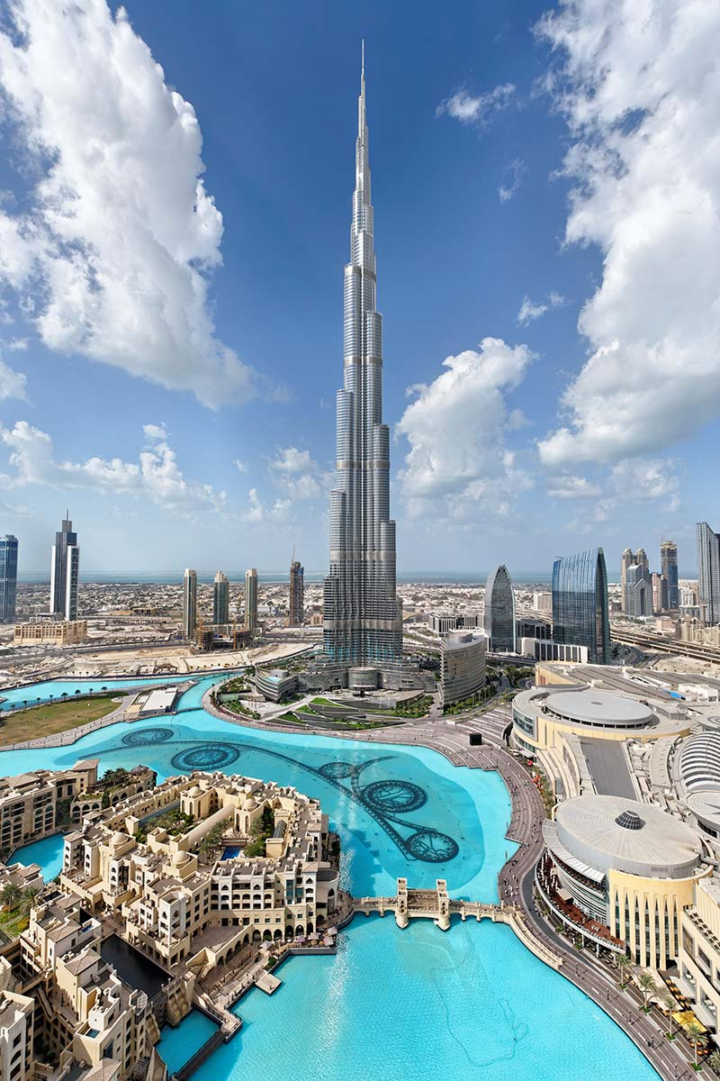
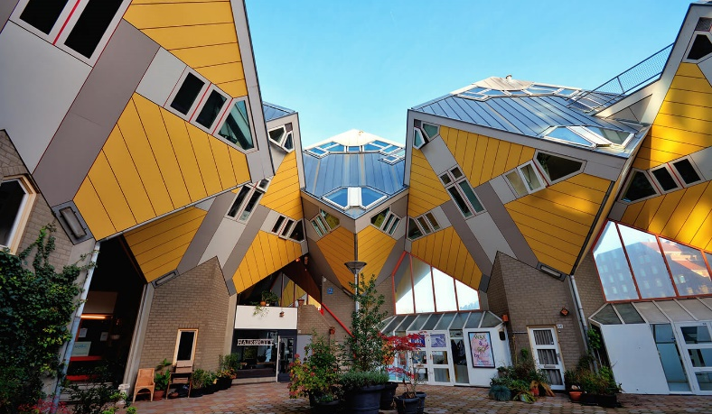
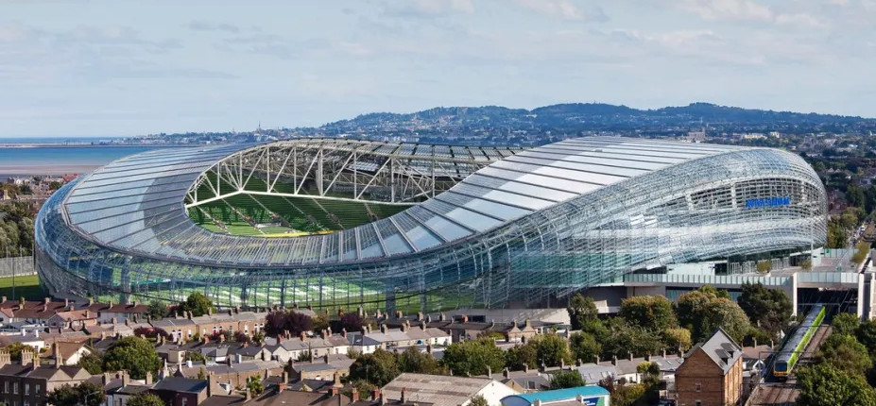
Most often
architects &
engineers use combinations of repeated or different shapes to achieve the goals of the structure. Basic shape structures can be designed to create unexpected and eye-catching features and styles.
Photo: Cube Houses, Rotterdam, Netherlands, novatr.com
Photo: Burj Kahlifa, India, guinessworldrecords.com
Photo: Aviva Stadium, Dublin, Ireland ©avivastadium.ie

