Slide 1
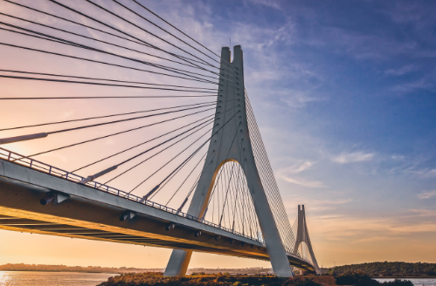
Bridges

Slide 2
Early Bridges
Bridges were being built/used before houses
Trees
Rocks
Vines

Slide 3
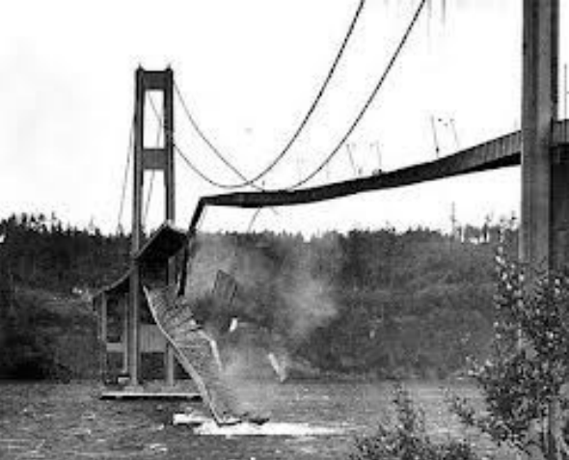
Bridge Problems
Mistakes can be costly and very dangerous
1940:
“Galloping Gertie”

Slide 4
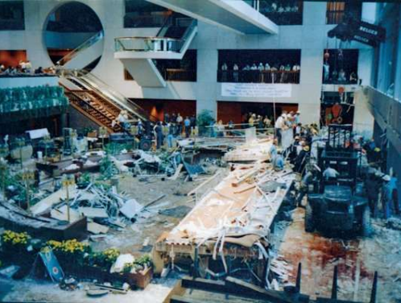
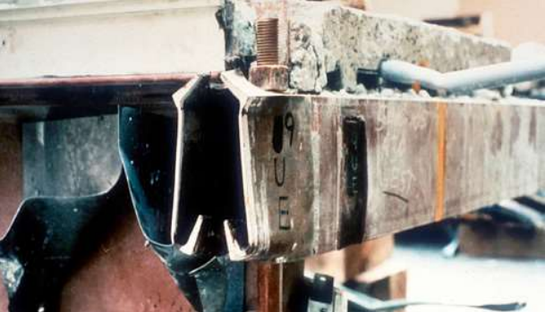
Bridge Problems
1981: Kansas city indoor walk way collapse

Slide 5
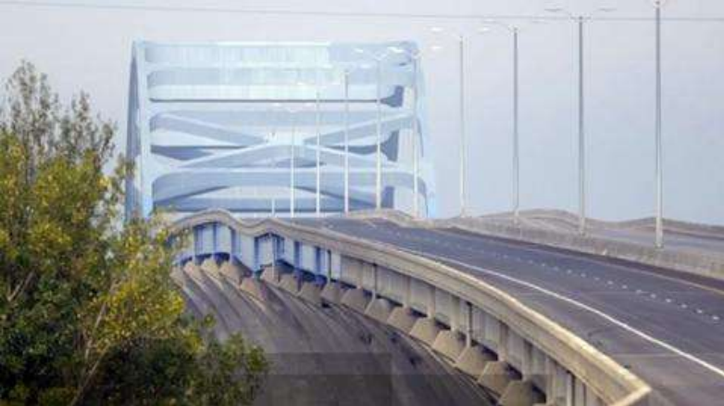
Bridge Problems
2013: Leo Frigo Bridge
Pier sank about 3 feet – problem w/soil causing corrosion, effecting more than 1 pier

Slide 6
Bridge Problems
What caused these problems?
Did the designers use wrong materials?
Was it caused by too much stress on the bridge?

Slide 7




Stresses of a Bridge
Tensile
Stretching and pulling forces
Compression
Pushing and squeezing forces
Shear
Tearing and sliding forces
Torsion
Twisting and bending forces

Slide 8


Bridge Problems
Compression
Bridge piers may buckle under weight
Stretching (mostly suspension bridges)
Cables on the bridge stretch under weight
Twisting
Unbalanced forces cause torsion stress
Bending
Weight of bridge or load on the bridge causes it to sag/bend
Shear
Weight of bridge or load on the bridge causes it to slide/tear apart

Slide 9
Materials
Early bridges: natural materials
Would rot and deteriorate or not appropriate for larger spans
Modern material selection is very important
Is it strong enough?
Is it long lasting?
Does it allow flex?
Modern Materials: steel, concrete

Slide 10
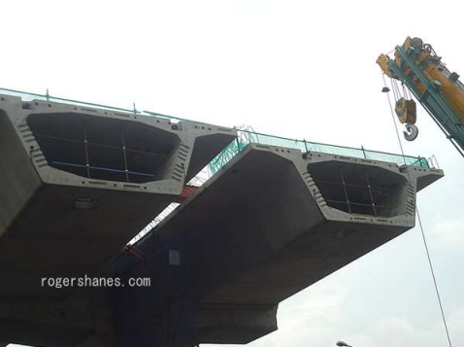
Steel in Bridges
Cables
Girders
Beams
Tubes
I-beams: supportive over long distances
Box girder: ridgid, can be given curve, wind resistant.

Slide 11
Concrete
Mix of sand, stone, cement and water
Dries hard
Can be easily shaped
Beams, footings, guards
Great under compressive forces
Not so great under tensioning forces
Can be reinforces with steel (rods or cables)

Slide 12
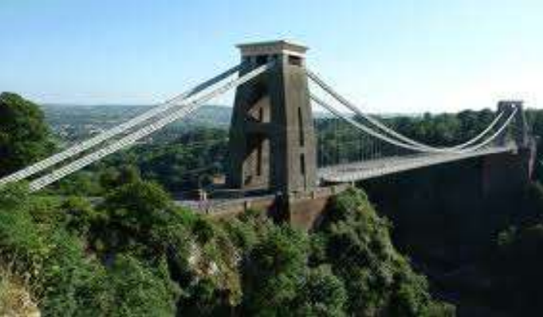
Types of Bridges
Beam
Arch
Suspension
Truss

Slide 13
Beam
Easy to build
Least expensive
Weight spread between 2 piers
Types
Girder
Cantilever

Slide 14
Arch
Curved to distribute load to abutments
Used by the romans for aquaducts

Slide 15
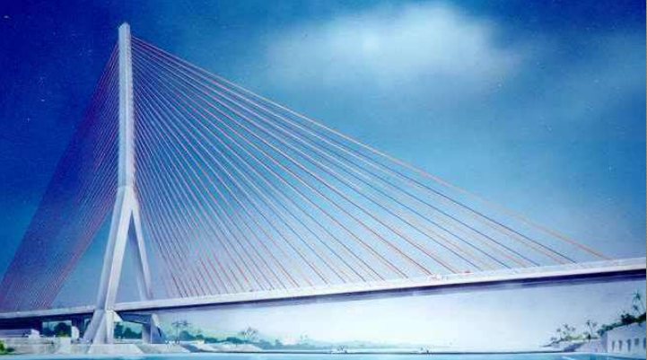
Suspension Bridges
Road surface is suspended by cables
Cables run from towers, anchored at the ends
Can cover very long distances
Trusses used to keep roadway rigid
Cable stay bridge
Shorter distance, less towers

Slide 16
Caissons
Used for building bridges over water
Rests on bedrock, under water and sand layer
Piers rest on top of caissons

Slide 17
Main considerations
Terrain
Reason
Length
Weather

