Slide 1
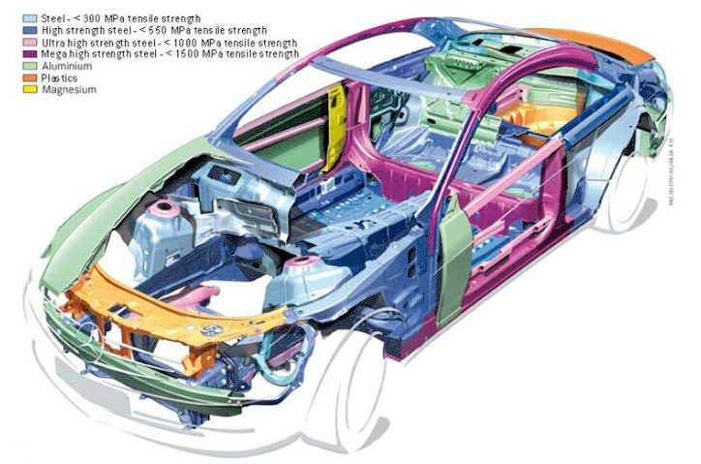
Subsystems in Transportation
Structural
Propulsion
Suspension
Guidance
Control
Support
Notes:
In any vehicle, these subsystems must exist and cooperate for the vehicle to be successful. Vehicles will be designed for different functions and exist in different environments, but these core subsystems exist across the board. Think for a minute on what each might mean in the context of a car.
http://4.bp.blogspot.com/-mcqCdpA6L-Q/T-RDSz0vkrI/AAAAAAAAAPk/bkBxdTnVmM0/s1600/2011_MB_CL_Class.jpg

Slide 2
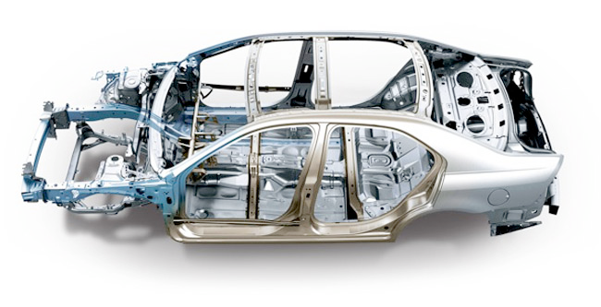
Structural
Notes:
The structural subsystem is the framework or body of a vehicle. In this case, the shell of a car, that keeps everything else in its place and provides the starting place for other systems.
http://www.gmotors.co.uk/news/wp-content/uploads/2010/12/frame.jpg

Slide 3
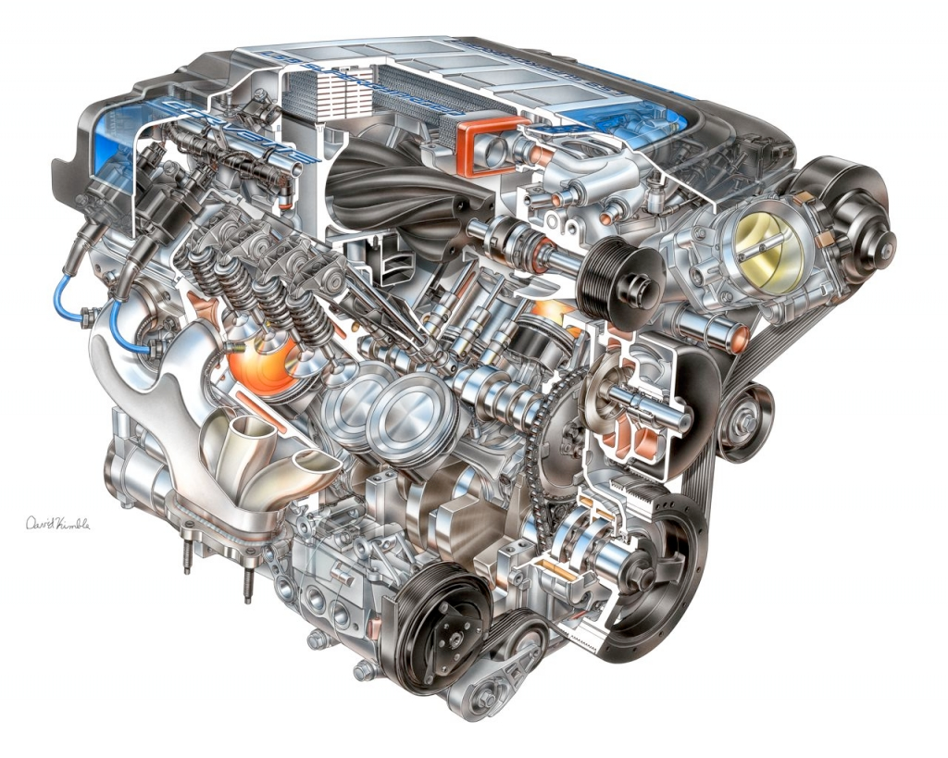
Propulsion
Notes:
This system is the energy source, energy converter, and power transmitter to move a vehicle. In a car this is the engine. It accepts chemical energy in the form of fuel, and converts it into kinetic energy through burning the fuel. In electric cars the motor that accepts electrical energy and outputs kinetic energy.

Slide 4
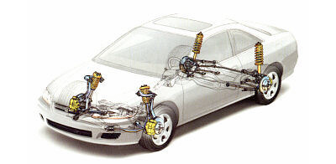
Suspension
Notes:
Suspension systems associate a vehicle with its environment. A car has a suspension system that involves its tires, the tools the engine uses to put its kinetic energy to moving the car forward, and springs to help cushion any bumps in the road or obstacles.
http://s.hswstatic.com/gif/car-suspension-12.jpg

Slide 5
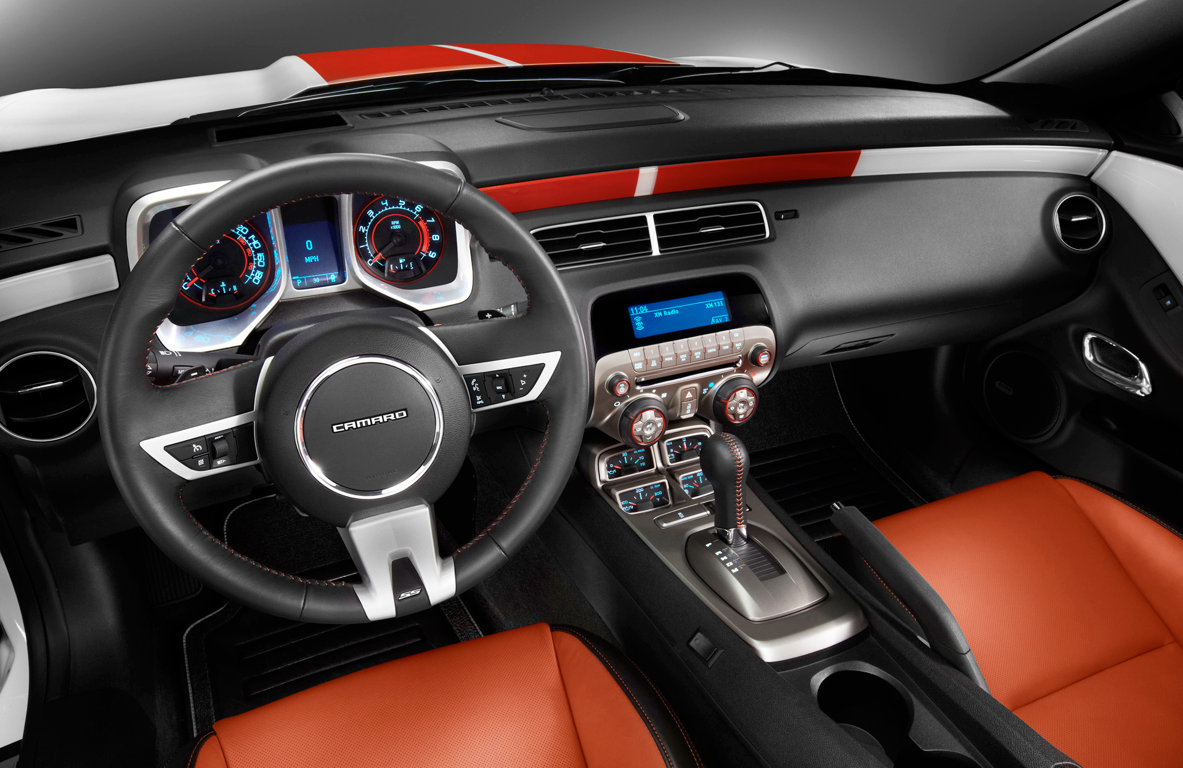
Guidance
Notes:
A guidance system provides information to the operator of a vehicle. In a car, this is the fuel gauge, check engine and oil lights, a GPS, the speedometer, and other gauges.

Slide 6
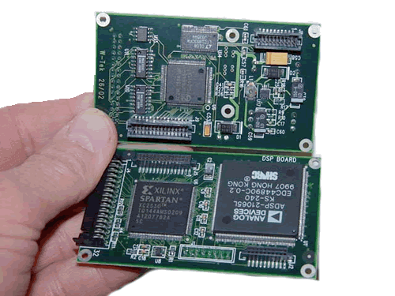
Control
Notes:
Control systems receive information from the guidance system to determine the changes in speed, direction, or altitude of a vehicle. While there are self driving cars a thing now, the most easy way to conceptualize this is in an autopilot for an airplane, or a cruise control system in a car.

Slide 7
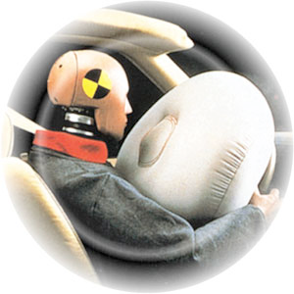
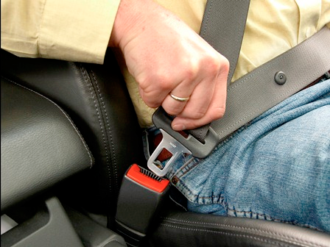
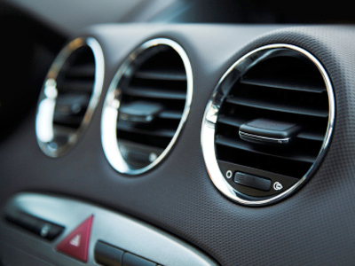
Support

