Slide 1
Transportation: a combination of individuals and vehicles

Slide 2
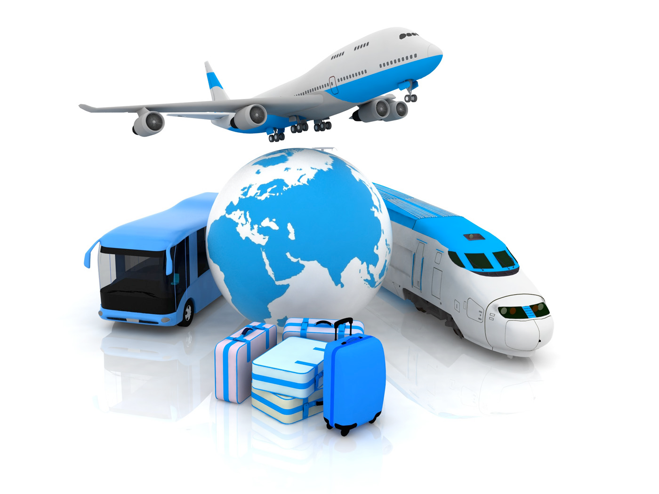
What is transportation?
Notes:
The definition of transportation is simple. Moving something from one place to another. The reason for spending an entire unit on it is because beyond its definition, its an extremely complicated and involved process.

Slide 3
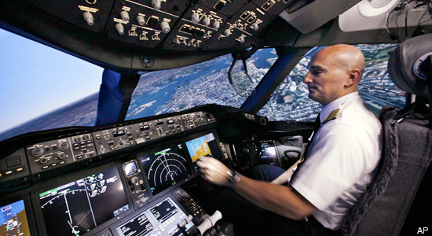
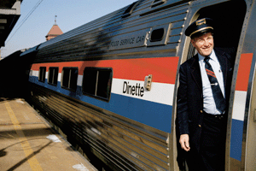
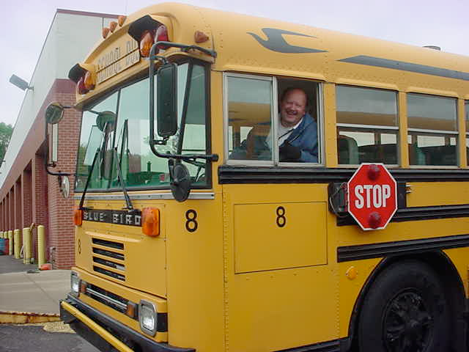
Who is responsible for transportation?
Notes:
Is it the bus and truck drivers? The train conductors, the plane pilots? A short answer is yes, but they aren’t the only ones.
http://www.northallegheny.org/cms/lib4/PA01001119/Centricity/Domain/48/MVC-003S.JPG
http://cdn.cnwimg.com/wp-content/uploads/2010/10/truckdriver.jpg
http://upload.wikimedia.org/wikipedia/commons/c/cc/Train_Conductor.gif
http://i.huffpost.com/gen/246247/PILOT-SIMULATOR.jpg

Slide 4
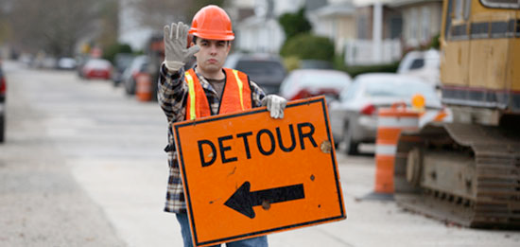
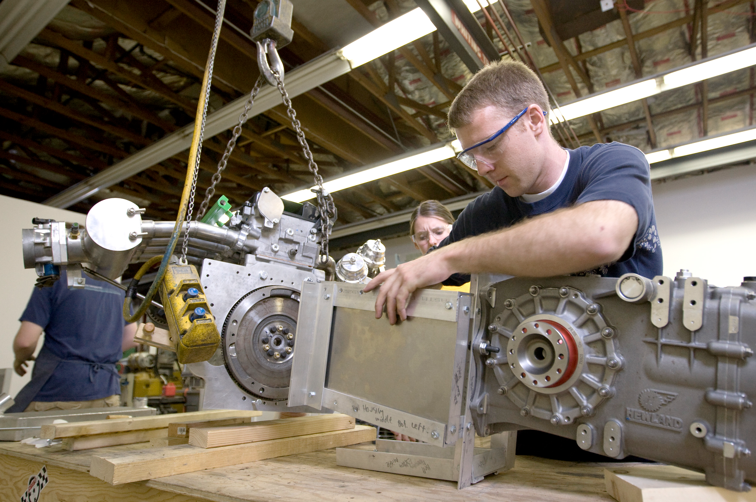
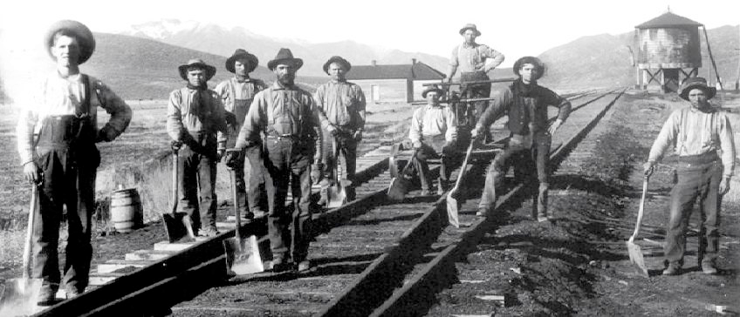
Notes:
Also responsible are the people who built the roads, cars, planes, and trains, as well as the airports, railroads, and ports. These people have just as much of an influence over the location of goods as the ones who physically move things. Without people to build the infrastructure we know and appreciate, like roads, railroads, seaports, airports, distribution facilities, the whole lot, transporting goods on the scale we currently do would be an impossibility.
http://www.edgarsnyder.com/images/large-550/car-accident/roads/road-worker-detour.jpg
http://news.byu.edu/releases/archive08/Jul/internationalcar/0807-19%20091.jpg
http://www.layoutsbysteve.com/picts/staff.jpg

Slide 5
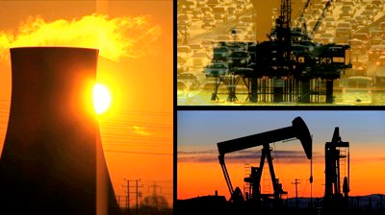
Notes:
Also responsible are the people who make fuel for the physical movers to run machines. Without people to gather, refine, or distribute fuel, goods and people could not be moved except by foot or horseback.
http://ak8.picdn.net/shutterstock/videos/740179/preview/stock-footage-montage-of-moving-panels-of-fossil-fuel-production-alternative-clean-renewable-power-sources.jpg

Slide 6
What are the vehicles these people use?
Notes:
Think about it. The drivers, the builders, the fuel refiners. What kinds of things do they use?

Slide 7
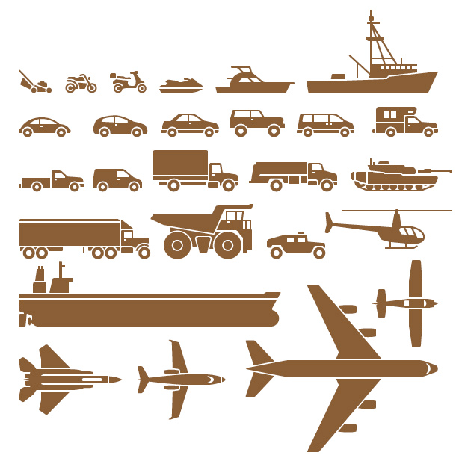
Vehicles in Transportation
Boats
Cars
Trucks
Trains
Planes
Notes:
There are hundreds of different vehicles used in transportation. The ones named only cover a few broad areas within which many different types of each could be used.

Slide 8
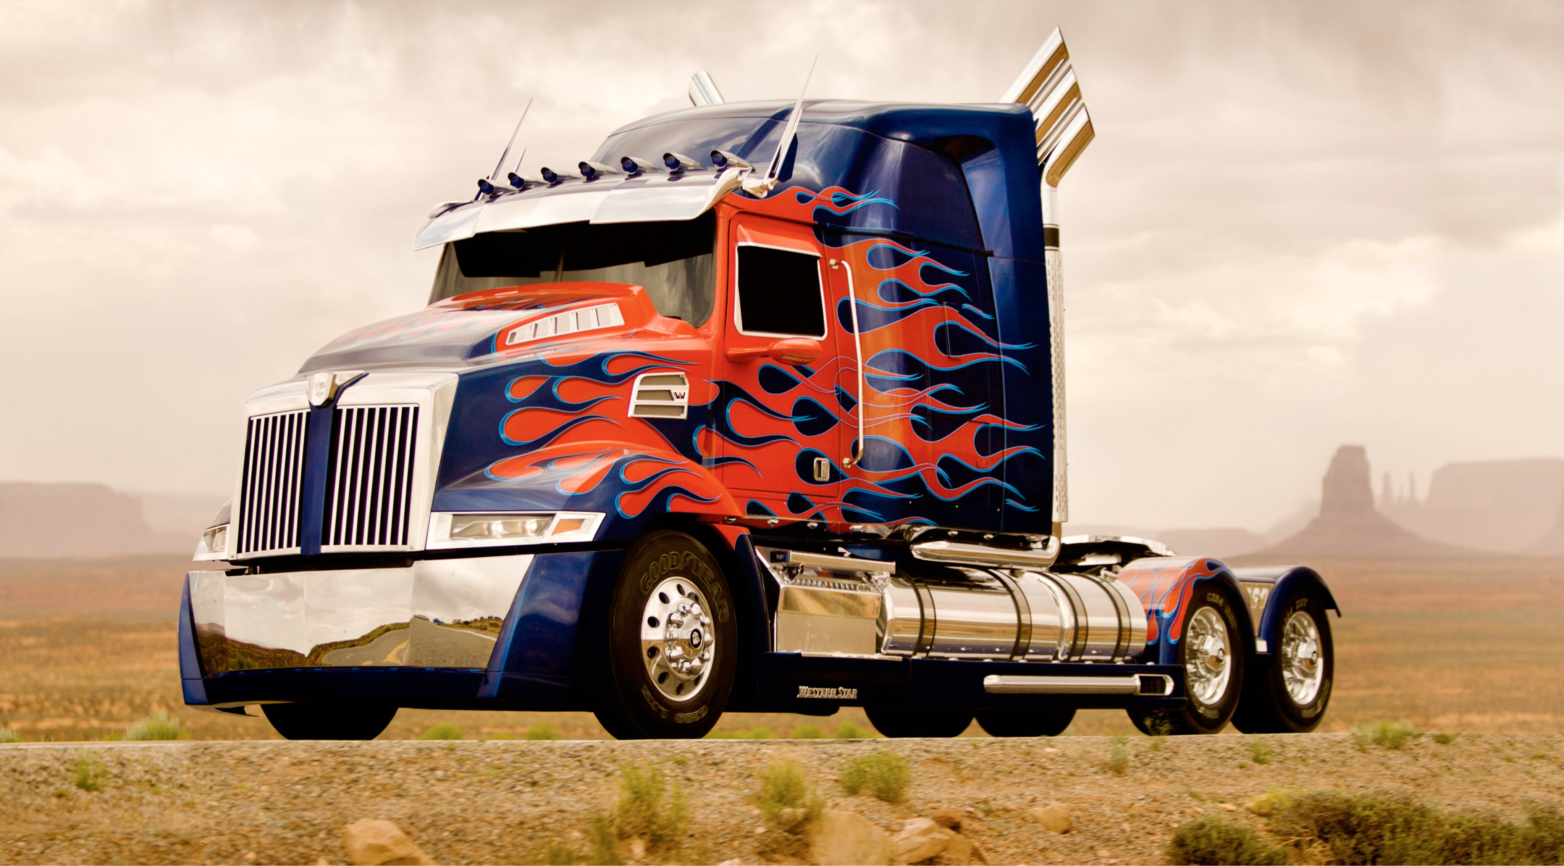
Take Trucks for Example
Notes:
There are the standard freight trucks, like the one shown, there are delivery trucks, there are flatbed pickup trucks, and many others. In a good’s journey from raw material to product, it may use a combination of many different varieties of trucks, as well as other vehicles.
http://i.imgur.com/Mxsr00R.jpg

