Slide 1
Government regulation

Slide 2
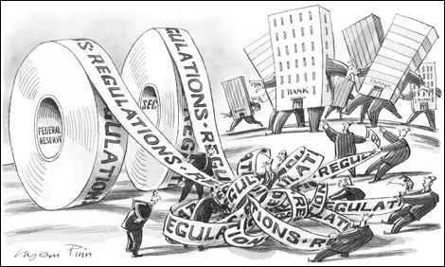
Government Regulatory Agencies
Notes:
Government regulations and codes frequently impact engineering, but its effects are felt more heavily on the transportation side of things. Land, sea, and air travel speeds are heavily impacted by the extent of government regulations. Not that these regulations are without merit, far from it.
http://www.fredthompsonsamerica.com/wp-content/uploads/2013/12/regulation.jpg

Slide 3
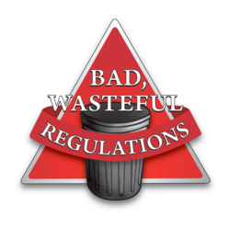
In what ways do regulations bog down transportation?
Notes:
Regulations are generally formed to make the world a better place. Sometimes, however, these good intentions can be corrupted or lead to inefficiencies which are harmful to everyone. What are some ways the transportation industry could be burdened by regulation - even necessary regulation?
http://ww1.prweb.com/prfiles/2012/01/20/9124808/gI_72410_bad-regulations.png

Slide 4


Inspections
Notes:
Lets look at inspection, for example. This could mean vehicle inspection, to make sure its not pumping dangerous gases into the air. It could mean inspection of the goods as they are transported to make sure there isn’t anything against the law along for the ride. Smuggling is a serious problem for a myriad of reasons, as is pollution.
http://www.hazardousareas.net/wp-content/uploads/2013/09/inspection.jpg
http://www.roadsidehazmat.com/wp-content/uploads/2014/02/Inspector.jpg

Slide 5
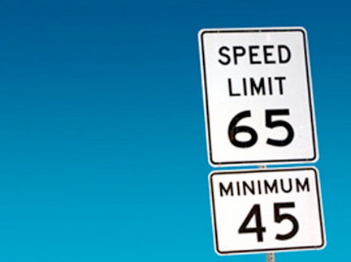
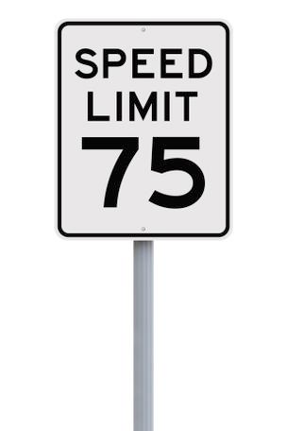
Speed Limits
Notes:
Another way regulations can slow down transportation is speed limits. This kind of regulation is up to the discretion of a state government. It exists out of an interest to save human lives and keep people safe, yet it has a direct impact on the speed of land transportation.
http://media.mlive.com/grpress/news_impact/photo/speedlimitjpg-7f6247a7aecdc44d_large.jpg
http://media.bizj.us/view/img/2579071/474185731*304xx308-462-0-0.jpg

Slide 6

Types of Regulation
Notes:
Speed limits and inspections are external regulations. These are things other people need to constantly perform to have an effect. The other type of regulation is an internal regulation, which impacts things as they’re made or built.

Slide 7

Codes and Standards
Notes:
Internal regulations come in the form of codes and standards. These are usually to preserve safety. These are lists of criteria for a vehicle, building, good, or service that are necessary for them to be legally allowed. This prevents people manufacturing a car that will crumple like its made of paper when it gets in a crash.

