Slide 1
Transportation process

Slide 2
What processes are common in transportation?
Receiving
Holding
Storing
Loading
Moving
Unloading
Delivering
Evaluating
Marketing
Managing
Communicating
Using Conventions
Notes:
Here is a list of the basic processes that may be used individually or in various combinations to move goods and people.

Slide 3
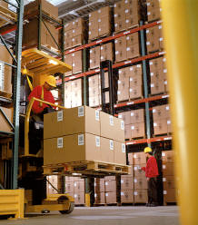
What do these mean?
Receiving
Holding
Storing
Loading
Moving
Unloading
Notes:
So we have our long, wandering list of terms. What do each of these mean? For starters, receiving means to take in goods and be able to process them to be ready for another step. Holding is to keep an item or items ready in the short term if the next step isn’t ready yet. Storing is to keep track of an item for the long term. Loading and unloading have to do with putting things on vehicles and taking them off, and moving is the physical movement of goods.

Slide 4

What do these mean?
Delivering
Evaluating
Marketing
Managing
Communicating
Using Conventions
Notes:
Delivery is the distribution of goods to the final consumer or retail store, evaluating is measuring the worth of a product or venture. Marketing is the action or business of promoting a good or service, managing is keeping track of and controlling. Communicating is making relevant information available and using conventions is keeping all of these processes relatively standard and compatible with each other.
http://larry5154.files.wordpress.com/2010/10/mailman.jpg

Slide 5
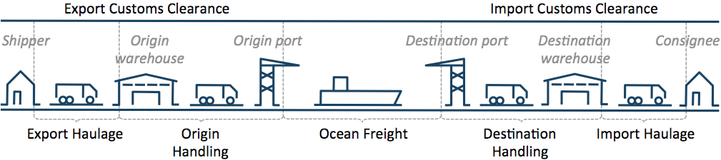
An Example
Notes:
In this example, there is a rough outline of the path a product will take when its on its way from a shipper to a buyer. What processes will the product be involved in on its path?
https://www.transporteca.com/images/explain/ShippingProcess.png

Slide 6
The product might be…
Loaded onto the export haulage vehicle
Unloaded and held or stored at the origin warehouse
Loaded onto origin handling, then loaded onto the ocean freight vehicle
Moved across a body of water
Unloaded and evaluated at port, then loaded onto the destination handling
Unloaded at a destination warehouse or distribution center
Delivered to a buyer
Notes:
As you can see by the sheer number of steps this product would take, the efficiency of all of these processes is essential. If there is a system developed for loading and unloading of trucks that reduces the time it takes to do, or decreases the number of times it needs to be done, it is extremely valuable.

Slide 7

Use of Conventions
Notes:
This need for the utmost efficiency brings to mind the use of conventions. A convention is a way in which something is usually done. It makes everything much more efficient if something is done in a standard way across the board, so that no matter where someone is loading or unloading, it’ll be done in about the same way. This makes things go much faster, as something that can be done without thinking can be done very quickly and easily, if not in general in the transportation world.
http://yorktown.cbe.wwu.edu/sandvig/mis314/lectures/images/noThink.jpg

