Slide 1
How to Set up Tinkercad
Teacher & Student
Accounts

Slide 2
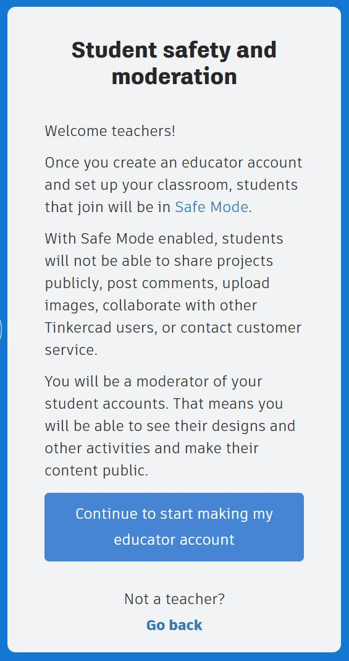
Educator Account Feature Benefits
Set up classes for students in “Safe Mode” which prevents students from making their projects publicly viewable.
Assign activities & monitor student progress
Access and view what students are working on without them needing to “turn in”
Option to link to google classroom to assign/turn in through that platform
Invite co-teachers to collaborate

Slide 3
Setting up an Educator Account
Navigate to https://www.tinkercad.com/join and follow the prompts or click to view the video link to the right for step-by-step instructions.
You will need to agree that you certify you are an educator and that parents/guardians have given their consent for students to use Tinkercad. It will also come up again later when creating classes, per a new policy as of January 2025. You may want to consider sending home a permission slip/student contract. An example is included in the curriculum content.
You will receive an email from Autodesknoreply@autdodesk.com requiring you to click to verify your email address before your account will be activated. The email link does have a time expiration.
Autodesk/Tinkercad Children’s Privacy Statement Link

Slide 5
Classes - Seats vs. Student Accounts
There are two ways you can set up your Tinkercad Classes for students to join.
Seats - This method gives the teacher most control of student activity. Student accounts are deleted if class is deleted.
Students do not set up their own account. No personal data collected.
Tinkercad randomly generates a “nickname” for each student that can be changed by the teacher.
Teachers add student names to the class and share the class code/link with students. Students type in their “nickname” to join and work within the class.
Student Accounts – This method allows the student to work outside of the class and join different Tinkercad classes set up by different teachers.
Teachers add student names to the class and share the class code/link.
Students set up their own personal accounts and then “sign in with email” or “sign in with google”. Email address and student ages will be needed.
Students 12 and under will create a “child account”.
Account Types
Help Page Link

Slide 7
Joining a Class as a Student
Teachers can invite a student to join a Tinkercad Class in two ways
Seats - Teacher created a seat for the student in a particular Tinkercad class
Student clicks on the link or enters the code that the teacher provides.
Student enters the “nickname” the teacher provides.
Student Accounts – Teacher is inviting the student to link their existing account to a particular Tinkercad Class
Student logs into their Tinkercad account.
Student then clicks on the link or enters the code that the teacher provides.
Joining a Tinkercad
Class Help Page

