Slide 1

Entrepreneurship

Slide 2

What is Entrepreneurship?
Using your skills and creativity to create something valuable
Using the resources you have wisely
Making smart decisions along the way
Aiming for your product to earn a profit

Slide 3

Every Product You Create Involves:
Designing
Budgeting
Calculating your Base Production Cost
Setting a Product Price Using Markup
Understanding Customer Needs

Slide 4
From Products to Profits
Early 20th century:
Small businesses made everyday items for local communities.
1970s–1980s:
Advertising, endorsements, and packaging helped products reach more customers.

Slide 5
From Products to Profits Continued
Today:
Market research strengthens product design.
Digital marketing enhances sales performance.
This shows how understanding customers and promoting products turns ideas into successful businesses.

Slide 6

Cost Analysis
Carefully looking at all the costs involved in making a product.

Slide 7

Materials Cost
Money spent on items used to make the product.

Slide 8

Labor Cost
Payment for time and effort.

Slide 9

Base Production Cost
Materials + Labor + Packaging
+ Marketplace/Other Fees

Slide 10

Profit Margin or Markup
Percentage added so you earn money.

Slide 11

Product Price
Final price customers pay.

Slide 12

Profit
The money earned after subtracting your base cost.

Slide 13

Opportunity Cost
What you give up when choosing one option over another.
What did I give up?

Slide 14
Let's do
Cost Analysis

Slide 15
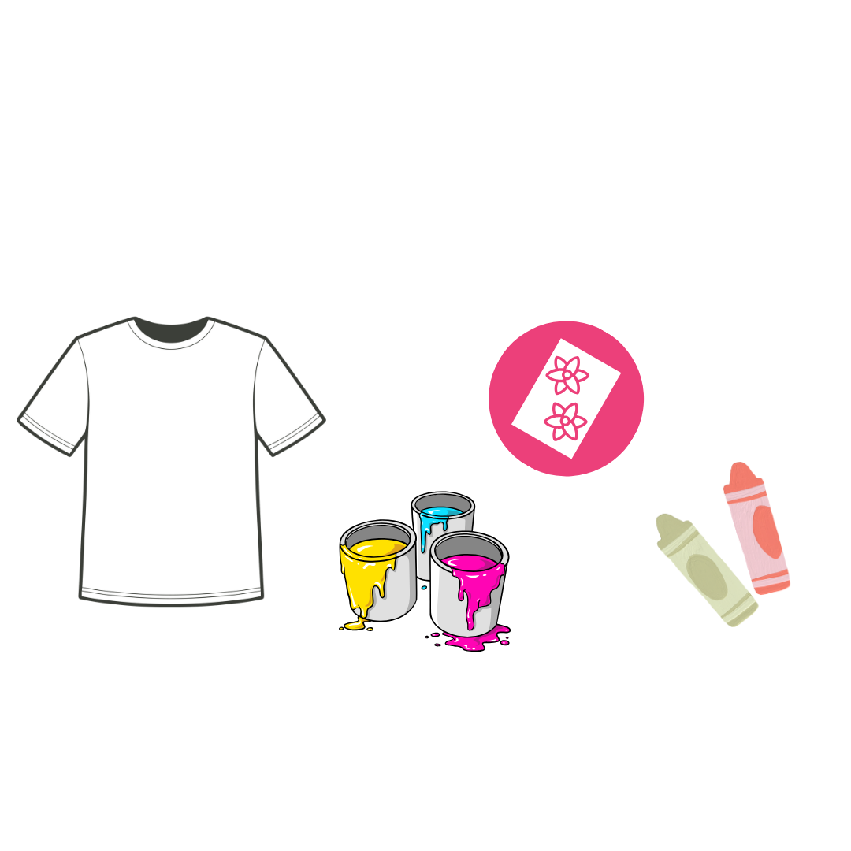
T-shirt Custom Design
If we are selling T-shirts, we start by listing all the materials we need. The total of these materials is our Materials Cost, which is also our Variable Cost.

Slide 16
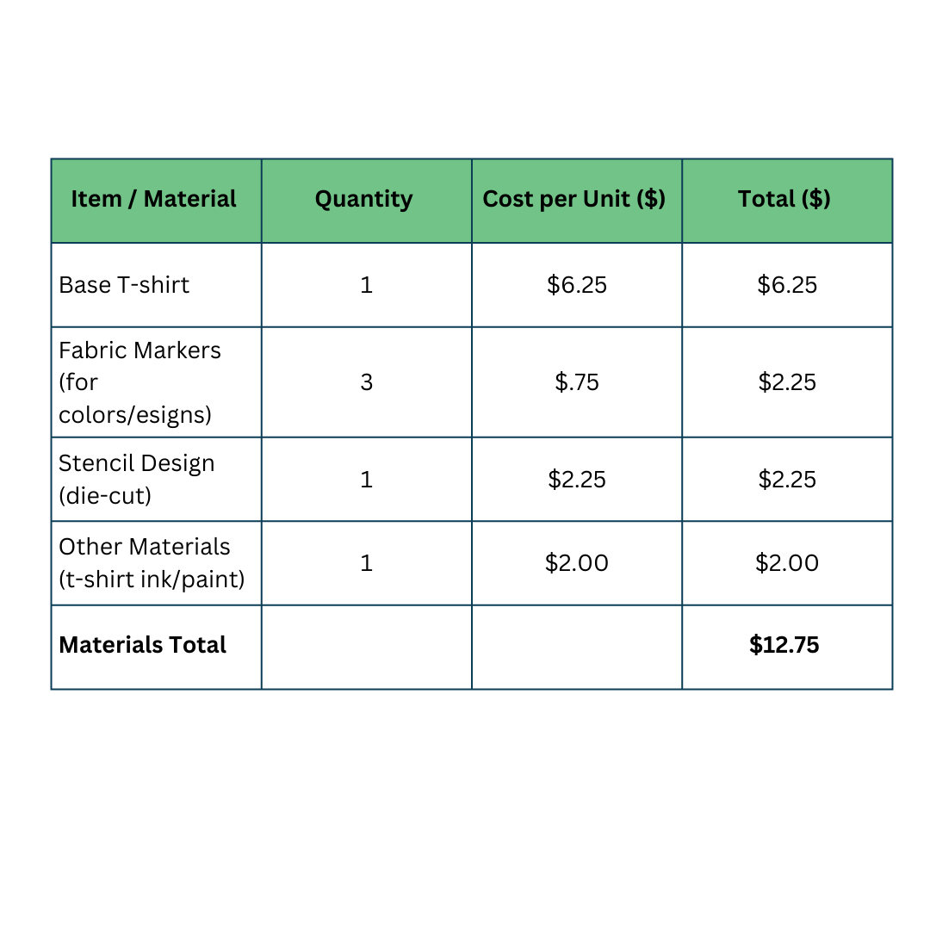
Materials Cost
Materials Cost = $12.75

Slide 17

T-shirt Custom Design
Next, we need to get the Labor and Packaging Costs. The total of these costs will become our Fixed Cost.

Slide 18
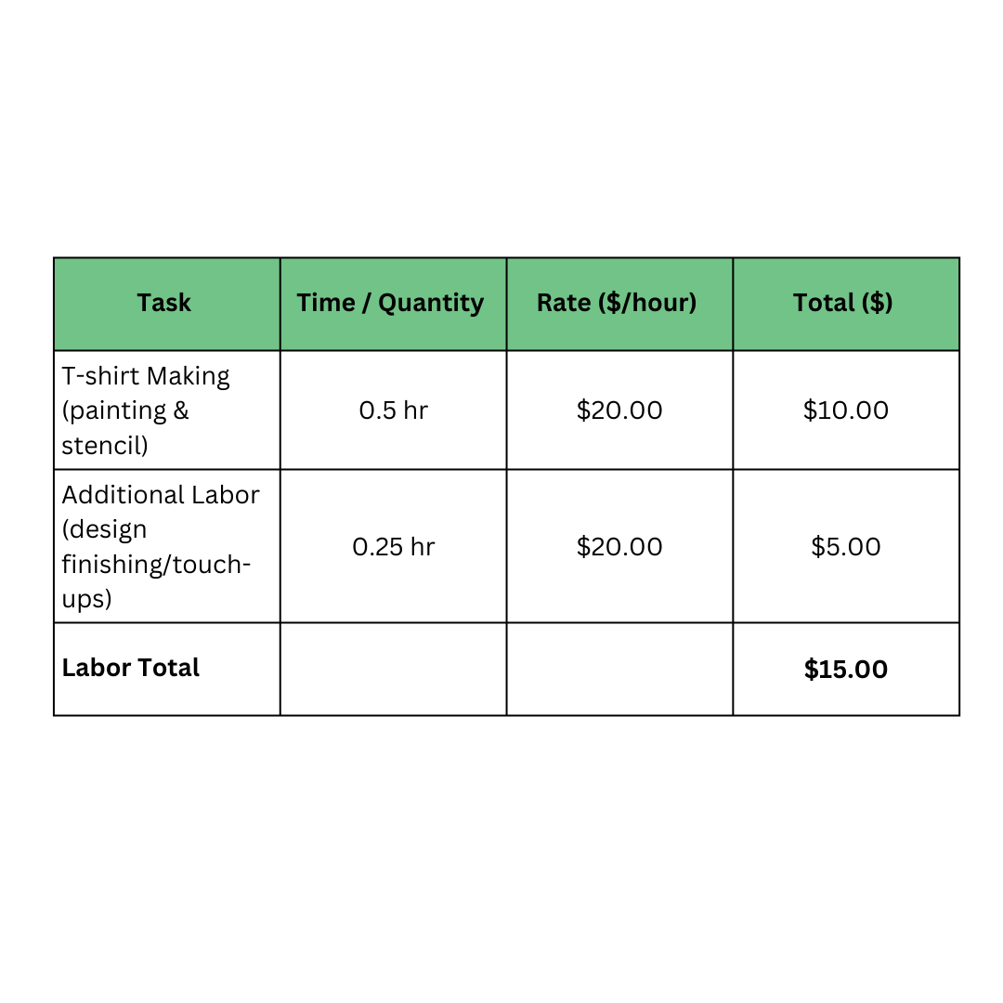
Labor Cost
Labor Cost = $15.00

Slide 19
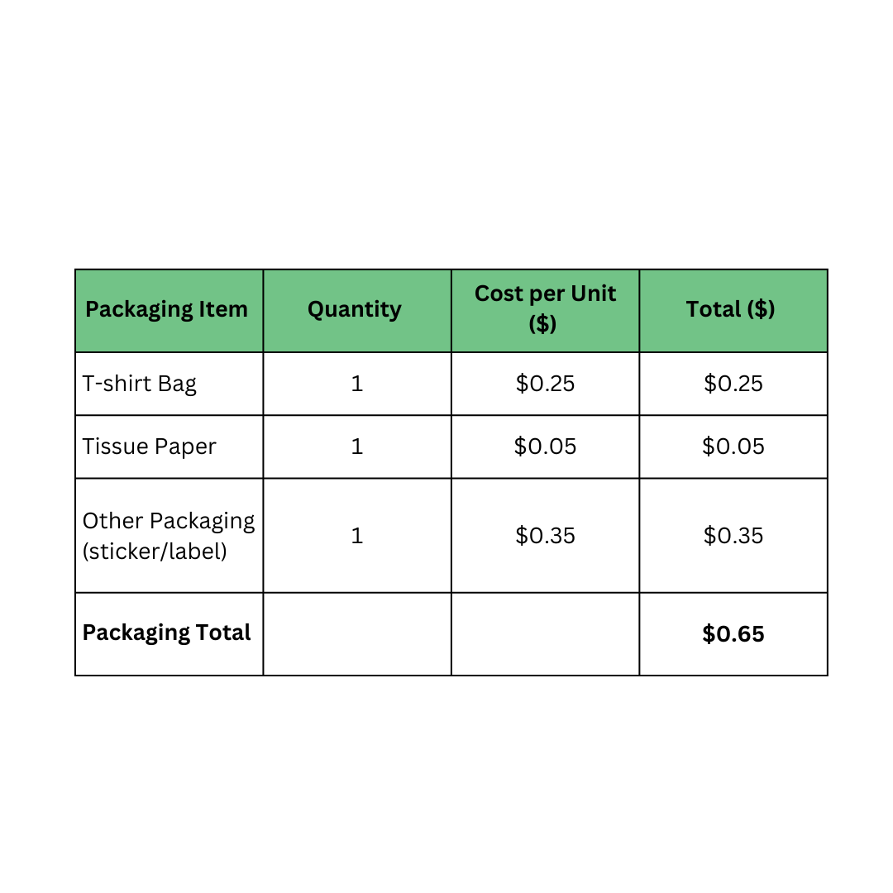
Packaging Cost
Packaging Cost = $0.65

Slide 20
Add Up All Costs
This becomes our Base Production Cost.
Formula:
Base Production Cost = Materials + Labor + Packaging

Slide 21
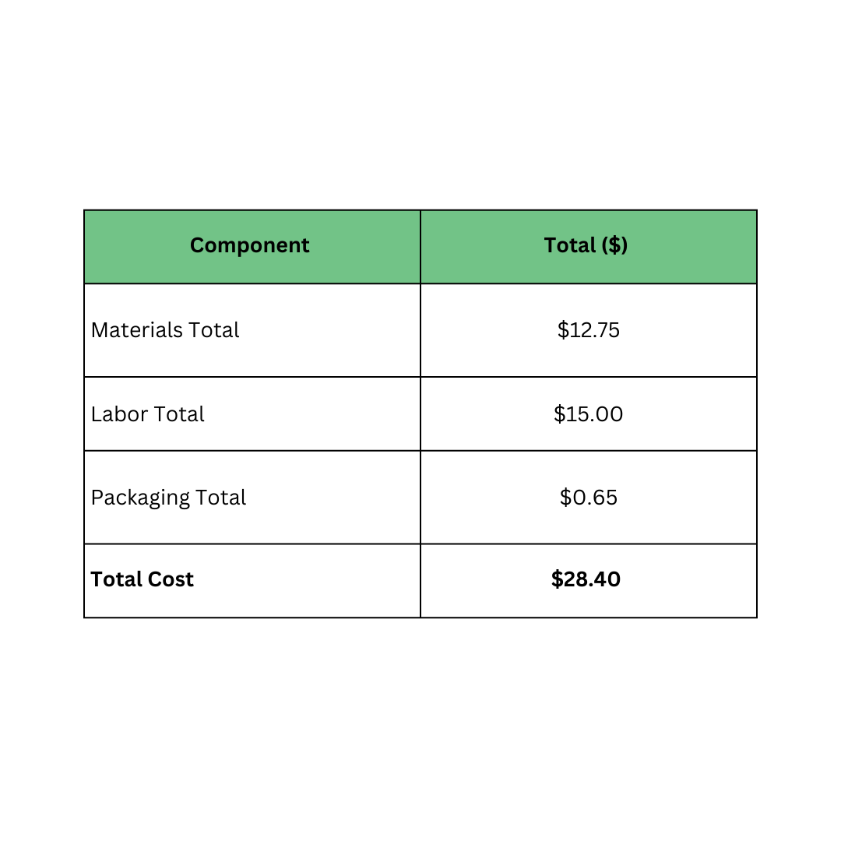
Base Production Cost
Base Production Cost = $28.40

Slide 22
Decide on a Profit Margin or Markup
Once we decided, let's get the Profit Margin:
Profit Margin = Base Production Cost x Markup

Slide 23
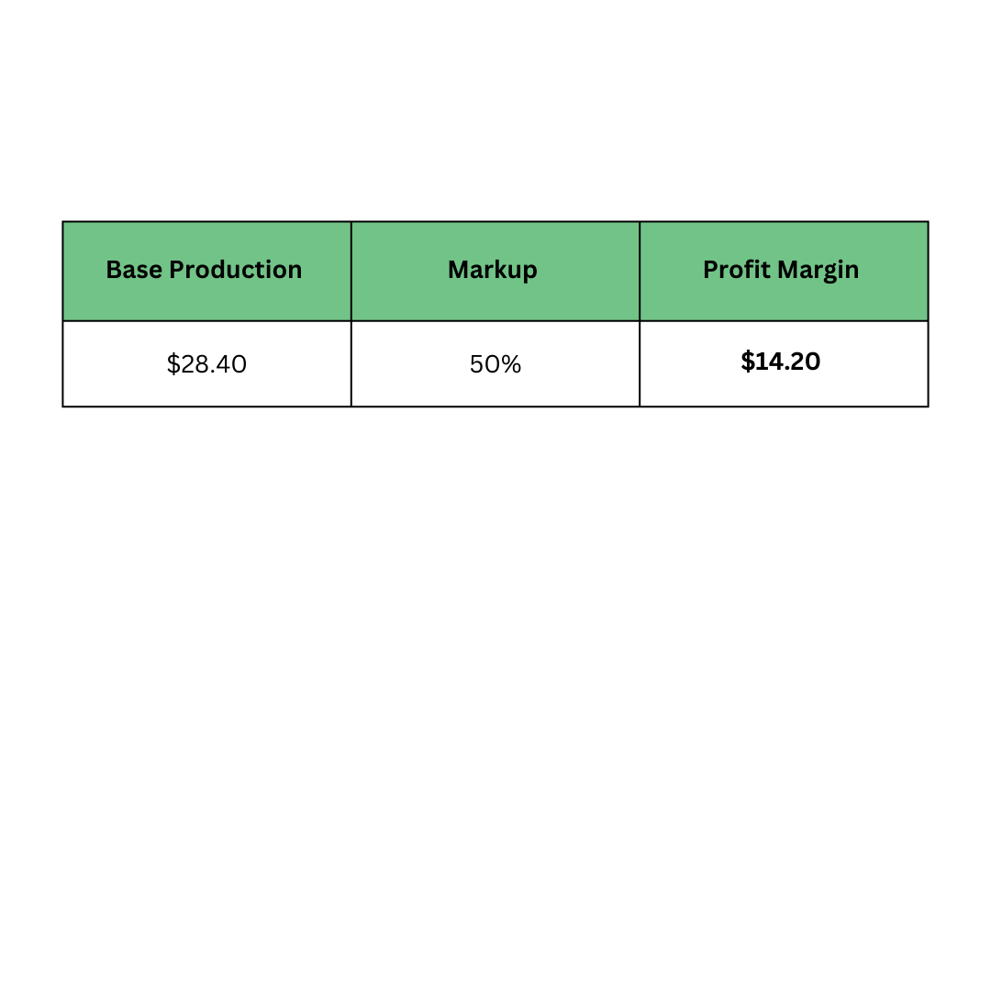
Profit Margin
Let's say we use a 50% Profit Margin to ensure all costs are covered and keep the business sustainable.
Profit Margin = $14.20

Slide 24
Take Note:
If your calculator doesn’t have a percent button, you can still do the problem by turning the percentage into a decimal. To do that, just move the decimal point two places to the left. Example: 50% → 0.50
Then multiply the base production cost by that decimal. Do the same with all formulas involving percentages.

Slide 25
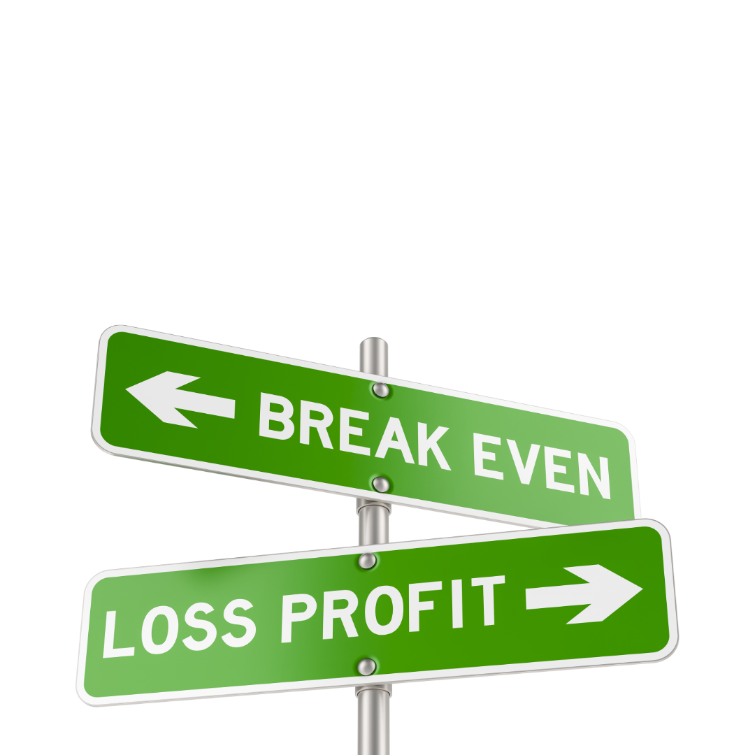
Break-even Price
The Break-even Price is the amount you need to charge for a product so that you cover all your costs. This means you don’t lose money or make money — you “break even.”

Slide 26
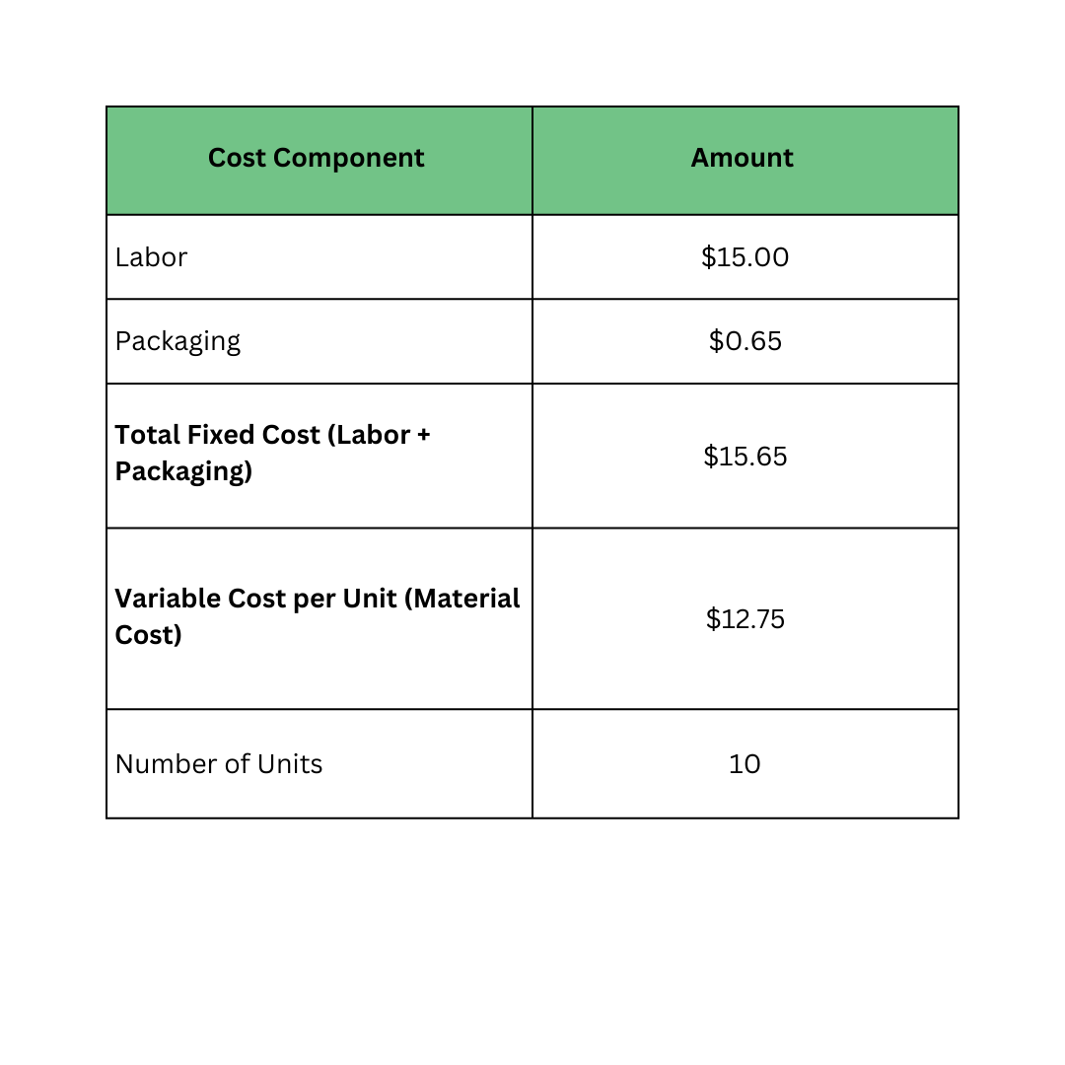
Break-even Price
Let's bring up the Fixed Cost and the Variable Cost again with our target number of units.

Slide 27
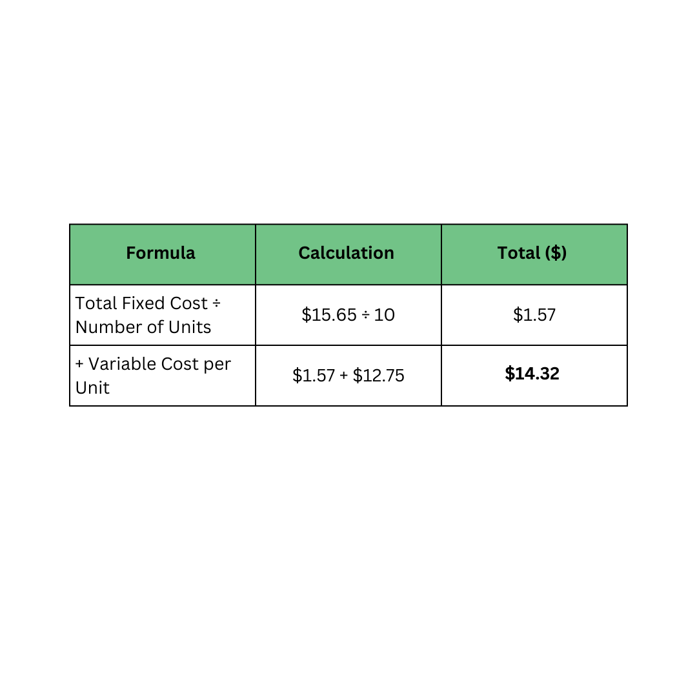
Break-even Price
Break-even Price = (Total Fixed Costs ÷ Number of Units) + Variable Cost Per Unit
Break-even Price: $14.32

Slide 28
Opportunity Cost
Here, we can list what we could not include due to time, money, or materials. This will help us make smarter choices.
Example: Extra stencil layers, glitter/shine paint,
glow-in-the-dark paint.

Slide 29

Calculate Product Price
Time to get our selling price or the Product Price.
Product Price = (Base Production Cost x Profit Margin %) + Base Production Cost

Slide 30
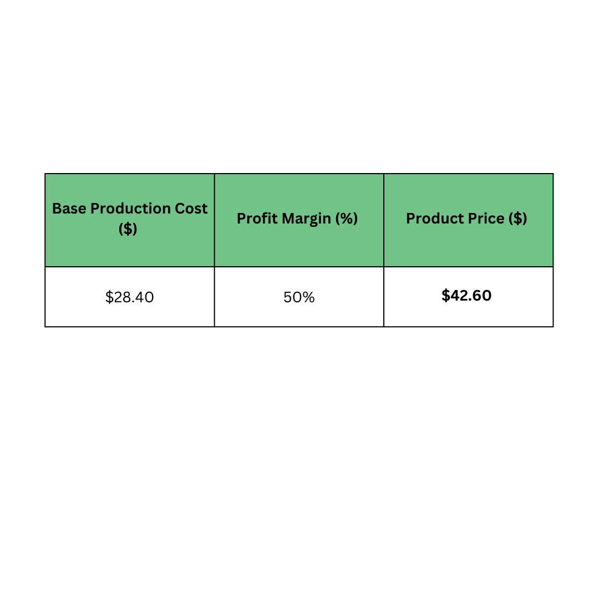
Product Price
Production Price = $42.60

Slide 31
Calculate Profit
Lastly, time to check our earnings using this formula:
Profit = Product Price – Base Production Cost
This will help us strategize our sales, like deciding how many products we need to sell to reach a certain profit.

Slide 32
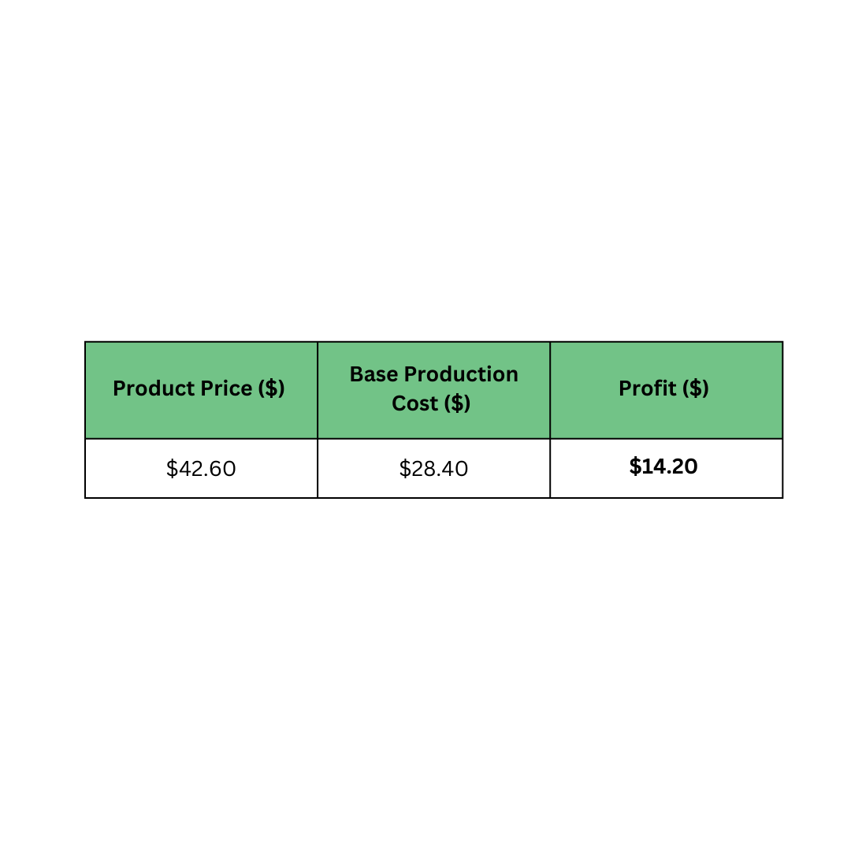
Profit
Profit for one T-shirt = $14.20

Slide 33

Think Like an Entrepreneur!
These are the key financial ideas every entrepreneur needs to make smart decisions and keep the business profitable.

