Slide 1

Marketing and Product Promotion

Slide 2

What is Marketing?
Sharing a product’s value with customers
Connecting products with the right customers
Creating interest and demand
Explaining what makes the product special
Notes:
Younger Student Meaning: Marketing is how we tell people about a product, show why it’s special, find the right people who would like it, and get them excited to try it.

Slide 3

Branding
Gives a product a unique identity so customers recognize it.
Logo / Name​
Colors​
Symbols / Patterns​
Style / Theme​​
Tagline / Slogan​​
Brand Personality & Values​
Notes:
Think about LEGO.
Logo and colors: The bright red LEGO logo is easy to recognize.
Products and style: LEGO toys are all about building and creativity.
Feeling: When kids see LEGO, they think “fun” and “imagination.”
All of this together—logo, colors, toys, and the feeling it gives—is branding. It’s how LEGO shows who they are and what makes them special.

Slide 4


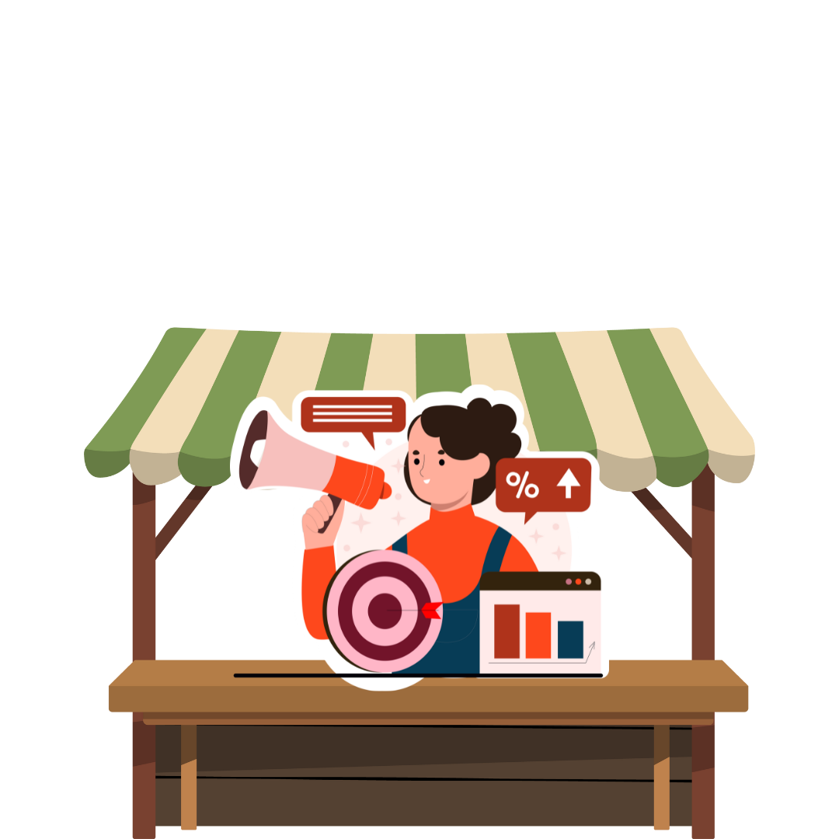

Promotion
Shows customers that a product exists and why it matters.
Social Media
Posters or Flyers
Word-of-Mouth​
School Events or Booths
Notes:
Imagine McDonald’s giving out free Happy Meal toys.
They tell kids, “Come get the new toy with your meal!”
Kids get excited and want to go to McDonald’s.
That’s promotion—it’s a way to show people something fun or special so they want it.

Slide 5
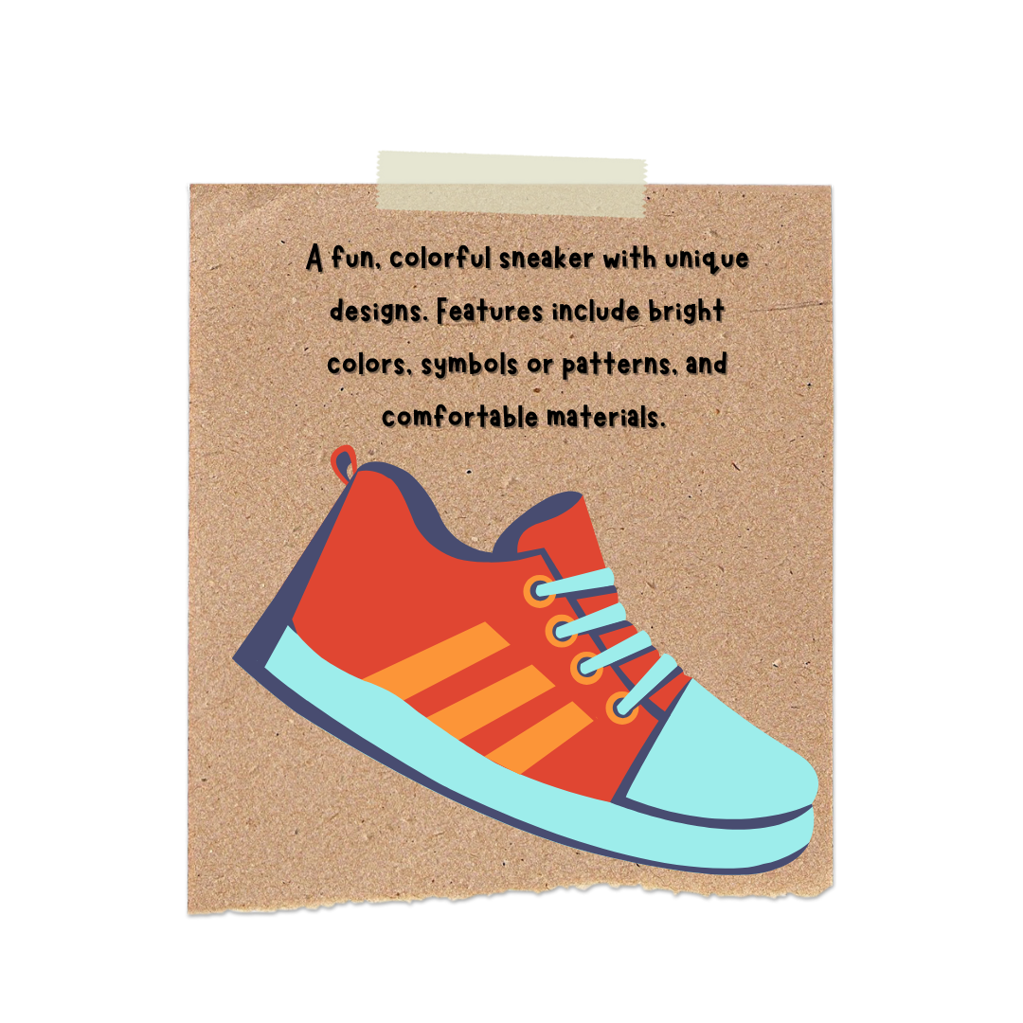
The 4Ps of Marketing
Product - What it is, features, and benefits

Slide 6
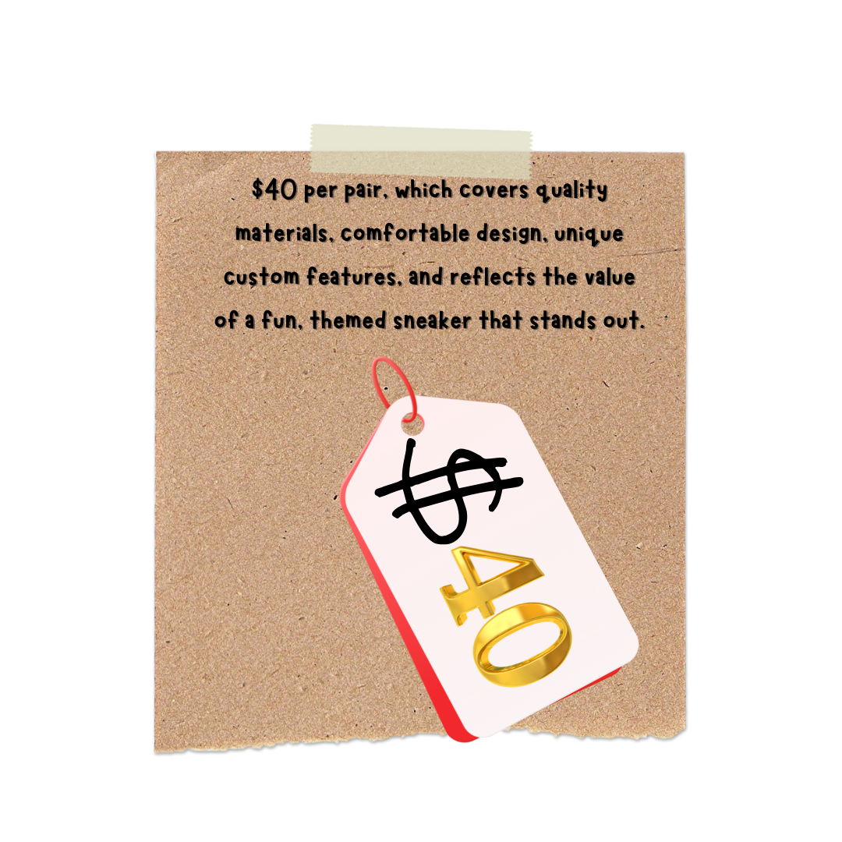
The 4Ps of Marketing
Price - How much it costs and why

Slide 7
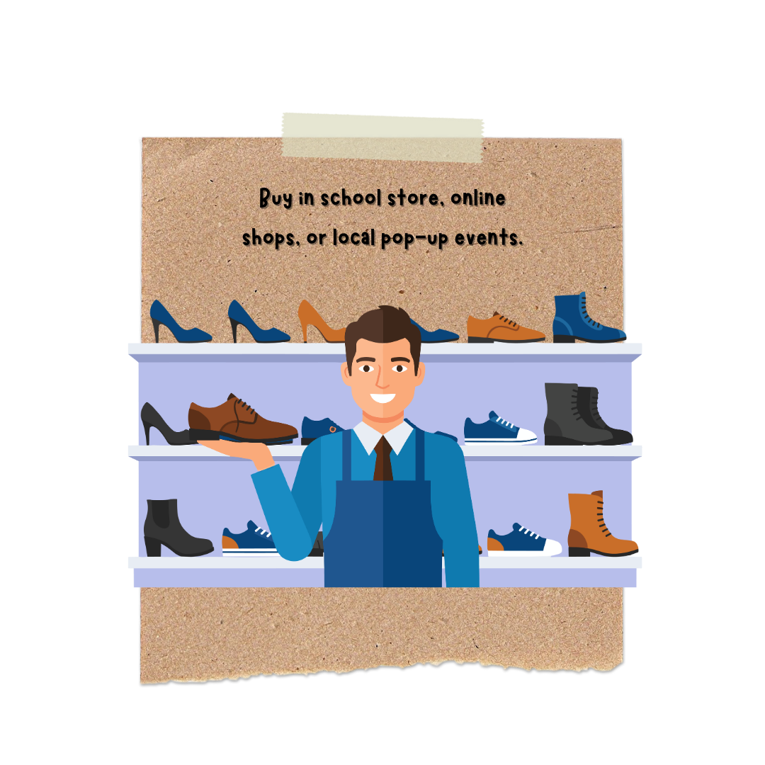
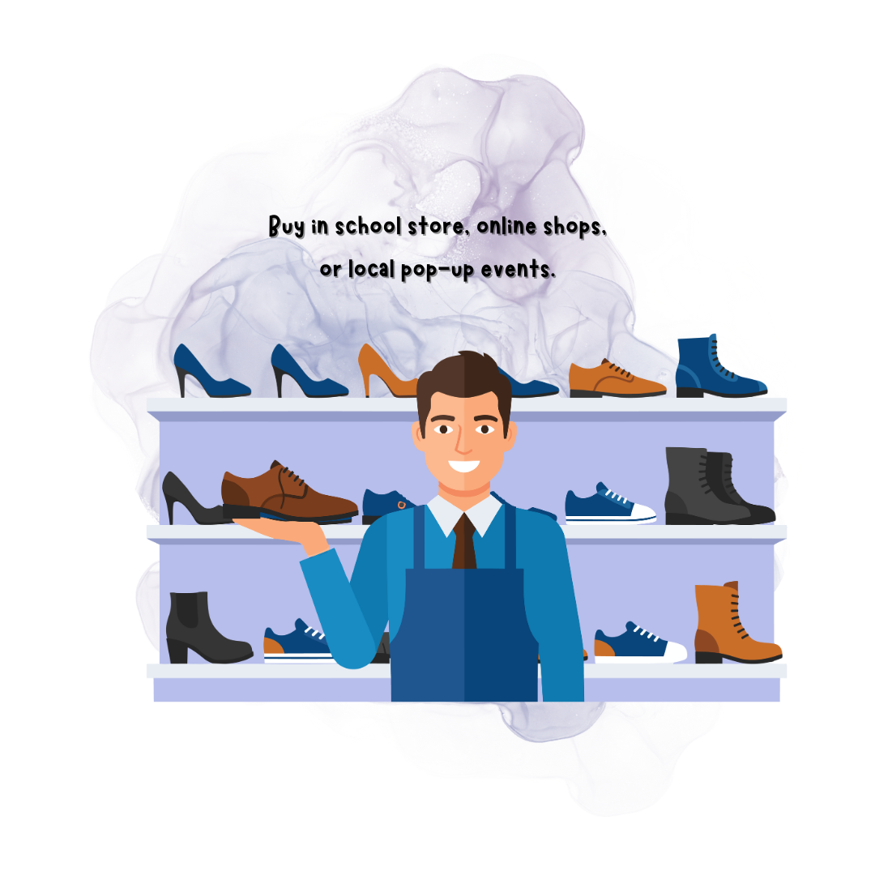
The 4Ps of Marketing
Place - Where customers can buy it

Slide 8
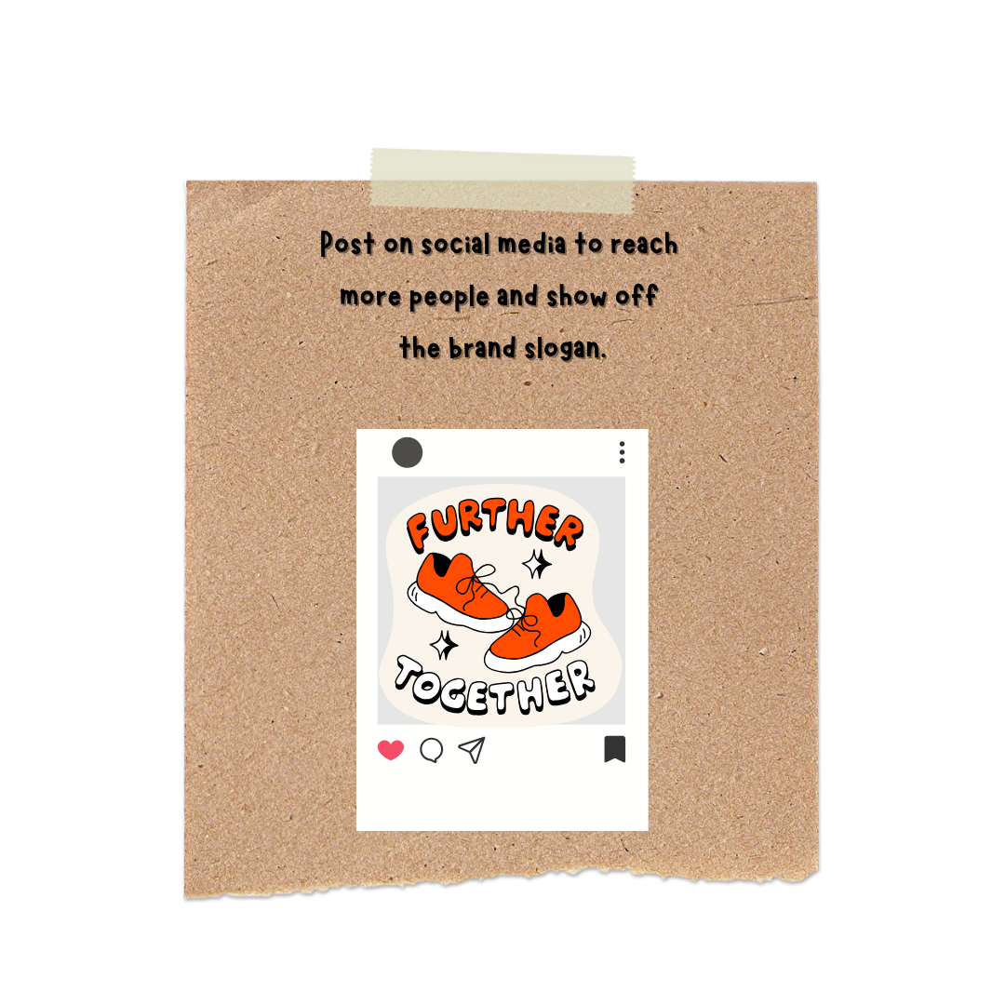
The 4Ps of Marketing
Promotion - How it’s advertised

Slide 9

Let's Create a Marketing Plan

Slide 10
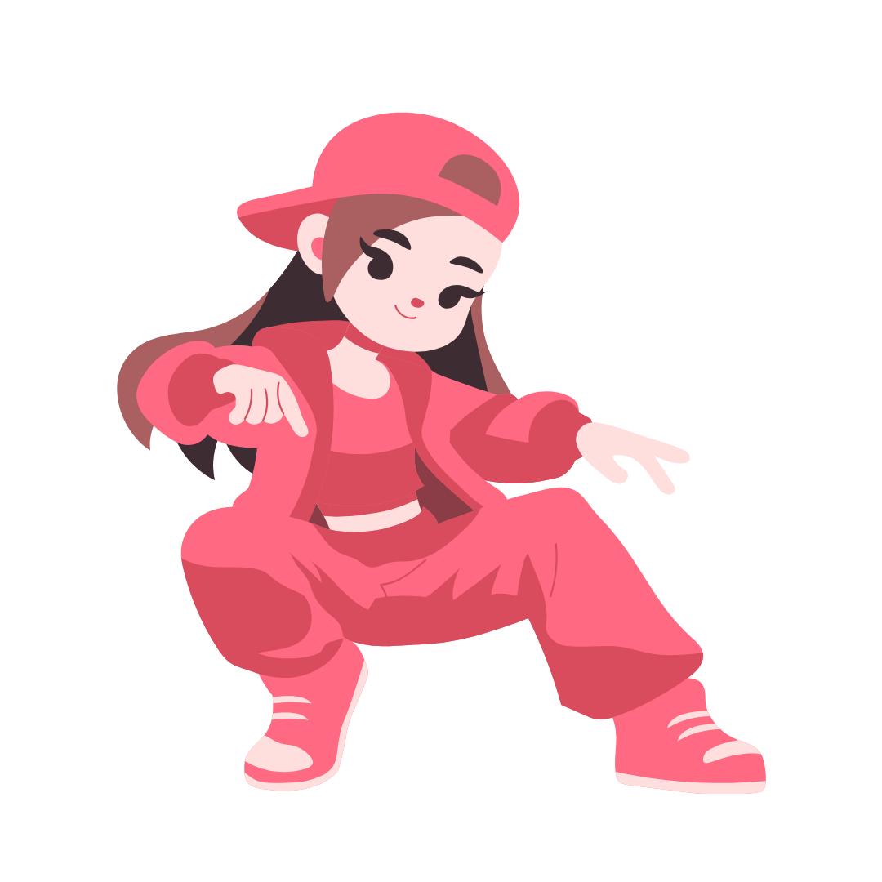
Target Market
Anna wants to explore the world of graffiti and hip-hop, all while expressing herself through a one of a kind pair of shoes that no one else owns.

Slide 11

Goal
Graffiti - The musician’s names are written on the shoe by a custom designer in a graffiti style.
Hip Hop - The shoe is characterized by the graffiti style musician names displayed across the shoe.
One of a kind - The shoe can be a one-of-a-kind product because it can be customized by writing your favorite musicians on it and using your logo and/or signature.

Slide 12
Product
Details:
Base product - All shoes come with a white base and white soles.
Side shoe - Each shoe will display a minimum of 4 musician. names written by a custom designer in a graffiti style format.
Tongue of the shoe will be the color of your choosing with your name
Inside heel will have a black circle with customer signature or our logo.

Slide 13
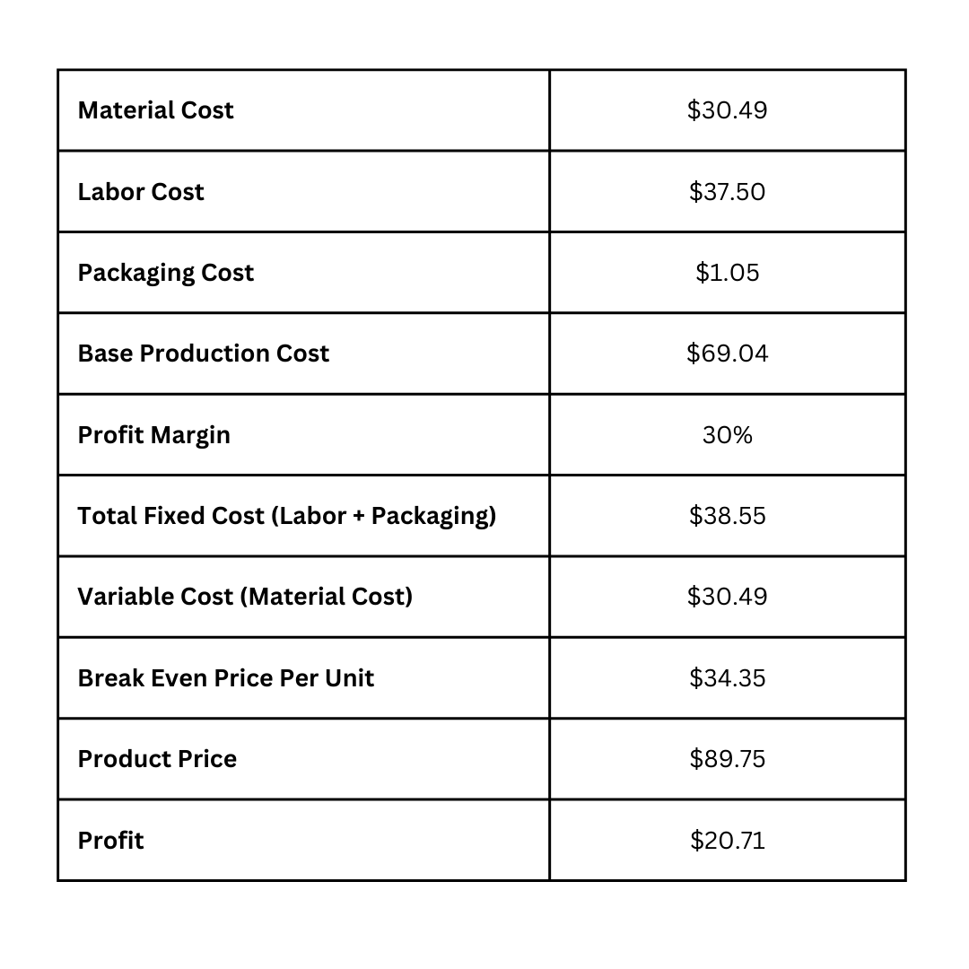
Price
Details: This will come from the cost analysis activity.

Slide 14
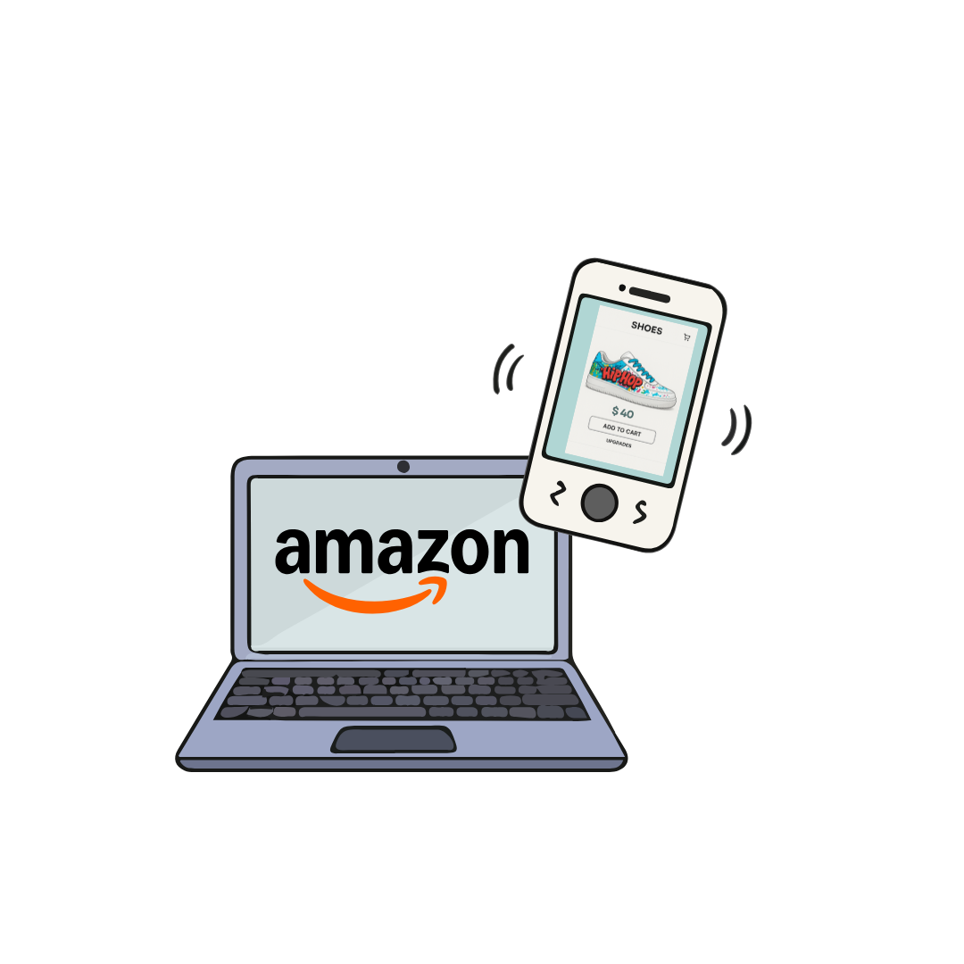
Place
Details:
There will be a website that will have the shoes pictured, along with prices and upgrade options. Customers will be able to send a picture of their signature and/or logo to include as well.
People will find out about our product through advertisements on social media and google advertisements.
The other option is Amazon where customers can buy the basic design at a higher price. The only customization available is the ability for customers to choose which music category their musicians will be chosen from
Customers will find out about our product through searching for custom shoes on amazon.

Slide 15
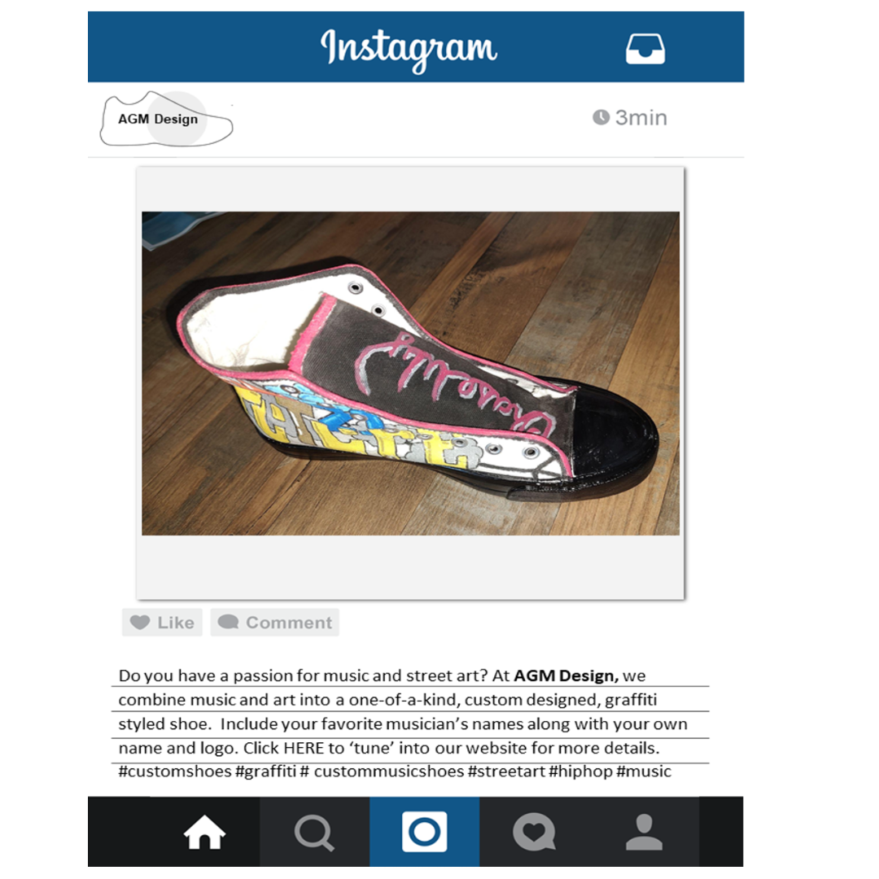
Promotion
Details: Promote through social media.

