Slide 1

Shoe Design

Slide 2
Key Educational Words
Science: Design Principles, Material Properties, Understanding of Surfaces, Durability, Flexibility, Visual Balance, Color Theory, Mood, Symbolism, Storytelling, Visual Communication
Technology: Tools for Design, Templates, Stencil Application, Airbrushing Techniques, Fabric Markers, Permanent Materials, Sketch, Experimentation, Style, Theme

Slide 3
Key Educational Words
Engineering: Precision in Design, Spatial Awareness, Measurement, Scale, Construction, Alignment, Planning, Pattern, Shape, Brainstorm, Revise, Finalize, Feedback, Iteration
Mathematics: Symmetry, Proportions, Scale for Design, Measurement, Harmony, Contrast, Personalization, Preferences, Customer, Market Trends

Slide 4
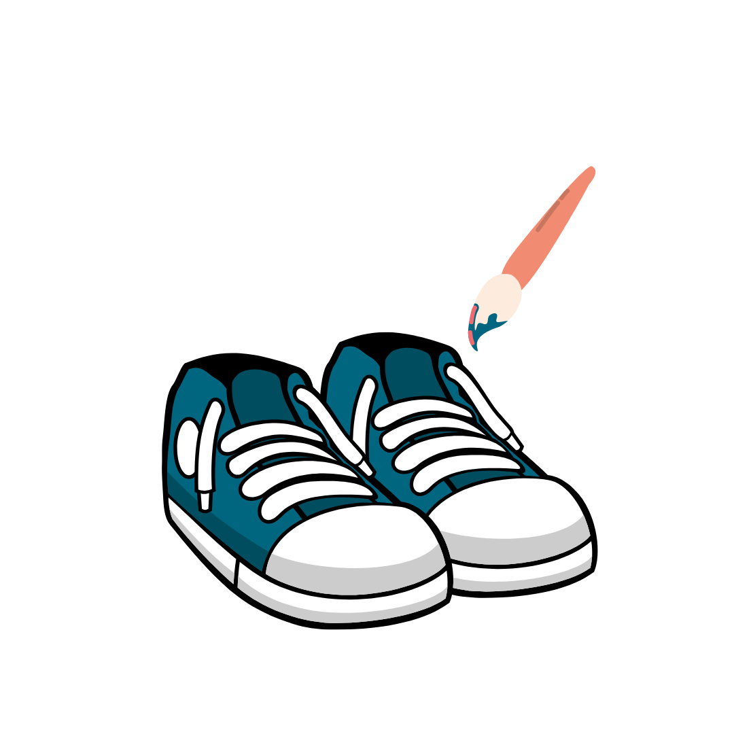
Shoe Design
process of developing footwear that balances functionality, comfort, and creativity
shaping the shoe’s structure, choosing materials, and applying design techniques to produce custom footwear that serves a specific purpose

Slide 5

Collaboration with JP Designs
JP Designs highlighted his work with major entertainment figures and his transition into entrepreneurship through custom shoe art, relying on techniques like airbrushing, understanding of materials, and precision in design—skills rooted in art and STEM.

Slide 6
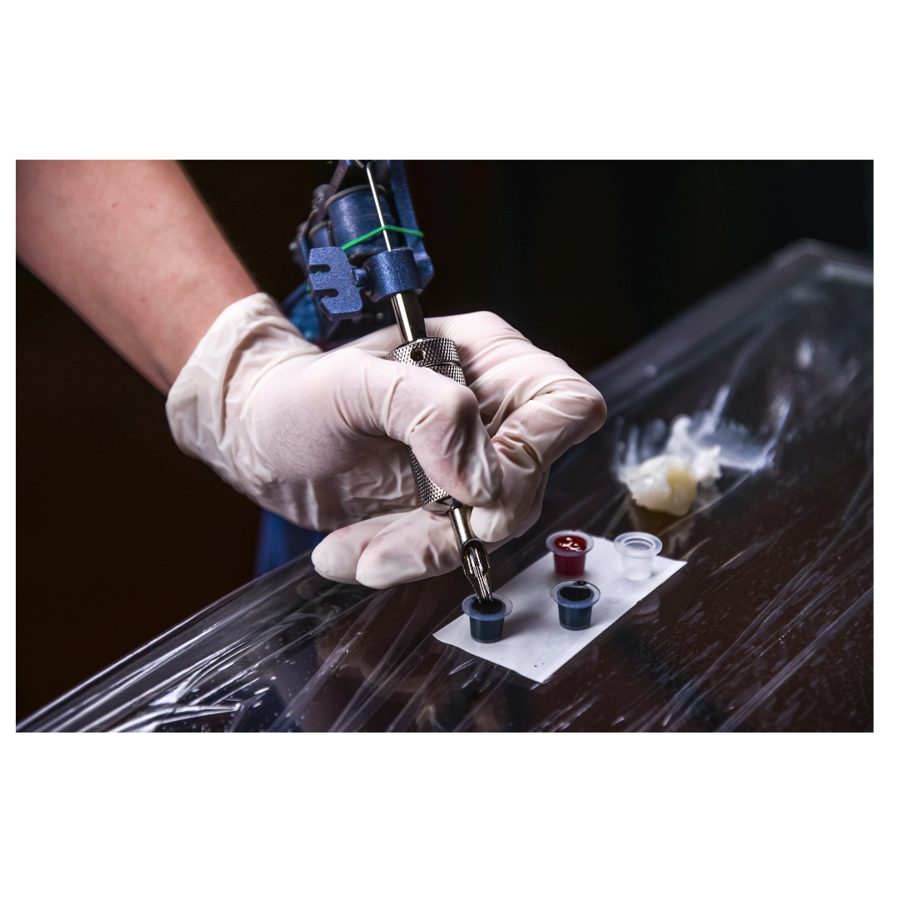
Collaboration with JP Designs
Miss Lexy shared her evolution from graffiti and canvas work to working with Houston Art Show curators, eventually becoming a professional tattoo artist and private studio owner. Her work also reflects STEM integration through the technical knowledge of tools, skin-safe inks, and design measurements essential in tattoo artistry.

Slide 7
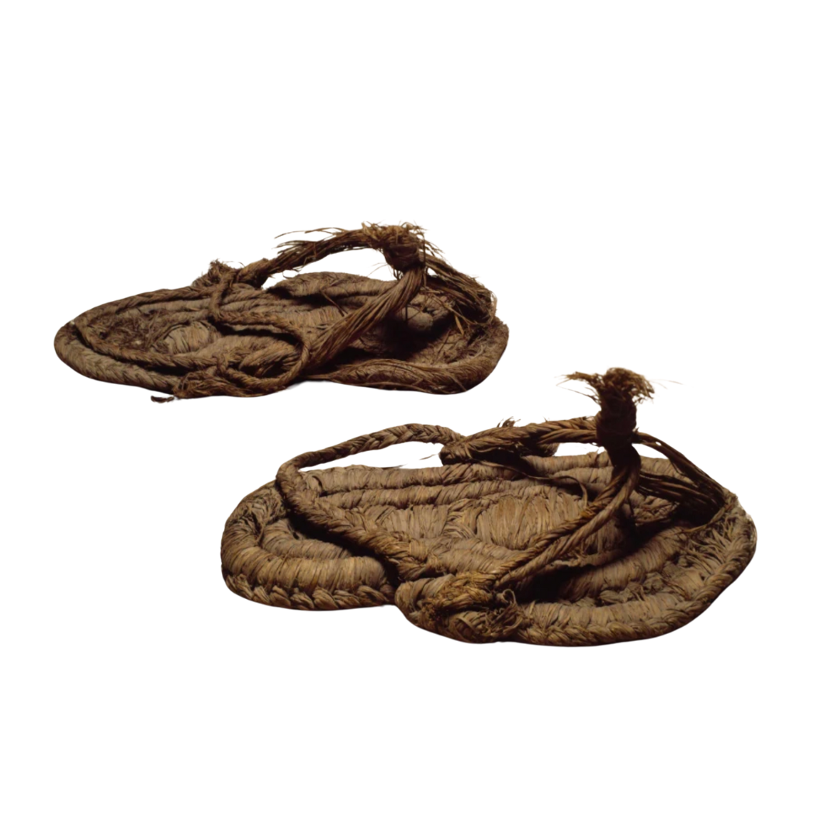
History of Footwear
Early Footwear looked like...
Brush shoes made from plant fibers
Saddle wood soles for walking
Simple sandals to protect the feet

Slide 8

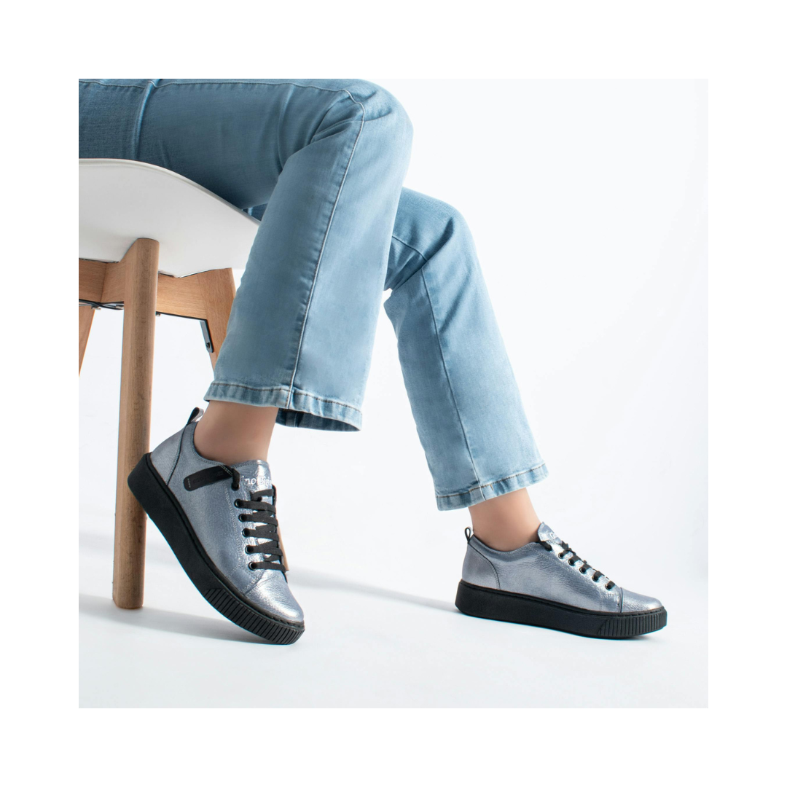
History of Footwear
Sneakers were first made to…
– Protect feet during running and sports
– Use stronger materials for better performance
Then sneakers became…
– A part of everyday fashion
– Popular in music, movies, and streetwear

Slide 9

History of Footwear
In the 1970s, big sneaker brands appeared like…
Nike​
Jordan​
Adidas​
Converse

Slide 10
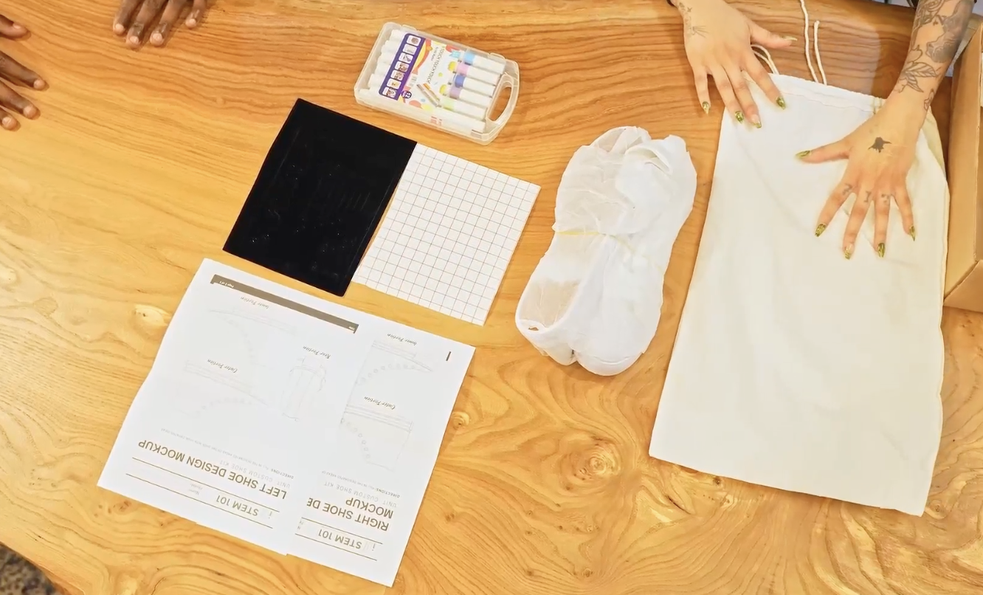
Materials for Custom Shoe Design
templates for creating shoes (left and right)
STEM 101 stencils
transfer tape
markers
shoes

Slide 11

Design Concept
Think of a concept!
A design concept is the central idea or message behind a piece of visual art or product design.

Slide 12

A. Personal Design
Creating something that reflects your own emotions, ideas, and experiences
Focus on creativity and individuality, not skill level
Turn simple designs into meaningful visual stories

Slide 13

B. Customer Design
Creating designs for other people =
learn about their personality, needs, and preferences
Market trends = what styles, colors, or themes are currently popular

Slide 14

Design Breakdown or Features
A design breakdown is how the design is created by breaking it into smaller components or features like symbols and colors

Slide 15
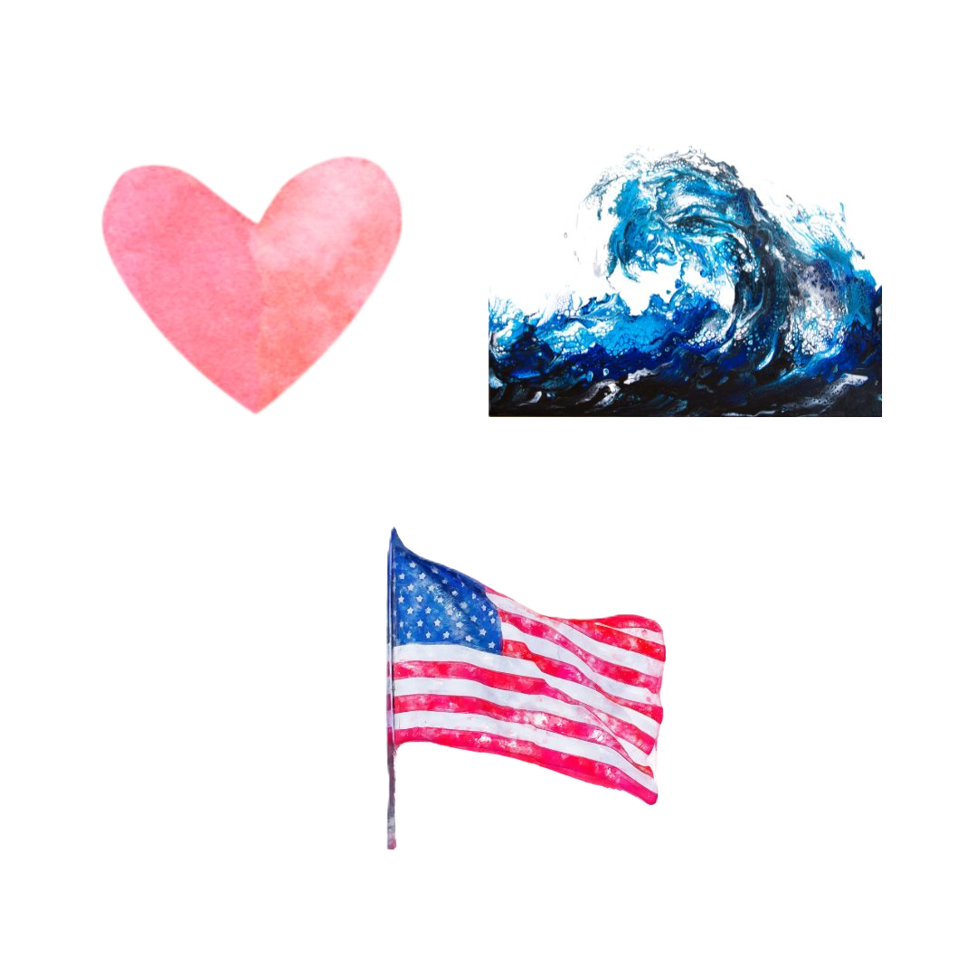
Symbolism in Art
Tell a story with your shoes!
Symbols are images or elements that represent deeper meanings or ideas.
In shoe design, students can use symbols to represent emotions (e.g., a heart for love), identity (e.g., a flag or cultural pattern), or experiences (e.g., waves for a love of the ocean).

Slide 16

Color Theory and Visual Balance
Colors evoke emotions: red can suggest passion or energy, blue might convey calmness or sadness.
Designers use color theory to create mood, harmony, or contrast in their designs.

Slide 17

Target Market
refers to the specific group of people a shoe designer focuses on when creating custom shoes. It involves understanding the customer's:
Age
Lifestyle
Interests and hobbies
Personality and preferences
Environment (where they live or spend time)
Fashion style and cultural influences

Slide 18

Sample Target Market
WHO: Your client’s name is Ms. Lewis. She is the school’s crossing guard.
WHERE: She works at the local school, helping children cross the street safely every day.
WHAT: Ms. Lewis is always cheerful and wears bright yellow clothing for visibility. She cares deeply about safety and being helpful to the community.

Slide 19
Sample Target Market
Design Breakdown or Features based on the Target Market:
Bright Yellow Base Color: Use a bright yellow color all over the shoe to match Mr. Lewis’s cheerful and safety-focused uniform.
Smiley Face Symbols: Add simple smiley faces on the sides or tongue of the shoe to show his friendly and positive attitude.
Traffic Sign Icons: Include easy-to-recognize traffic sign colors on top of the designs.

Slide 20
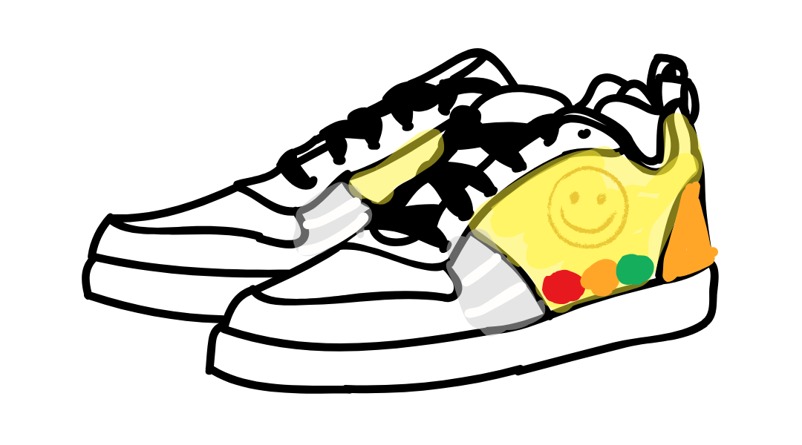
Custom Shoe Design Template Based on Target Market

Slide 21
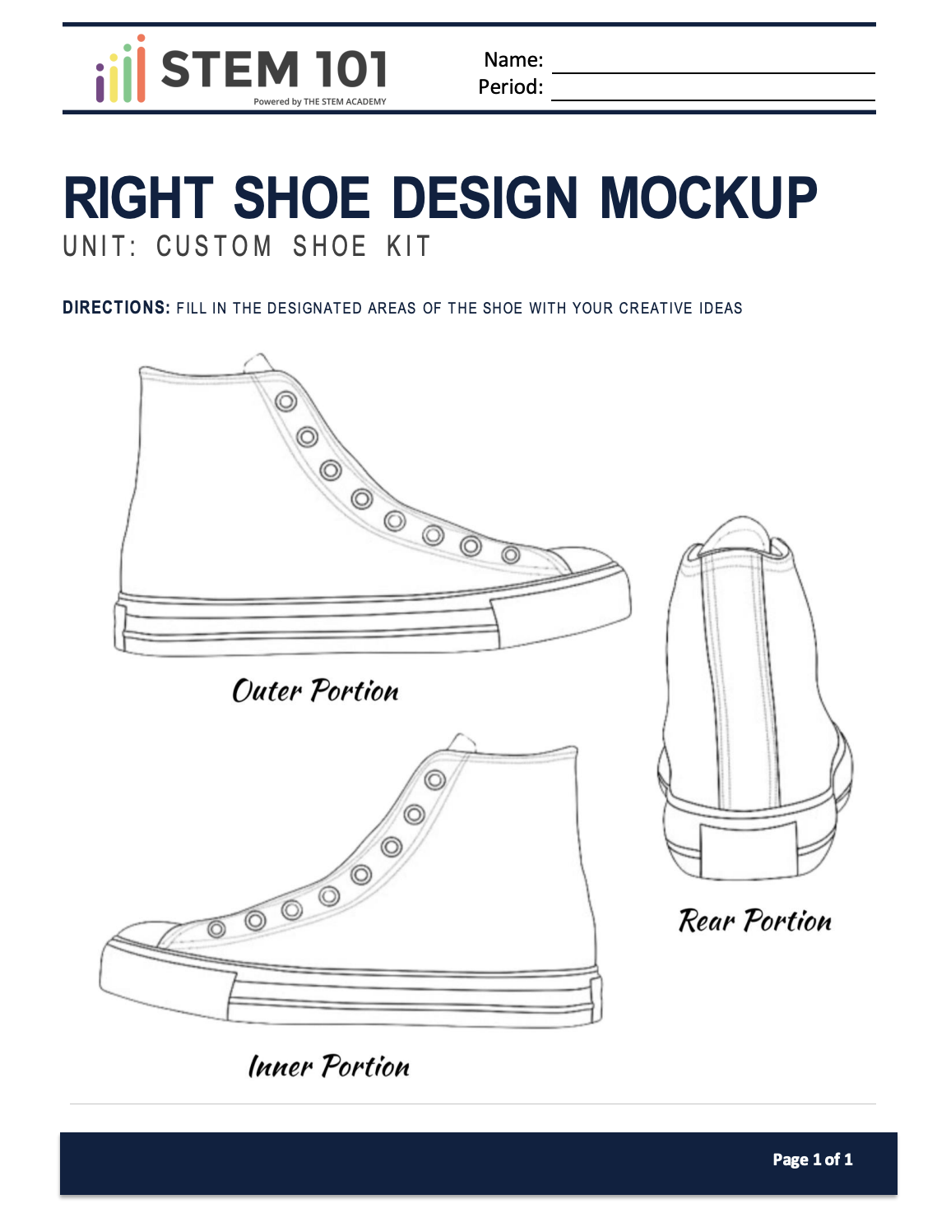
Using Templates
Templates are drafts, where ideas are flexible and open to change.
Using colored pencils on a template allows for easy changes, letting students test color schemes and layouts before committing.

Slide 22

Design Process Recap
Step 1: Brainstorm and choose a concept
Step 2: Sketch ideas using pencil on a template
Step 3: Add color using colored pencils and adjust design elements
Step 4: Revise based on feedback or reflection
Step 5: Finalize the design and prepare for presentation or production

Slide 23
Shoe Preparation
Prepare your workspace and shoes before painting!
Stuff shoes with tissue for structure and support
Remove laces to keep them clean
Know your materials—cloth shoes absorb paint better
Align shoes with your sketch to guide your design
Start with the right shoe for consistency and flow

Slide 24
Shoe Production
1. Cover areas with tape – Protect soles and untouched sections to avoid unwanted paint and get clean edges.
2. Lightly sketch your design – Use a pencil to plan your artwork; it’s easier to fix mistakes before painting.
3. Use light pressure – Prevent dark pencil lines from showing through lighter paint colors.

Slide 25
Shoe Production
4. Create sharp borders – Use tape for clean lines, or if unavailable, press inside the shoe and slowly roll your marker along the edge.
5. Focus on control and creativity – These techniques help you stay neat while expressing your unique design.

Slide 26
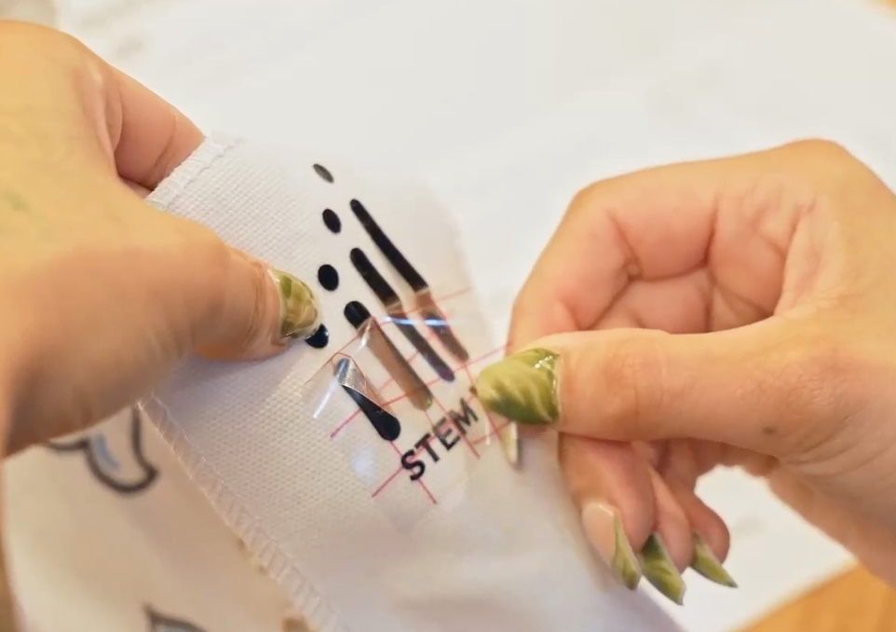
Stencil Application
Choose your stencil technique:
• Die-cut stencil:
– Place the vinyl shape on the shoe
– Paint over the exposed design area

Slide 27
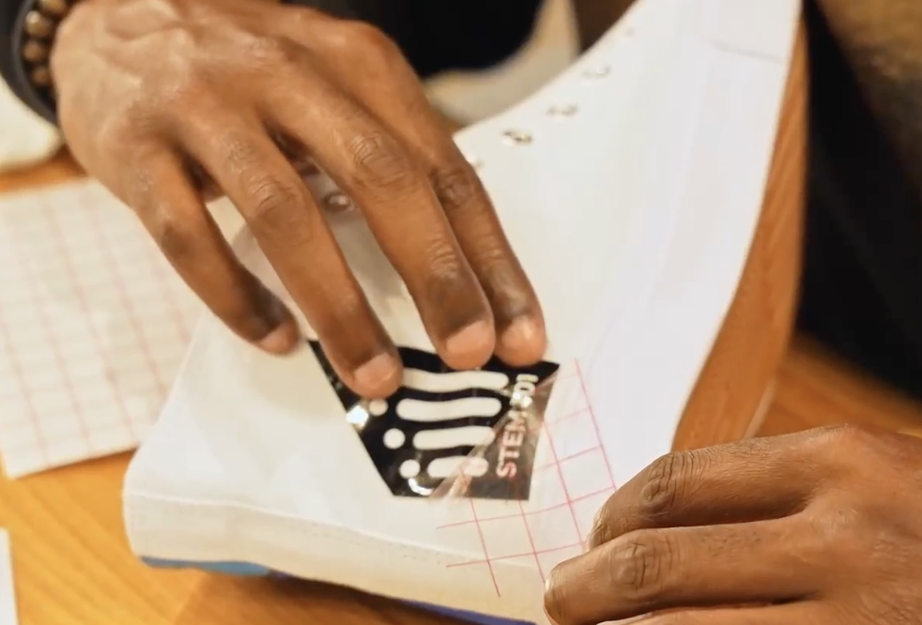
Stencil Application
Choose your stencil technique:
• Inlay stencil:​
– Place the full vinyl sheet with cut-out design​
– Paint inside the open
spaces​
​

Slide 28
Stencil Application
• Secure the stencil properly. Press down all edges to avoid air bubbles and paint bleed
• Apply paint with even pressure to prevent smudges and keep lines clean
• Remove stencil carefully. Use a clean, pointed tool like a toothpick or tissue-wrapped pencil tip
• Combine precision with creativity to share your story through your shoe art!

