Slide 1

ENTREPRENEURSHIP

Slide 2
What is an Entrepreneur ?
An Entrepreneur is someone who starts a new business or company and sells a product or service for a profit.

Slide 3
Entrepreneurs use Marketing Strategies to:
consider needs and wants of potential customers
use creative ideas to improve current products or services
use innovative thinking to produce brand new products or services

Slide 4
What is Marketing?
Marketing Includes:
Market Research
Product Development
Production
Advertising
Sales
Customer Support
Marketing - the process of getting people interested in a company’s product or service with the goal of sales

Slide 5
Analyze a Soap Product
Choose a soap product currently on the market.
What drew you to this choice? Who do you think the target market is for this product?
The Target Market is a customer group that has similar qualities that make them the most likely group to purchase a product or service.
ENTREPRENEURSHIP – Clean it Up

Slide 6





Target Market Examples
Target Markets can include both general and specific information about possible customers.
Common Market Categories include:
Age
Location
Hobbies & Interests
Personal Qualities
Families with children
2 years old or under
Professional
Sports Team Fans
Grocery shoppers with food allergies
Dog owners that go camping
ENTREPRENEURSHIP – Clean it Up

Slide 7
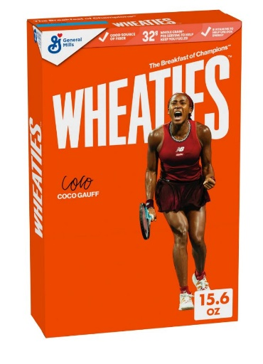
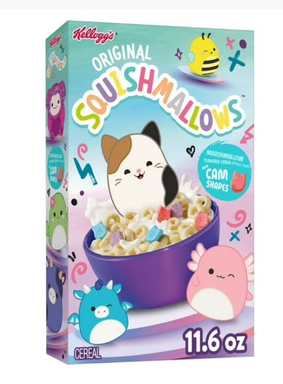
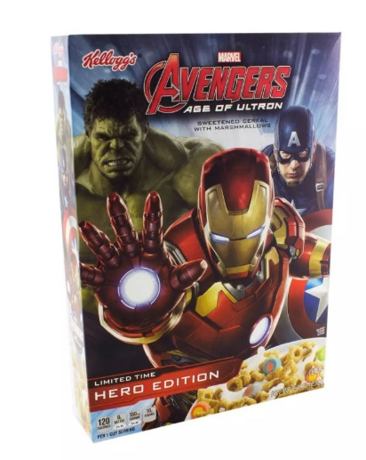
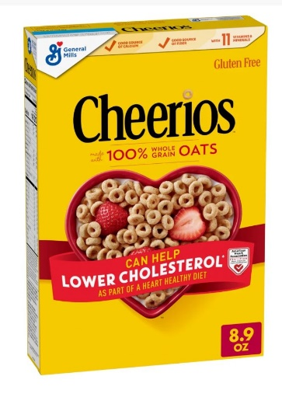
Match the Cereal Box Design to the Target Market
Children
Marvel Superhero Fans
Athletes
People Focused on
Health
ENTREPRENEURSHIP – Clean it Up

Slide 8
Athletes
Children
People Focused on
Health
Marvel Superhero Fans
ENTREPRENEURSHIP – Clean it Up

Slide 9
Discuss the following after completing Research p.2
1. What types of soap were analyzed by the class?
We use a variety of soaps in our daily lives. Hand soap, body wash, face cleansers, shampoo, bath bubbles, baby soaps, pet soaps, dish soap, laundry detergent, surface & floor cleansers, stain removers, etc.
2. What were some of the target markets of the class examples?
Are you or your family members included in most of the target markets? Is there a target market that seemed to be missing from our class examples?
3. What did you like best about the examples?
Are these qualities you hope to include in your soap product?
4. What did the class feel needed most improving?
Can you include some of these qualities? Would this make your product more marketable?
ENTREPRENEURSHIP – Clean it Up

Slide 10





What Ingredients are we using in our soap products?
Water
The amount of water you add will determine the thickness, strength, and foam amount of your soap product.
Essential Oils
Essential oils provide scent and other benefits to your soap product. Cedarwood, Lavender, and Orange are your options. You can use oils alone or combine them.
Castile Soap
This is the foaming agent for your soap product.
ENTREPRENEURSHIP – Clean it Up

Slide 11
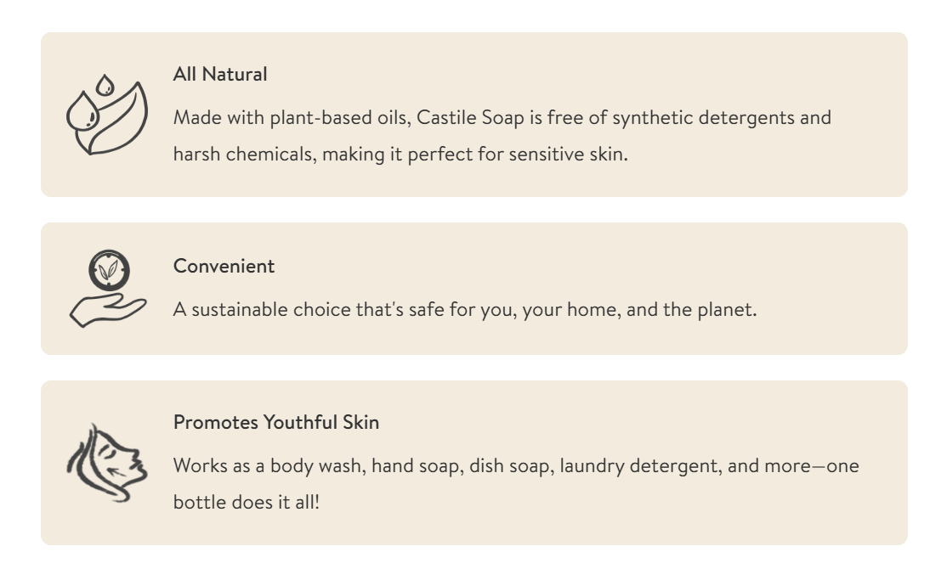
Castile Soap Information
Details
Castile Soap is made from saponified plant oils. It is considered to be natural and is perfect for DIY liquid soaps and other cleaning products.
Ingredients: Water, Organic Vegetable Oil Blend (Organic Sunflower Oil, Organic Coconut Oil, Organic Extra Virgin Olive Oil, Organic Castor Oil), Potassium Hydroxide, Citric Acid, Organic Aloe.
ENTREPRENEURSHIP – Clean it Up

Slide 12


Essential Oils Information - Cedarwood
ENTREPRENEURSHIP – Clean it Up

Slide 13


Essential Oils Information - Lavender
ENTREPRENEURSHIP – Clean it Up

Slide 14


Essential Oils Information - Orange
ENTREPRENEURSHIP – Clean it Up

Slide 15
Create Your Soap Recipe
For a liquid hand soap, the recommended ratio is
Castile Soap 1 part : Water 3 parts
What would the ratio amounts be for a 400 mL bottle?
Step 1 - Divide the total volume by 4 total parts (1 soap + 3 water = 4 total parts)
  400 ÷ 4 = 100
  Each part = 100 mL
Step 2 – Calculate the totals using the ratio
  Castile Soap 1 : Water 3
  1 x 100 mL : 3 x 100 mL
  Castile Soap 100 mL : Water 300 mL
Check your math 100 mL + 300 mL = 400 mL
What would the ratio amounts be for our 60 mL soap bottle if following the suggested ratio?
Answer on next slide
ENTREPRENEURSHIP – Clean it Up

Slide 16
Create Your Soap Recipe
What would the ratio amounts be for our 60 mL bottle?
Step 1 - Divide the total volume by 4 total parts (1 soap + 3 water = 4 total parts)
  60 ÷ 4 = 15
  Each part = 15 mL
Step 2 – Calculate the totals using the ratio
  Castile Soap 1 : Water 3
  1 x 15 mL : 3 x 15 mL
  Castile Soap 15 mL : Water 45 mL
Check your math 15 mL + 45 mL = 60 mL
If you are creating a thicker/more soapy product, your ratio should include more Castile Soap.
If you are creating a thinner/less soapy product, your ratio should include more water.
ENTREPRENEURSHIP – Clean it Up

Slide 17



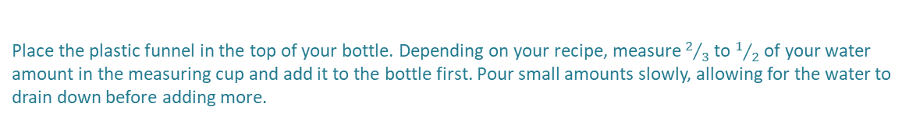
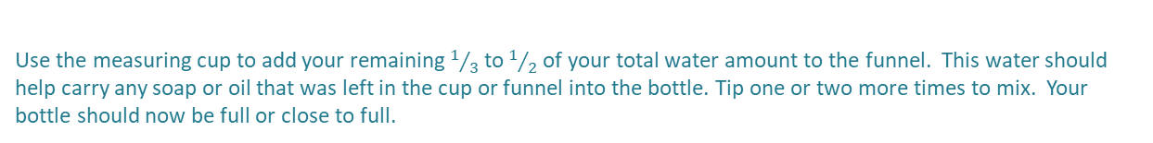
Recommended Soap Mixing Procedure
Place the plastic funnel in the top of your bottle. Depending on your recipe, measure $2/3$ to $1/2$ of your water amount in the measuring cup and add it to the bottle first. Pour small amounts slowly, allowing for the water to drain down before adding more.
Use the provided measuring cup to measure your Castile Soap amount. Slowly pour it through the funnel into the bottle. Aim for the center hole of the funnel so as much soap goes directly into the bottle as possible. Set measuring cup aside – do not rinse.
Carefully add the desired amount of drops of each essential oil to the bottle through the funnel (no more than 3 total). Aim for the center hole of the funnel as you did above with the soap. The drops come out quickly. You might want to practice over a garbage can or sink first to get the feel for it.
Put the cap back onto the bottle making sure it is closed. Slowly and gently turn the bottle upside down 2-3 times to mix. Do not shake. Try to create as few bubbles as possible.
Use the measuring cup to add your remaining $1/3$ to $1/2$of your total water amount to the funnel. This water should help carry any soap or oil that was left in the cup or funnel into the bottle. Tip one or two more times to mix. Your bottle should now be full or close to full.
ENTREPRENEURSHIP – Clean it Up

Slide 18
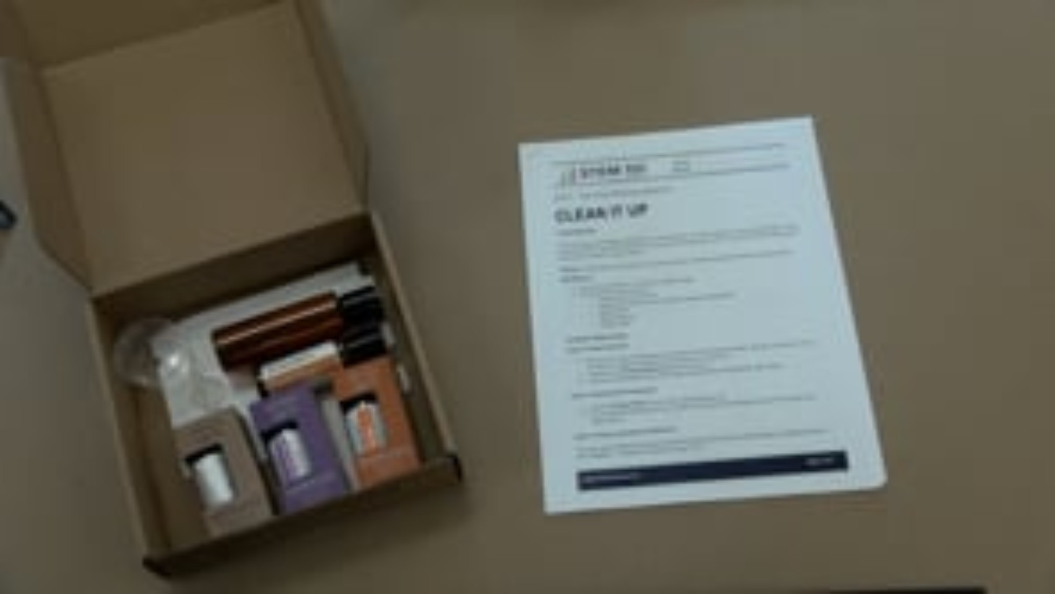
ENTREPRENEURSHIP – Clean it Up

Slide 19

Click the image above to play the game
ENTREPRENEURSHIP – Design Your Own Logo

Slide 20




A logo is a graphic symbol that represents a brand, business, organization,
or product.
It can include images, text,
or both.
What are the business advantages of logos?
Help customers recognize and remember a business
Catch attention & make products stand out among the competition
Can appeal to and draw in specific target markets
Provide a design theme for marketing and advertising
ENTREPRENEURSHIP – Design Your Own Logo

Slide 21



Things to consider when creating a logo:
Typography or Font Style
Artistic Style
Color Palette
The goal in creating a logo is to design something that catches the eye, but isn’t too complex!
ENTREPRENEURSHIP – Design Your Own Logo

Slide 22





Some well known logos have hidden images or meanings you may not have noticed before:
ENTREPRENEURSHIP – Design Your Own Logo

Slide 23




Some well known logos have hidden images or meanings you may not have noticed before:
Arrow shows that Amazon sells products from “a to z”
Second and third “T” are images of people holding a tortilla chip over a bowl
Pink “31” hidden in B & R for the 31 ice cream flavors of
Baskin Robbins
“M” for Milwaukee forms the fingers of the baseball glove, “B” for Brewers forms the thumb with baseball in center
“Hershey’s Kiss shape” formed sideways in between the K and I
ENTREPRENEURSHIP – Design Your Own Logo

Slide 24
Things to consider when designing your label
Placement of Logo Image
Text Style & Font
Additional Information
Colors
Patterns
Borders
2.5 inches
3 inches
ENTREPRENEURSHIP – Design Your Own Logo

Slide 25
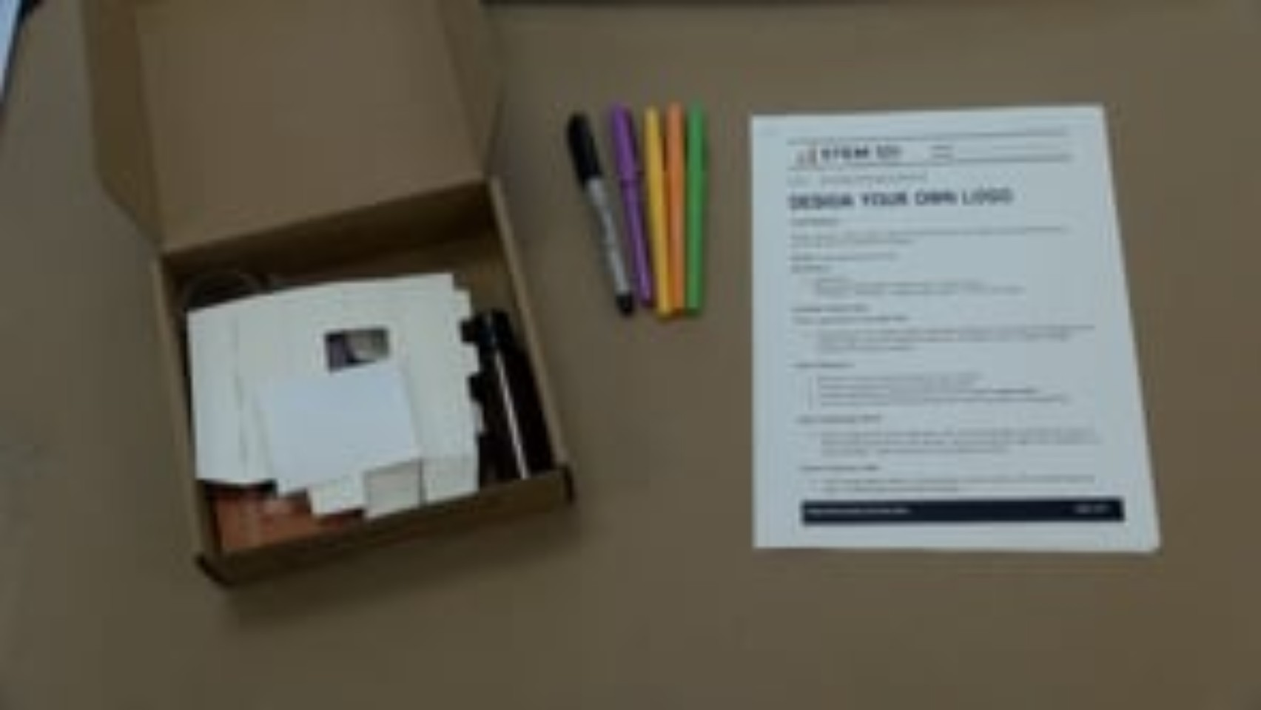
ENTREPRENEURSHIP – Design Your Own Logo

Slide 26
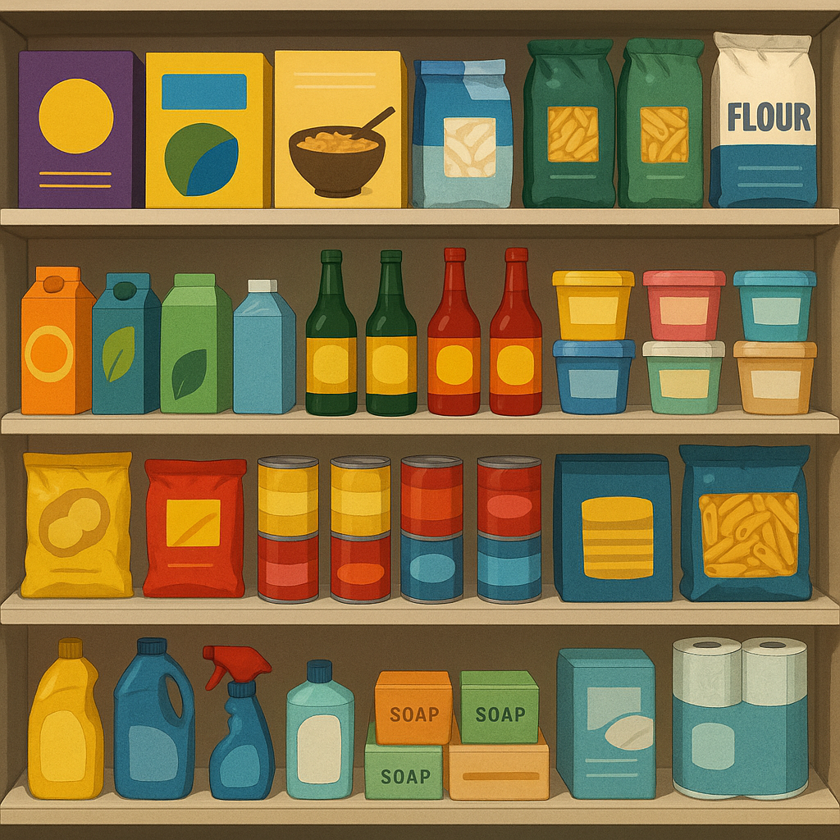
Product packaging serves many different purposes.
How many can you think of?
ENTREPRENEURSHIP – The Total Package

Slide 27
Effective Product Packaging Can…
Protect the product from getting dirty, contaminated, damaged or broken
Preserve the product to keep it fresh or help it last longer
Contain multiple loose parts or items
Make product use easier for the customer
Make storage and shipping easier for both customers and sellers
Promote advertising or information about the product
ENTREPRENEURSHIP – The Total Package

Slide 28
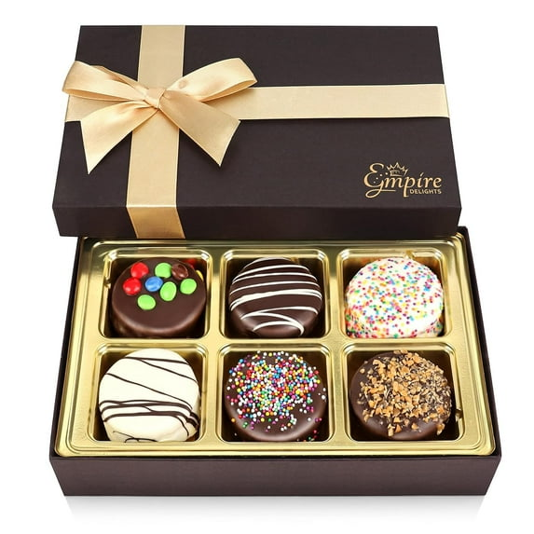
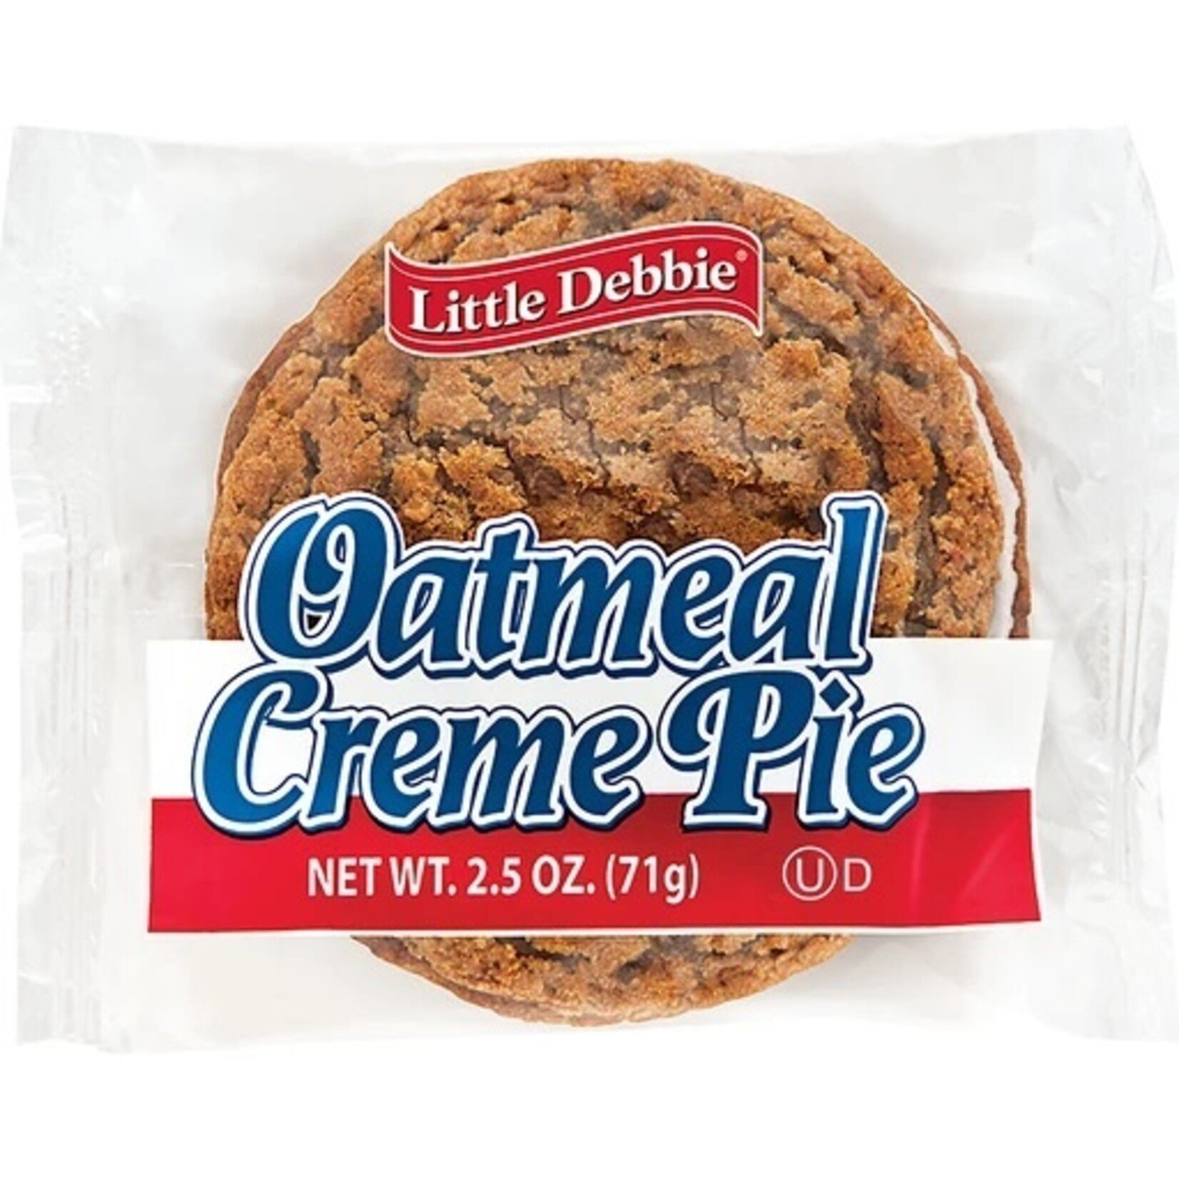
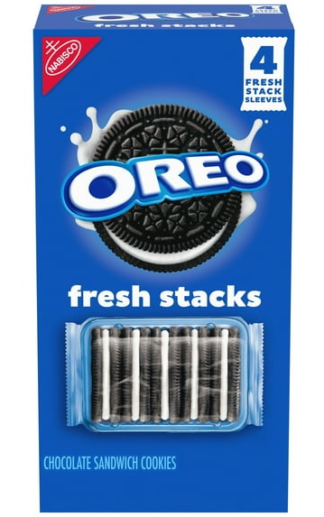
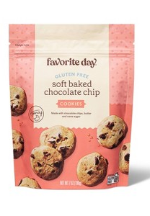
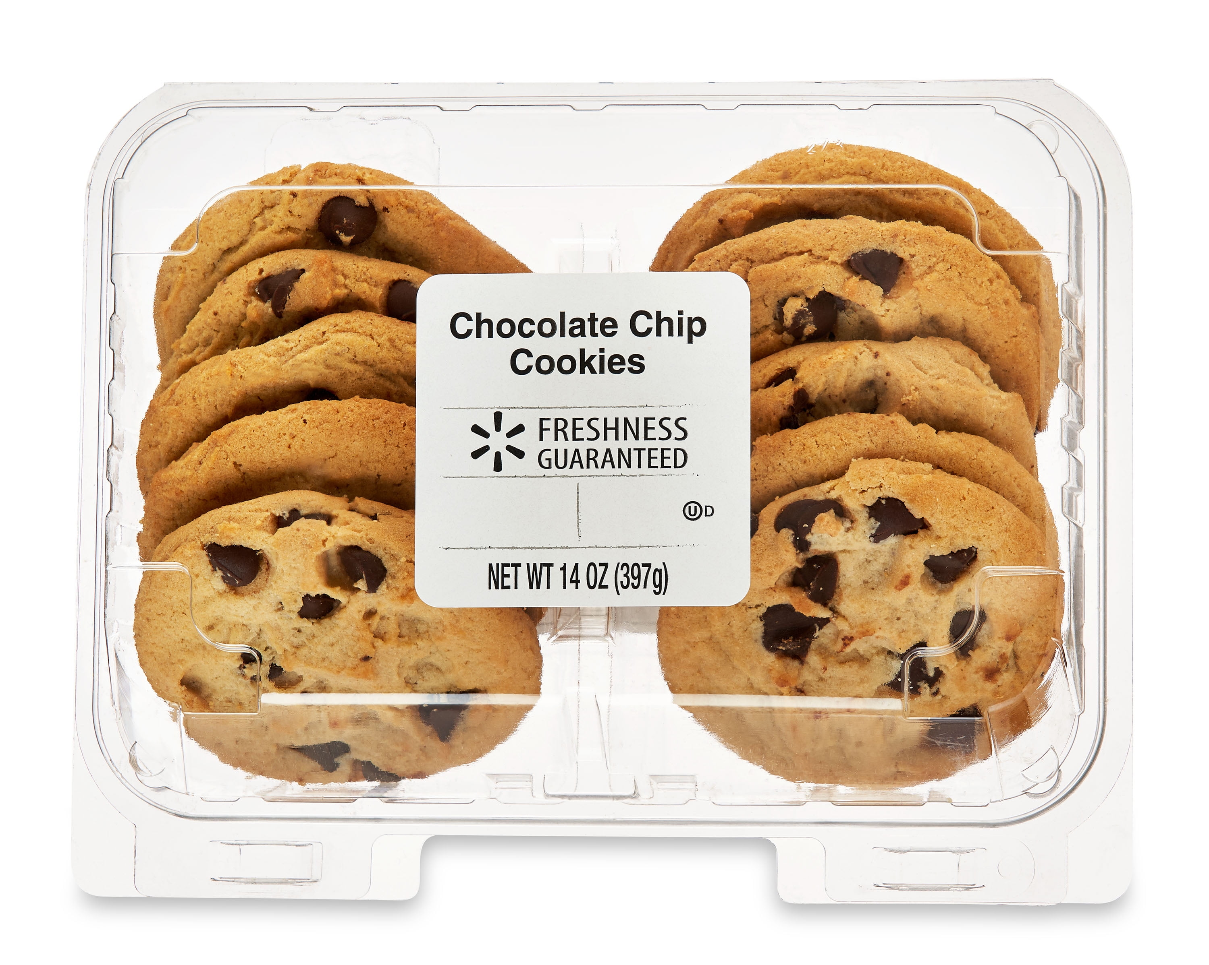
Entrepreneurs need to consider if additional or unique packaging features will increase sales enough to make the additional expense worth the profit.
ENTREPRENEURSHIP – The Total Package

Slide 29

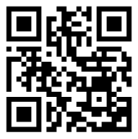
Bar and
QR codes can be scanned to access additional information that isn’t printed
on the package.
A Bar Code is made of vertical lines read by a digital scanner to access information such as price, size, expiration date, etc. The different thicknesses represent binary code combinations. Coordinating numbers are listed below the lines that humans can read and interpret.
A QR (Quick Response) Code is a code made of a grid of black and white square combinations. The grid pattern also represents binary code combinations. Because QR Codes are vertical and horizontal, they can hold more encoded information than a Bar Code. QR Codes can be scanned by smartphones or other digital devices to connect to fact sheets, websites, apps, and more.
Did you know you can easily create your own unique QR Code with links using a variety of online programs and apps?
ENTREPRENEURSHIP – The Total Package

Slide 30
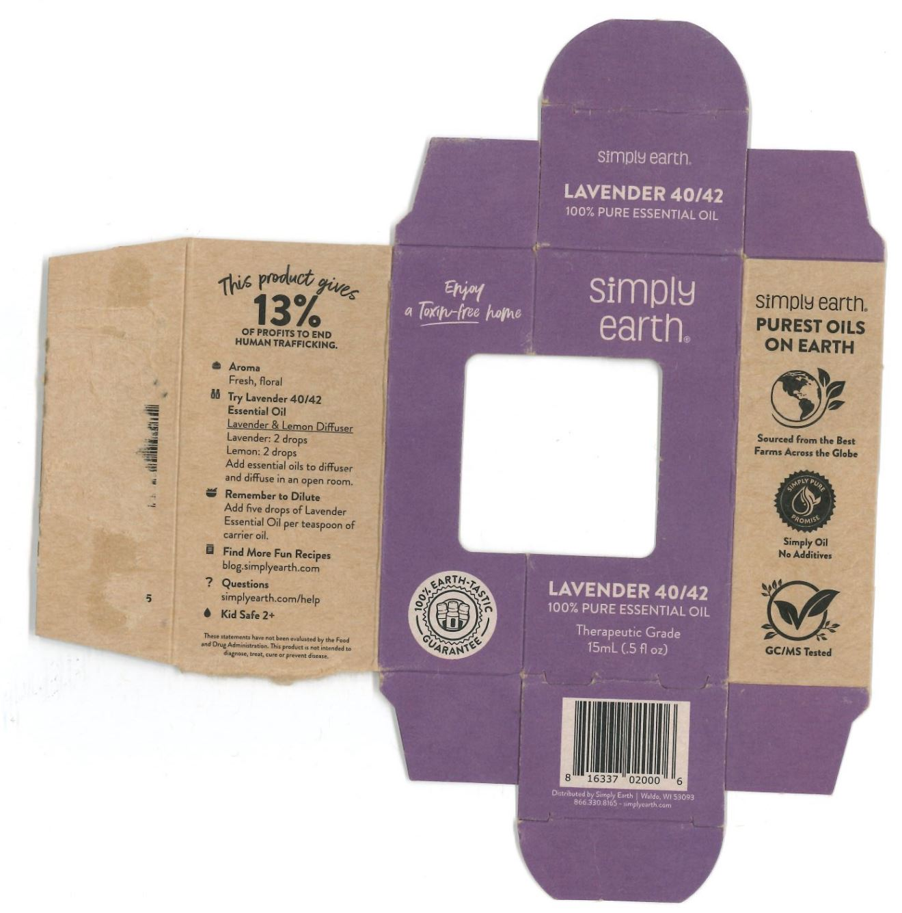
Product Information
Packages and labels often include
Product Type and Name
Product Size
Nutrition Information
Ingredients
Directions for Use
Company Information
ENTREPRENEURSHIP – The Total Package

Slide 31

Box Die Cut Template Comparison
3 tabs fit into open slots to secure
Flap is secured with glue
3 open slots for tabs
ENTREPRENEURSHIP – The Total Package

Slide 32
Box Die Cut Template Design & Assembly
Design – Use the template on page 4 of Design Brief
Label the 6 Visible Faces
  Front “F” Back “BK” Left Side “L”
  Right Side “R” Top “T” Bottom “BM”
Label the Window
Draw an “X” on the NON-Visible Flaps
3 tabs fit into open slots to secure
Assembly
Face shown is the outside of package
Fold back perforated lines - - - - - - - -
Insert tabs into slots
3 open slots for tabs
ENTREPRENEURSHIP – The Total Package

Slide 33
Box Die Cut Template Design & Assembly
X
T
X
X
3 tabs fit into open slots to secure
Design – Use the template on page 4 of Design Brief
Label the 6 Visible Faces
  Front “F” Back “BK” Left Side “L”
  Right Side “R” Top “T” Bottom “BM”
Label the Window
Draw an “X” on the NON-Visible Flaps
BK
L
F
R
X
X
X
window
Assembly
Face shown is the outside of package
Fold back perforated lines - - - - - - - -
Insert tabs into slots
X
X
BM
X
3 open slots for tabs
X
ENTREPRENEURSHIP – The Total Package

Slide 34
X
Your Box Package Design
Should Include
T
X
X
BK
L
F
R
A graphic or text information on each of the 6 visible box faces.
Company Name and/or Logo
Product Name or Type of Soap
Volume of product
Additional text or images of your choice
(Optional) QR Code that links to additional information about product or company
X
X
X
window
X
X
BM
X
X
ENTREPRENEURSHIP – The Total Package

Slide 35
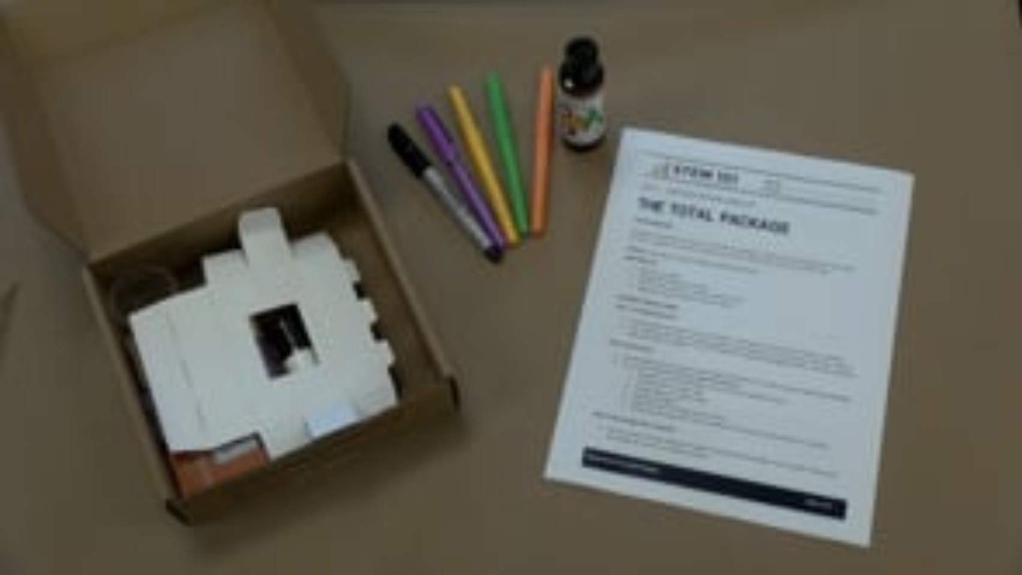
ENTREPRENEURSHIP – The Total Package

Slide 36


Depending on the size and goals of a business, one or more people may be in charge of handling the different budget or money tasks for a company. There are many different specialized financial careers in business. Some examples are:
Bookkeeper - enters day to day business transactions (money coming in and going out)
Accountant – oversees bookkeeping and makes sure regulations are met and required reports are filed on time
Product Manager – does the research necessary to set product prices
Chief Financial Officer – Analyzes budget and plans for the long term finances of a company
ENTREPRENEURSHIP – Stay on Budget

Slide 37
All companies must consider Assets, Liabilities, & Expenses
when creating a budget and sales plan for their products.
assets - anything of value that the business owns Examples include: owned property or a building, money saved or invested, equipment or vehicles that are fully paid for, product inventory | liabilities – debt or obligations a business owes other parties NOT including supplies or costs of production Examples include: loan payments
expenses – costs of production & normal business operations Examples include: rent/lease payment, utilities (water, electricity, heat) production equipment and supplies, marketing & printing service fees, office supplies, furnishing, employee wages & benefits, income taxes
ENTREPRENEURSHIP – Stay on Budget

Slide 38
Types of Expenses
Supplies |  | Utilities & Bills | Services | Wages
Non - Consumable | Consumable
purchase once and continue using | used up with one or more uses | Paid to companies for costs of operation & production | Work done by other companies for your product | Money paid to employees
Examples
equipment, machines, tools, furniture | parts, materials, packaging, ink | electricity, water, internet, lease payment | printing, shipping, advertising | Hourly, salary, overtime, benefits
ENTREPRENEURSHIP – Stay on Budget

Slide 39

What to charge?
In order to remain in business, a company must make a profit.
SALE PRICE – ALL EXPENSES = PROFIT
The current average profit margin for U.S. businesses ranges from 7% - 10%. This means some businesses have higher profits and some have lower.
Examples:
Sale Price per item | - Total Expenses per item | = Profit per item | Profit ÷ Price | = Profit Margin %
$3.99 | - $3.60 | $0.39 | $0.40 ÷ $4.00 | 0.097 or 9.7%
$4.50 | - $3.60 | $0.90 | $0.90 ÷ $4.50 | 0.2 or 20 %
$3.75 | - $3.60 | $0.15 | $0.15 ÷ $3.75 | 0.04 or 4%
ENTREPRENEURSHIP – Stay on Budget

Slide 40
What to charge?
There are many things to consider when setting a sale price for a product.
Philanthropy - Do you plan to dedicate a portion of sales to a community organization or cause? Do you plan to sponsor events or donate products or money to groups that ask? If so, you may need to aim for a higher profit margin.
Promotions - Do you plan to offer discounts or promotions?
  Examples: 10% discount for teachers or Buy 3 products, get 1 Free If so, the discount or promotion needs to increase sales by an amount that will make up for the profit loss.
ENTREPRENEURSHIP – Stay on Budget

Slide 41
Most Entrepreneurs will need to prepare and present a Sales Pitch at some point.
You may need to pitch, or convincingly present, your ideas to other team members to get your product or business ideas approved.
You may need to pitch your business to investors, people who contribute money to help your business grow, and typically receive a percentage of the end profits.
Shark Tank Video Clip Link
ENTREPRENEURSHIP – Pitch It

Slide 42
What is Advertising?
Forms of Advertising:
Paper Ads – Newspaper, Magazines, Posters & Flyers
Billboards & Digital Signs
Commercials & Infomercials
Online Pop Up Ads
Social Media Content
Brand Ambassadors
Sponsorships
Advertising – various forms of communication used to persuade a potential customer to purchase a product or service
ENTREPRENEURSHIP – Pitch It

